Slide 1
Department of Public Safety Wrecker Services Administration Unit
On-Line Filing
Original Application
Renewal Application
August 27, 2025

Slide 2
Welcome!
Introductions
Housekeeping
Email notifications
Application fees
Required documents
Naming Conventions for Required Documents
Renewal Application process
Original Application Process

Slide 3
Terms and Acronyms
Company = Wrecker Service Company
DPS = Department of Public Safety
PII = Personal Identifying Information
Renewal Season = October 1 through December 1 of each year
SOS = Secretary of State
WSU = Wrecker Service Administrative Unit
License = Wrecker Service License

Slide 4
Wrecker Service Administrative Unit (WSU) Staff
Trooper Heath Ragland
Inspections, OHP Rotation, Complaints
Kevin Behrens
DPS Attorney
405-425-2113
Kevin.Behrens@dps.ok.gov
Kimberly Dammen
WSU Administrator
405-425-2241
Kimberly.dammen@dps.ok.gov
Candice Ramsey
WSU Supervisor
405-425-2295
Candice.Ramsey@dps.ok.gov
WSU Staff
Michael Hoffpauir
Territory I
405-425-2311
Mary Ballard
Territory II
405-425-2319
Sarah Stafford
Territory III
405-4252356
Amber Plog
Territory IV
405-425-2325
Wrecker Services 405-425-2312
Email
wrecker@dps.ok.gov

Slide 5
Housekeeping
3-hours of continuing education
On-line attendees must attend up to the Q&A portion to be issued the full CE hours.
Academy is in session
Make way for the Cadets
Bathroom locations
Please silence cell phones
Slide deck will be available on the website

Slide 6
Email Communication
Quickest, efficient way to get information to the industry
Does WSU have your current email address?
Add WSU email address to your email address book to help reduce the risk of emails going to your spam folder
wrecker@dps.ok.gov
Notes:
When 2026 Administrative rules go into effect (sometime in July 2026) the WSU official communication will be via electronic

Slide 7
Email Notifications – Industry Wide
September 1 – Notice of upcoming renewal season
October 1 – you will receive an email with a link to your renewal application
November 15 – Reminder renewal season ends December 1
December 15 – Notice a Wrecker Service License expires at 1159 on December 31.
Law enforcement agencies will be notified on December 31 (or the last working day of the year) of Wrecker Companies with expired licenses
January 1 – Anyone who has not submitted a renewal application or has not received a Wrecker Service License, Cab Card(s), or Driver Card(s) is not licensed to provide wrecker and towing services.
Those found to be operating after December 31 without a valid Wrecker Service License will face a 45-day prohibition period to obtain a License
Notes:
If you do not receive the September 1 email next week, you need to contact the WSU immediately.
Possible reasons: the WSU does not have an email address for your company
there is an error in our system and need to identify what happened
Let us know asap if you did not receive the email from DPS for this training

Slide 8
Application Fees
Original Application fee - $500.00
Renewal Application fee - $250.00
Electronic payment is now accepted
Debit/Credit card payments are accepted
There is a 4% fee to use this service
Cannot accept ACH payments or wire transfers
Check, money order, cashiers check
WSU will not start processing an application until the fee is received

Slide 9
Required Documents
Insurance policy (DEC page)
List of all current employees
CHRC for ALL employees (This is an annual requirement)
Training Certificates for all DRIVERS (This is an annual requirement)
Drug Screening for all DRIVERS (This is an annual requirement)
Proof of Driver’s License for all DRIVERS (This is an annual requirement)
MVR, or
Copy of the driver’s license
SOS Certificate (This is an annual requirement)
Lease agreements, if applicable
A list of all Wrecker Vehicles
A list of Law Enforcement Rotations in which the Company participates

Slide 10
Naming Convention for Documents
File name format for uploaded documents
Lease documents
LEASE – Office – Company Name
LEASE – Storage – Company Name
Secretary of State certificates
SOS – Company Name
Insurance
Insurance – Company Name
Criminal History Records Check
CHRC – Last Name First Name
Training Certificates
Training – Last Name First Name
Proof Of Driver’s License
DLN – Last Name First Name
Drug Screening
Drug Screen – Last Name First Name
PDF and TIFF file format only
Notes:
Can only accept pdf or tiff file format.

Slide 11
Renewal Season
October 1 – December 1
Applications received during this period are timely
Application cannot be saved and returned to later
Important to make sure you have everything you need to complete the application in one sitting
Will receive priority processing
December 2 – December 31
Applications received during this period are untimely
Companies whose renewal link has expired will have to submit a paper application
Processing will not be a fast as on-line applications
Will be processed as quickly as possible, but cannot guarantee completion before December 31
January 1 or later
Renewal applications received during this period are out-of-time
The Wrecker company will be required to submit:
An original application packet
Original application fee
Successfully pass inspections
Notes:
Dec 2 – Dec 31 applications – Out of time will not be able to access the renewal link
Will must submit a paper application
Only 20 working days in December; cannot guarantee a late application will be processed before the current WSL expires
IF the renewal is received on or after Jan 1, the application, required documents, and fee will be returned.

Slide 12
Renewal Application Packet
Completed and signed Wrecker Service License Application
Application fee of $250.00
Lease agreement for any leased property
Secretary of State Certificate
A list of wrecker vehicles
Storage Facility information
A list of all Law Enforcement rotations
Insurance
A list of all employees
Criminal history records check (CHRC) (all employees) (This is an annual requirement)
Training Certificates (drivers only) (This is an annual requirement)
Proof of driver’s license (drivers only) (This is an annual requirement)
Negative drug screening (drivers only) (This is an annual requirement)

Slide 13
September Reminder
On September 1 of each year, a reminder email from wrecker@dps.ok.gov will be sent to each Company that currently holds a Wrecker Service License
Start gathering and prepare required documents
Insurance policy (DEC page)
List of all current employees
CHRC for ALL employees (This is an annual requirement)
Training Certificates for all DRIVERS (This is an annual requirement)
Drug Screening for all DRIVERS (This is an annual requirement)
Proof of Driver’s License for all DRIVERS (This is an annual requirement)
MVR, or
Copy of the driver’s license
SOS Certificate (This is an annual requirement)
Lease agreements, if applicable
A list of all Wrecker Vehicles
A list of Law Enforcement Rotations in which the Company participates
Notes:
Need to see the reminder to detail what is included in the email
Example will be provided on the next slide

Slide 14
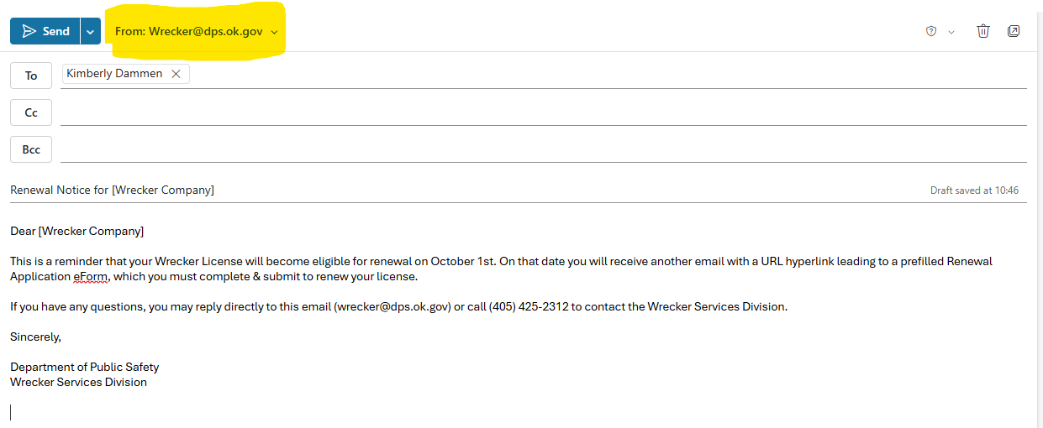
September 1st Email
Notes:
Email sent from Wrecker@dps.ok.gov
If we do not have your email address, you will not receive the notifications.
Get us your email address!

Slide 15
Renewal Application
On October 1, the Company will receive an email from wrecker@dps.ok.gov
This email will have a link to the renewal application
The application is prefilled with
Company’s Information
Ownership information
The application will have selected information available to import into the application
Employee WILL NOT be prefilled or available for selection
This information contains PII
The State is prohibited from distributing or making available PII

Slide 16
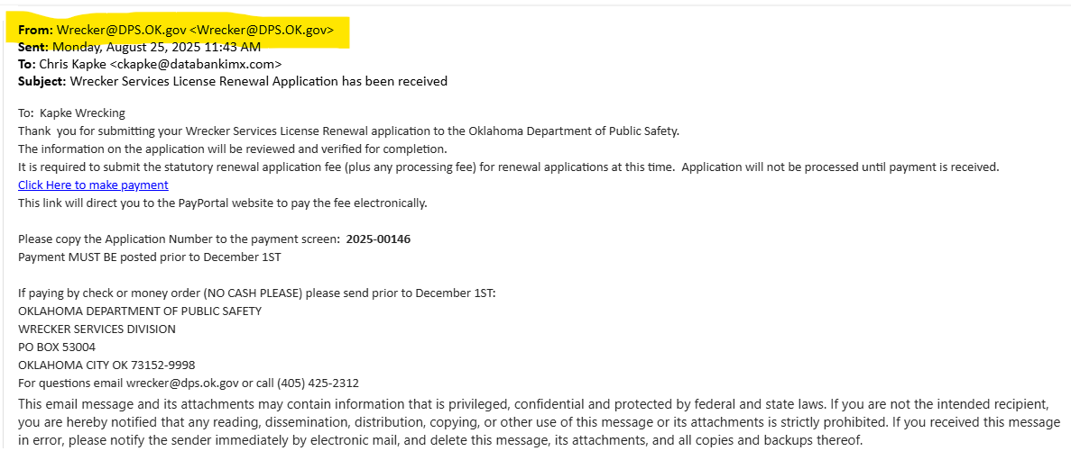
October 1st Email
Notes:
Payment prior to Dec 1 = Payment must be received by Dec 1 (for electronic filings)

Slide 17
Renewal Application (cont.)
Carefully review each section of the application to verify the information is current and accurate.
Prefilled sections
Company information
Company ownership
Able to Import Information on
Storage Facility
Law Enforcement Rotation
Vehicle Information
Company must provide
Employee Information
Notes:
Prefilled sections:
Company Name Ownership
Physical Address, city, state, zip Type of owner – LLC, Corp., Sole, etc
Point of Contact Federal ID #
Wrecker Class Owner name, address, dln, dob, title, alias
Phone numbers – Day time, after hours, POC
County
Bldg ownership
Mailing Address

Slide 18
Renewal Application (cont.)
To ADD information to a section
“Add Existing” button just below the section header
Click on the button to see the list the Department has on file
Review each row
If the information is still applicable, click on the ADD button at the end of the row
Repeat this step for each line item in the list
Click on the REMOVE button on the right side of the line item for
Storage Facilities
Law Enforcement Rotation Information
Wrecker Vehicle Info
Owners/Corporate Officers/Partners/Members
Employee and Driver Information

Slide 19
Review Prefilled data
Wrecker Company information will be prefilled
Company Ownership is prefilled
Carefully review each prefilled field to ensure accuracy
Updates needed?
Click on the field and make the necessary changes

Slide 20
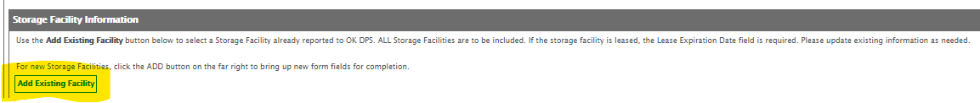
Import Existing Data
Select “Add Existing…” to see the information currently on file with the WSU
Select each row that is still active to add to the application
If you need to add data that is not on the list, select the ADD button found on the right side of the screen
Notes:
Add Existing to
- Storage Facility
- Law Enforcement Rotation
- Wrecker Vehicle

Slide 21
Renewal Application (cont.)
Upload all required documents:
Proof of required insurance
DEC Page is acceptable
Policy must be active
Secretary of State Certificate, if applicable
For everyone listed on the application
National Criminal History Record Check for each person listed on the application (This is an annual requirement)
For every wrecker vehicle operator
Proof of Training requirements for each wrecker vehicle operator (This is an annual requirement)
Drug Screening for each wrecker vehicle operator (This is an annual requirement)
Proof of driver’s license (This is an annual requirement)
Lease, if applicable

Slide 22
Naming Convention for Documents
File name format for uploaded documents
Lease documents
LEASE – Office – Company Name
LEASE – Storage – Company Name
Secretary of State certificates
SOS – Company Name
Insurance
Insurance – Company Name
Criminal History Records Check
CHRC – Last Name First Name
Training Certificates
Training – Last Name First Name
Proof Of Driver’s License
DLN – Last Name First Name
Drug Screening
Drug Screen – Last Name First Name

Slide 23
Renewal Application Signature
The renewal application must be signed by the owner of the company or authorized corporate officer/stakeholder
Signed under penalty of perjury
Authorized signatory name
Authorized signatory’s title
Authorized signatory’s location (city)
Date Signed
Digital Signature
Notes:
Penalty of Perjury statement:
"I have read all Department rules and Oklahoma Statutes regarding Wrecker and Towing services and shall, in good faith, endeavor to abide by all applicable laws and rules governing the Wrecker and Towing Service for which this application is made.
The Wrecker Service License Applications consists of three parts: Part 1 - Company information, Part 2 - Vehicle Information, and Part 3 - Employee Information. The following certification pertains to all three parts:
I verify under penalty of perjury under the laws of Oklahoma that the foregoing is true and correct.“

Slide 24
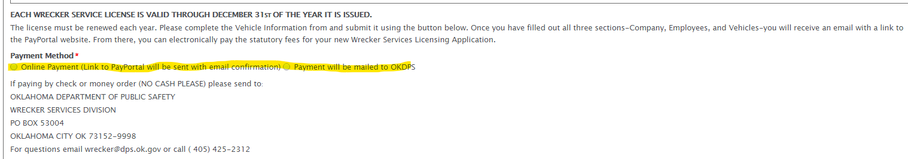
Method of Payment
Select how the wrecker company will submit the fee
Submission will not be permitted without all required documents being uploaded

Slide 25
Submitting Renewal Application
Click on the Submit button at the bottom of the screen
The application cannot be submitted until all documents and required information is provided
If Online Payment was selected, you will receive an email from wrecker@dps.ok.gov with a link to make the electronic payment
There is a 4% fee that will be added to the Online Payment option. This fee is assessed by the credit card company. The state does not retain any portion of this fee.
Original License: $500 (license fee) + $20 (4% payment fee) = $520
Renewal License: $250 (license fee) + $10 (4% payment fee) = $260

Slide 26
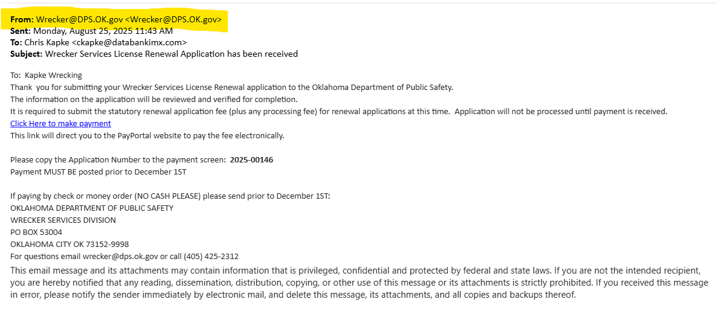
Pay Portal Email
Notes:
Again, email says payment must be sent prior to December 1st. Actually, the payment needs to receive it by December 1st

Slide 27
Processing the Renewal Application
The Renewal Application will not be processed until the application fee has been received
Wrecker Service Administrative Unit (WSU) reviews the application packet
If the submitted documents do not meet regulations, WSU staff will contact the Company via email (from wrecker@dps.ok.gov)
Processing the Renewal Application will stop until the Company resolves the deficiency(ies)

Slide 28
Required Inspections
The WSU will send an Inspection Request to OHP for
Storage Facility not previously reported and inspected
Wrecker Vehicle not previously reported and inspected
Change of address for the principal place of business
The Renewal Application will not be approved until the Company passes all required inspections and meets all statutory and administrative regulations

Slide 29
Wrecker Service License
Upon approval of the renewal application packet and required inspections have been passed
WSU will issue
Wrecker Service License
Cab Card(s)
Driver Card(s)
Issued via email from wrecker@dps.ok.gov
Only upon the issuance of the above, is the Company approved and licensed to provide wrecker and towing services for the next calendar year

Slide 30
When can an Original Application be Submitted
An original application can be submitted any time throughout the year
If the application is approved
Before September 30
License is valid through December 31 of current year
The Wrecker Service Company is expected to submit a renewal application
Between October 1 and December 31
License valid from date of approval through December 31 of the following year
Wrecker Service Company will not submit a renewal application until the follow years renewal season

Slide 31
Original Application Packet
Completed and signed Wrecker Service License Application
Application fee of $500.00
Lease agreement for any leased property
Secretary of State Certificate
A list of wrecker vehicles
Storage Facility information
Insurance
A list of all employees
Criminal history records check (CHRC) (all employees)
Training Certificates (drivers only)
Proof of driver’s license (drivers only)
Negative drug screening (drivers only)

Slide 32
Naming Convention for Documents
File name format for uploaded documents
Lease documents
LEASE – Office – Company Name
LEASE – Storage – Company Name
Secretary of State certificates
SOS – Company Name
Insurance
Insurance – Company Name
Criminal History Records Check
CHRC – Last Name First Name
Training Certificates
Training – Last Name First Name
Proof Of Driver’s License
DLN – Last Name First Name
Drug Screening
Drug Screen – Last Name First Name

Slide 33
Original Application for Wrecker Service License
Link to request an application will be on the Wrecker Services page of the DPS website
Sign up for the application
Select Yes, Company email is available
If you do not provide an email address, you will not be able to submit an application
Company name
Company email address

Slide 34
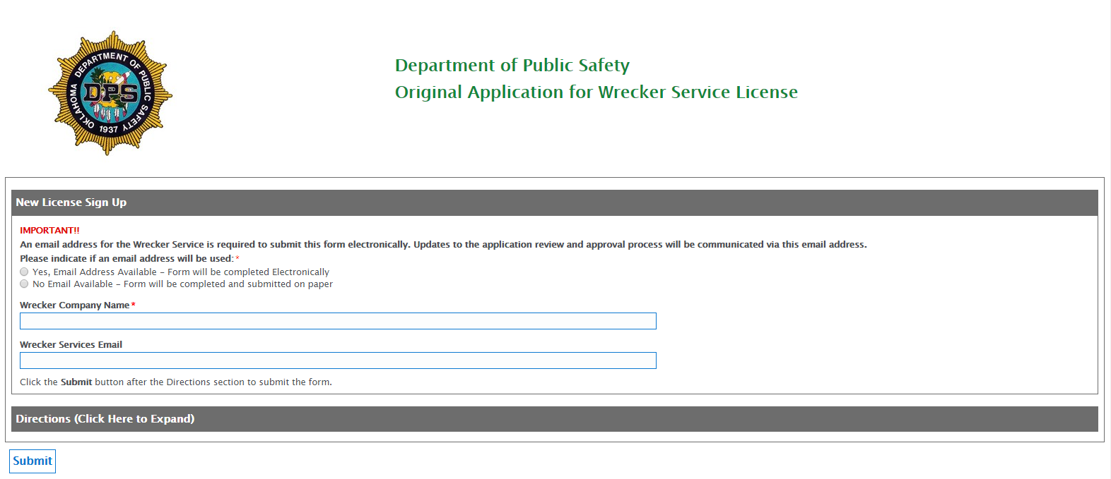
Original Application (cont.)

Slide 35
Original Application for Wrecker Service License (cont.)
Email from wrecker@dps.ok.gov will be sent to the email address provided by the Company that includes 3 links
You can complete each part of the application in any order
The required signature is on the Vehicle Information Form
Information is not saved until the SUBMIT button is selected
Instructions for each section of the application is attached to the application
Instructions for both the Original and Renewal Wrecker Service License application will be available on the DPS website
Upload documents
Notes:
You can complete the application in any order; however the signature is on the Vehicle Information link. This should be the last link to be completed

Slide 36
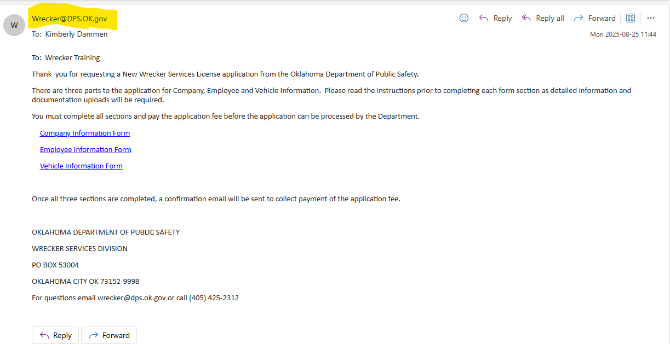
Original Application (cont.)

Slide 37
Required Documents for Original Application
Completed and signed Wrecker Service License Application
Lease agreement for any leased property
Secretary of State Certificate
A list of wrecker vehicles
Storage Facility information
Insurance
A list of all employees
Criminal history records check (CHRC) (all employees)
Training Certificates (drivers only)
Proof of driver’s license (drivers only)
Negative drug screening (drivers only)

Slide 38
Naming Convention for Documents
File name format for uploaded documents
Lease documents
LEASE – Office – Company Name
LEASE – Storage – Company Name
Secretary of State certificates
SOS – Company Name
Insurance
Insurance – Company Name
Criminal History Records Check
CHRC – Last Name First Name
Training Certificates
Training – Last Name First Name
Proof Of Driver’s License
DLN – Last Name First Name
Drug Screening
Drug Screen – Last Name First Name

Slide 39
Original Application for Wrecker Service License (cont.)
Sign application
Authorized signatory name
Date signed
Authorized signatory’s Title
Authorized signatory’s Location (city)
Select Method of Payment
Online payment
Email will payment link will be sent after the submission of the application
Check, Money Order, Cashier’s Check. No cash, please.
Click on Submit

Slide 40
Company Information
Information gathered under this link:
Wrecker Company Information
Storage Facility Information
Insurance
Law Enforcement Rotations (if none, select None in the first drop down list)
Company Ownership – Secretary of State Certificate (must upload the Secretary of State certification for any business model except sole proprietor/individual owner
Owners /Corporate Officers/ Partners/Members – each owner, corporate officer, stakeholder must be submitted. However, the National Criminal History Records Check must only be submitted for those directly involved in the operation of the company.

Slide 41
Company Information (cont.)
Required documents needed to complete this link:
Lease agreements, if applicable
Office lease(s)
Storage facility lease(s)
Certificates of Insurance – If you have multiple policies to meet the requirements of OAR 595:25-5-23, you must attach the declaration page for each policy
Secretary of State Certificates – mandatory for any business other than a sole proprietor
National Criminal History Records Check for all owners, officers, and stakeholders directly involved in the operation of the wrecker company

Slide 42
Employee Information
Information gathered under this link:
Employee Name
Driver’s License Number
Employee Type
Office
Driver
Garage
Owner
Driver license class
Employee Aliases
Date of Birth
US Citizen

Slide 43
Employee Information (cont.)
Required documents need to complete this link:
Nationwide Criminal History Records Check
Each person listed on the Application
Training Certificates for each wrecker vehicle operator
For Wrecker Vehicle Operators (Drivers) only
Proof of Driver’s License (copy of license is acceptable)
For Wrecker Vehicle Operators (Drivers) only
Drug Screening results (to be uploaded with the Proof of Driver’s License)
For Wrecker Vehicle Operators (Drivers) only

Slide 44
Wrecker Vehicle Information
Information gathered in this link:
Wrecker vehicle(s) used to provide wrecker and towing services under the DPS issued Wrecker Service License
Vehicle ID Number
Vehicle Make
Vehicle Year
License Plate
Vehicle GVWR
Vehicle Type
Vehicle Status
Documents required to complete this link:
None

Slide 45
Original Application Signature
The renewal application must be signed by the owner of the company or authorized corporate officer/stakeholder
Signed under penalty of perjury
Authorized signatory name
Authorized signatory’s title
Authorized signatory location (city)
Date Signed
Digital Signature
Notes:
Penalty of Perjury statement:
"I have read all Department rules and Oklahoma Statutes regarding Wrecker and Towing services and shall, in good faith, endeavor to abide by all applicable laws and rules governing the Wrecker and Towing Service for which this application is made.
The Wrecker Service License Applications consists of three parts: Part 1 - Company information, Part 2 - Vehicle Information, and Part 3 - Employee Information. The following certification pertains to all three parts:
I verify under penalty of perjury under the laws of Oklahoma that the foregoing is true and correct.“
This statement is on the Vehicle Information page.

Slide 46
Method of Payment
Select how the wrecker company will submit the fee
Submission will not be permitted without all required documents being uploaded

Slide 47
Submitting Original Application
Click on the Submit button at the bottom of the screen
The application cannot be submitted until all documents and required information is provided
If Online Payment was selected, you will receive an email from wrecker@dps.ok.gov with a link to make the electronic payment
There is a 4% fee that will be added to the Online Payment option. This fee is assessed by the credit card company. The state does not retain any portion of this fee
Original License: $500 (license fee) + $20 (4% payment fee) = $520
Renewal License: $250 (license fee) + $10 (4% payment fee) = $260

Slide 48
PayPortal Email

Slide 49
Processing the Original Application
The Wrecker Service Administrative Unit (WSU) will start processing the application only after the application fee has been received
After the original application packet has been processed and approved, the WSU will send the company information to the OHP
The OHP will set up date and time for inspections

Slide 50
Inspections
The Trooper will contact the company to set the date and time for inspections
The Trooper will inspect
Principal place of business
Storage facility(ies)
Wrecker Vehicle(s)
The Trooper will submit the inspection results electronically
The Company will receive an email with the inspection results
After the Company has passed the inspections for the principal place of business, storage facility(ies) (if applicable), and wrecker vehicle(s)
The wrecker company registers and tags each wrecker vehicle

Slide 51
Wrecker Service License
The Company will submit proof of registration and tag of each wrecker vehicle to wrecker@dps.ok.gov
Upon receipt and verification, WSU will email the Company the
Wrecker Service License
Cab Card(s)
Driver Card(s)
Wrecker Company is now licensed and can start providing wrecker and towing services

Slide 52
Questions and Answers

Slide 53
Wrecker Service Administrative Unit (WSU) Staff
Trooper Heath Ragland
Inspections, OHP Rotation, Complaints
Kevin Behrens
DPS Attorney
405-425-2113
Kevin.Behrens@dps.ok.gov
Kimberly Dammen
WSU Administrator
405-425-2241
Kimberly.dammen@dps.ok.gov
Candice Ramsey
WSU Supervisor
405-425-2295
Candice.Ramsey@dps.ok.gov
WSU Staff
Michael Hoffpauir
Territory I
405-425-2311
Mary Ballard
Territory II
405-425-2319
Sarah Stafford
Territory III
405-4252356
Amber Plog
Territory IV
405-425-2325
Wrecker Services 405-425-2312
Email
wrecker@dps.ok.gov

