Slide 1
Creating & Processing Adopted Client Records
Presented by: Vickie Foster & Emily Mueggenborg

Slide 2
Purpose
To provide an overview of procedures for creating and processing adopted records to maintain compliance with Oklahoma Adoption Laws.
Notes:
Emily

Slide 3
Before You Begin
Make sure you have the required documentation.
Adoption Decree/Verifying Documentation
Birth Certificate
Adoptions cannot be processed without the required documentation.
Notes:
Emily

Slide 4
Review Guidance Documents
CHDs:
Adoption Scenarios and Creating and Processing Adopted Client Records
Accessible via OSDH Records and Community Health Systems (RCHS) SharePoint page – Adoptions
Notes:
Emily

Slide 5
Review Guidance Documents
Independent Clinics:
Adoption Tip Sheet (Adoption Scenarios & Check Sheet)
Accessible via WIC Training Link, Policy and Procedure Manual, Tip Sheets, Adoption Tip Sheet
Notes:
Emily

Slide 6
Adoption Scenarios
Blended Adoption
Adoption is in the format of an “open” adoption where the biological and adoptive families and the child/children are aware of and agreeable to the adoption.
Use discreet questioning to confirm knowledge will not cause undo harm.
Make changes in record and allow PHOCIS to create an alias.
Notes:
Vickie – Start here.
Mention the importance of reviewing adoption scenarios to determine how to proceed since not all scenarios require all the complete opening and closing of PHOCIS records and hardcopy charts. Go over each of the adoption scenarios and the caveats that make them different from the closed adoption process – i.e. an adoption that requires all steps of opening/closing a new PHOCIS record and a new hardcopy chart.

Slide 7
Adoption Scenarios
Name stays the same
PHOCIS record will not change, but original hardcopy chart will need to be closed and a new chart opened.
Update guardian information in PHOCIS with adoptive parent information in Mother/Father fields.
Notes:
Vickie

Slide 8
Adoption Scenarios
Alias already created in PHOCIS
No need close the original PHOCIS record.
Update PHOCIS with correct information.
Close the original hardcopy to ensure none of the birth parent information is accessible and open a new chart.
Notes:
Vickie

Slide 9
Adoption Scenarios
Last name hyphenated
Adding a hyphenated last name to one that is already in PHOCIS (Smith to Smith-Jones).
Will need to close the original hardcopy to ensure none of the birth parent information is accessible.
Notes:
Vickie

Slide 10
Adoption Scenarios
Changing to birth father’s name
Neither the PHOCIS record nor the hardcopy need to be closed.
Notes:
Vickie

Slide 11
Adoption Scenarios
Adoption by step-parent if birth parent is deceased
No need to change the PHOCIS or hardcopy records.
Notes:
Vickie

Slide 12
Adoption Scenarios
Adoption by foster parent
Client is being adopted by foster parents and the client’s PHOCIS and hardcopy record are already in the foster parent’s name, with no mention of birth parents.
Uncheck “foster” in demographics and save.
If there is mention of birth parents or “foster” information, close the hardcopy chart and open a new chart.
Notes:
Vickie

Slide 13
Adoption Scenarios
Closed Adoption
Follow complete steps of processing client’s original records and creating a new record under adopted name.
Notes:
Vickie

Slide 14
Check The eWIC Household Account
Determine if client is currently or has ever been on WIC.
Check to see if the client is part of an eWIC Household.
If the client has never been on WIC or is not a member of an eWIC Household, you can bypass all the steps about WIC.
Notes:
Emily
When processing an adoption for a client in PHOCIS, you should check to see if the client is currently or has ever been on WIC. To do this, check to see if they are part of an eWIC Household. If they have never been on WIC or are not a member a an eWIC household, you can bypass all the steps about WIC.

Slide 15
Check The eWIC Household Account
Notes:
Emily
When checking the eWIC Household Account screen, check to see if there are other members. In this example, as you can see, there is only one member of this household.

Slide 16
Check The eWIC Household Account
If the client is the only eWIC household member and is active on WIC:
Terminate for reason of “Transfer to Another Area.”
Print the VOC. Keep for later.
Deactivate the eWIC household.
Destroy the eWIC card, if available.
Document card destruction on the unusable eWIC Card Log according to policy.
Notes:
Emily
If the client is the only eWIC household member and is active on WIC:
Terminate for reason of “Transfer to Another Area.”
Print the VOC. Keep for later.
Deactivate the eWIC household. PHOCIS won’t let you remove the only person in a household unless you deactivate the account first. PHOCIS will give you a wardning that you are creating an orphaned account. This okay and what you need to do.
Destroy the eWIC card, if available.
Document card destruction on the unusable eWIC Card Log according to policy.

Slide 17
Check The eWIC Household Account
If the client is the only eWIC household member and is not active on eWIC:
Deactivate eWIC household.
Destroy the eWIC card, if available.
Document card destruction on the unusable eWIC Card Log according to policy.
Notes:
Emily

Slide 18
Check The eWIC Household Account
Notes:
Emily
In this example of the eWIC Household Account, you will see there are other active members.

Slide 19
Check The eWIC Household Account
If the client is in a household with other members, is active on WIC, and they don’t have current or future benefits:
Remove the client from the eWIC household.
Terminate the client for reason of “Transfer to Another Area.”
Print VOC. Keep for later.
Notes:
Emily

Slide 20
Check The eWIC Household Account
If the client is in a household with other members, active on WIC, and they have current or future benefits:
Contact PHOCIS/WIC Helpdesk or your WPC to split the client out of the eWIC household.
After the split is complete:
Terminate the client for reason of “Transfer to Another Area.”
Print the VOC. Keep for later.
Deactivate the eWIC household.
Notes:
Emily

Slide 21
Check The eWIC Household Account
If the client is in a household with other members, but they are not active on WIC:
Remove the client from the eWIC household.
Printing a VOC is not needed since the client is not active on WIC.
Notes:
Emily

Slide 22
Check The eWIC Household Account
If client is due to be recertified, treat as a new WIC client.
Set up a certification appointment using the client’s new name and information.
Notes:
Emily

Slide 23
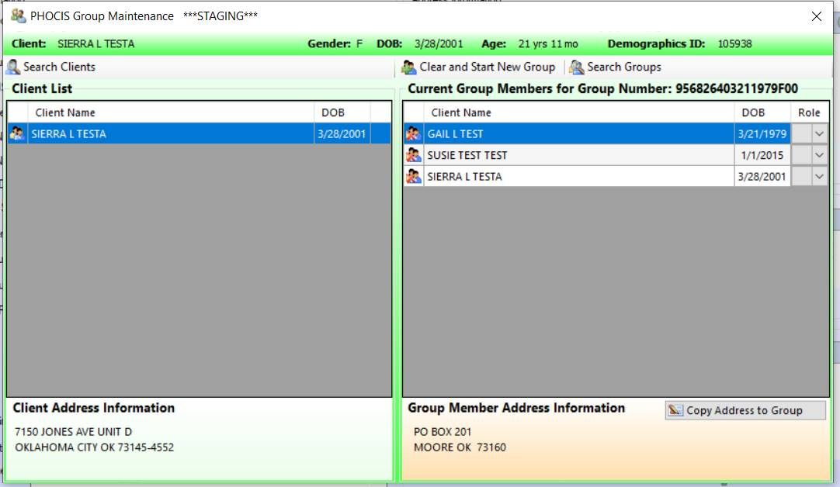
Ungroup In PHOCIS
Notes:
Vickie
Any Client being adopted must be ungrouped from their family group in PHOCIS.
Mention the importance of ungrouping – to begin separating from the old record/identity.

Slide 24
Remove SSN From Demographics
Notes:
Vickie
Next, check PHOCIS/Demographics screen for client SSN. If the SSN is present, it must be removed.

Slide 25
Closing The PHOCIS Record
Notes:
Vickie
Closing the PHOCIS record.
Reiterate the importance of reviewing and identifying the applicable adoption scenario, since all scenarios do not require the closing of the PHOCIS record.
Appointment module, select client tools, close client file.

Slide 26
Closing The PHOCIS Record
Notes:
Vickie
When prompted, select “Yes, “ to “Are you sure you want to close this client’s file.”

Slide 27
Closing the PHOCIS Record
ADOPTED
Notes:
Vickie
Add comment, “adopted”.

Slide 28
Notes:
Vickie
Select “No” to “Do you want to print a closed file separator now”?

Slide 29
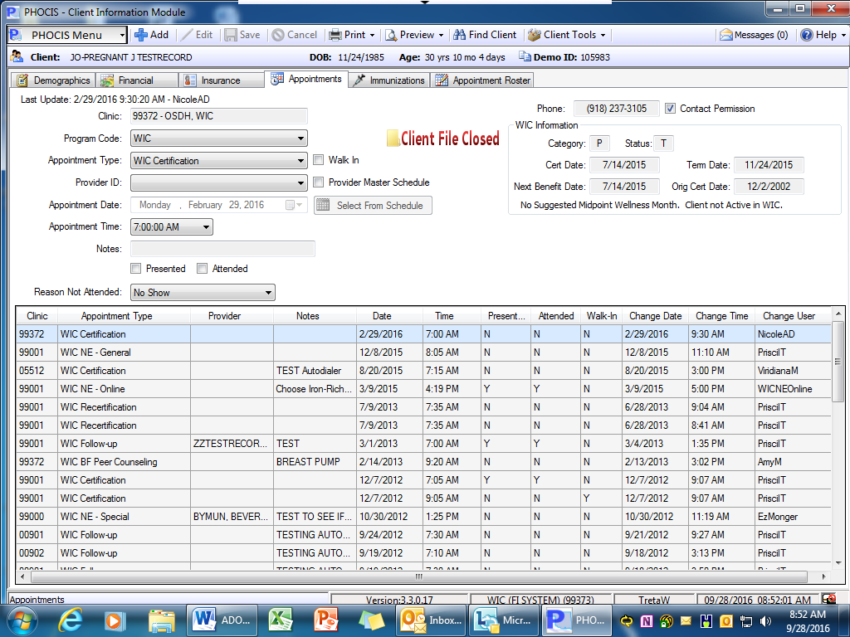
Notes:
Vickie
The record is now “closed” in your clinic only.

Slide 30
Review Appointment Screen
Review the appointment screen for any attended appointments at another clinic.
If there are appointments at another clinic, you must contact the clinic and ask them to close the PHOCIS record in their clinic and follow instructions to seal the original chart.
Reach out to your WPC if you need help with who to contact.
Notes:
Vickie

Slide 31
Notes:
Vickie
This record has received services at multiple clinics. All clinics would need to close the record in their clinic.

Slide 32
Close The Hardcopy Chart
Review hardcopy chart for information pertinent to the child’s long term care.
Information such as health information, ERFF, etc.
Copy pertinent information and return original pages to the original chart
Does not include Consent, Notice of Proxy, and Certification Statement. New forms will be completed with new name.
Notes:
Vickie

Slide 33
Close The Hardcopy Chart
Black out any identifying information such as name, date of birth, address, phone number, SSN, insurance information, and biological parent information.
Copy Again.
Place the last copied documents in the Administrative section of the client’s new record.
Shred the first blacked out copy.
Notes:
Vickie

Slide 34
Copy The Adoption Decree
Make a copy of the adoption decree and/or other documentation provided verifying the adoption.
Place copy in the Administrative section of the original chart.
Notes:
Vickie

Slide 35
Seal The Original Chart
Write across an envelope “UNDER SEAL – DO NOT RELEASE INFORMATION WITHOUT COURT ORDER OR IF REQUESTED FOR INTERNAL AUDIT.”
Write the birth name, date of birth, and date the record is eligible for destruction on the outside of the envelope.
5 years from the adoption date if WIC only.
Otherwise, until the child reaches the age of 21.
Seal with confidential tape and file.
Notes:
Vickie

Slide 36
Open New Hardcopy Record
Take the VOC and black out the name, client ID and date of birth. Make a Copy.
Place copy with the other copied items (pertinent information) and open a new chart.
Collect new Consent for Service, Certification Statement, Proxy, if needed, etc.
Shred the original copy of the VOC.
Notes:
Emily

Slide 37
Open New PHOCIS Record
Create a new PHOCIS record under the new name.
If the client was not active on WIC, certify under new name.
If the client was active on WIC, use the information from the VOC printed at the start of the process, and transfer the client in as an out of state transfer from Oklahoma.
Enter the next benefit date as today’s date.
Notes:
Emily

Slide 38
Open New PHOCIS Record
Do not put Medicaid information with the original name in the Insurance Module of PHOCIS.
If needed, remind parents to contact OHCA to update Medicaid to their adopted name.
If the client is not covered by any other insurance, mark “no insurance” in the insurance module.
Notes:
Vickie

Slide 39
Add To PHOCIS Family Group
Add the client to a new PHOCIS family group
Or
Add to an existing PHOCIS family group if the new family is already in a PHOCIS group.
Notes:
Vickie
Mention linking to new adult caregivers in the PHOCIS group’s importance in establishing family connections and assisting with locating participants when the adult caregiver reaches out for assistance.

Slide 40
ENHANCED OSIIS and IMMUNIZATION RECORDS
Check for an immunization record in Enhanced OSIIS. Even if the child does not have a PHOCIS record it is necessary to check the OSIIS system if immunizations are given in your clinic.
Print a copy of the immunizations from the original, birth name
Create a new client record under the new adopted name in OSIIS
Have the nurse enter the immunization from the birth record into the new record with the adopted name. Immunizations should be entered as ‘history’ immunizations.
Please make sure all of these steps are completed. Once the original record is marked as “adopted patient’, the record will completely disappear and cannot be retrieved.
Shred the printed hardcopy of the shot record from the original birth record.
Notes:
Vickie

Slide 41
ENHANCED OSIIS and IMMUNIZATION RECORDS
Notify OSDH OSIIS Helpdesk or your Records Consultant of the adoption. Send the original birth name, date of birth and the OSIIS Client ID and ask that the record be marked as “Adopt Patient”.
OSIIShelp@health.ok.gov
Notes:
Vickie
Mention here that all our independents don’t have access to OSIIS, but should still email and let them know this is an adoption from an independent clinic without access to OSIIS. They will need to create a new record and the original record will need to be marked as adopted.

Slide 42
What Custody Related Information Can Be Documented In PHOCIS
Adoption – Never
Foster – Checkmark in demographics
Other custody situations – Nothing
Notes:
Vickie.
While on the subject of records… let’s talk a little about what custody related information can be documented in PHOCIS…
Cannot put anything in the comments regarding, custody, foster care, guardianship, adoption or anything related to any of those subjects They can put comments like ‘see file’ or they can actually write on the demographic report in the actual file to see papers in admin section but nothing goes in the demographics in PHOCIS except the check mark in foster care and the legal guardian name in the guardian information.

Slide 43
Helpful Resources – CHDs
OSDH Records Consultants
Mary Richards | MaryK@health.ok.gov | Districts 1,2,3, & 4
Vickie Foster | VickieF@health.ok.gov | Districts 5,6,7,8,9 & 10
Notes:
Emily

Slide 44
Helpful Resources – Independent Clinics
WIC Policy Team | 405-426-8504
Notes:
Emily

Slide 45
Questions?

