Slide 1
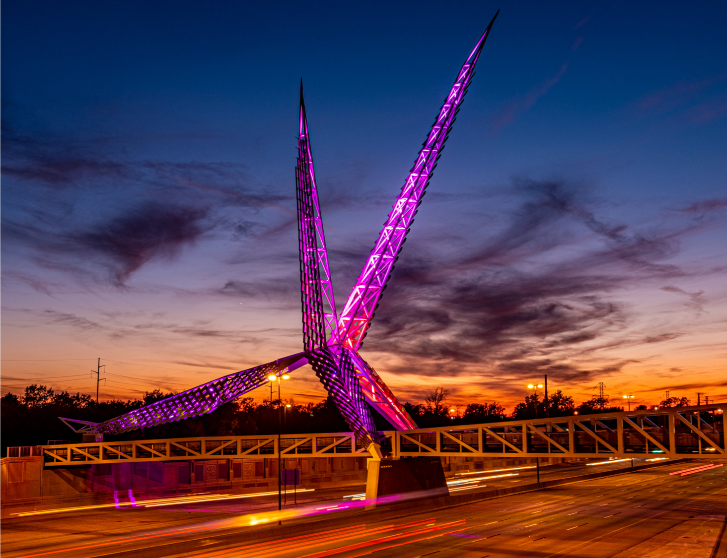

Welcome
Call to Order
Notes:
Welcoming AC team and quest
AC members and quest must sign in per the attendance sheet
Provide team with any Handout material

Slide 2

Preventive Health and Health Services (PHHS) Block Grant (BG)
Advisory Committee Meeting
2:00 pm
April 6, 2026
To learn more about the PHHSBG, please visit our SharePoint page or public webpage.
Notes:
Let Chair-person know the meeting can start- Call to Order
Thank you joining the Regular AC meeting

Slide 3

Agenda
Call to Order
Welcome and Introductions
Review and Approval of the Meeting Minutes
AP6 Challenges and Success stories
FY25 PHHS Block Grant AP6 Budget Spend-down Update
AP6 Budget Revision Requests
FY26 Proposal Requests - AP7, Evaluation
and Funding Recommendations
Advisory Committee Meeting Dates and Next Steps
Closing Remarks and Adjournment
Oklahoma State Department of Health | Preventive Health and Health Services Block Grant | 2026
Notes:
Chair-person - has called to order the meeting;
document or note the time start time
Today’s agenda:
Welcome and Introductions
Review and Approval of the Meeting Minutes from Dec2024
Challenges and Interim Success Stories
FY25 Block Grant Budget Spend-down Update and Budget Revision Requests
FY26 Proposal Requests, Evaluations and Funding Recommendations
Advisory Committee Meeting Dates
Closing Remarks and Adjournment
NOTE* If less than 4 board members are there, won't have a quorum. Can still have meeting if they want but cannot vote on anything.

Slide 4
Welcome
Introductions
Notes:
Welcome and thank you taking time of your busy schedules to meet and discuss the PHHS BG.
Big thank you to the new and returning AC team member.
Introductions-
I would like for everyone to introduce themselves, provide your name, current career position, and your PHHS block grant role
Round robin introductions – starting with the Block Grant Coordinator and then to my right

Slide 5
Review and Approval
-
Meeting Minutes
Notes:
Due to agency changes, there has been no quorum and voting has been delayed. My plan was to share documents via emails for previous AC meetings and give the team the opportunity to read and review.
But have a new approach, I can allow the team to read and review them and tabor the voting till the next meeting to allow time to review, ask questions etc
Will Need approval of the following minutes:
March 2025
Dec 2025
Do we have a motion?
If applicable-
Motion for approval of Minutes from:
No action required-
Second for approval -
Any discussion – no topic(s)
All in Favor
All opposed Nay:
Abstain:

Slide 6
AP6
-
Challenges
Success Stories
Budget Spenddown and Modifications
Notes:
Section will cover the AP6 current wp and budget cycle (Oct2025 – Sept2026) challenges . Success stories and

Slide 7



AP6
Challenges Success Stories
CATCH Kids Club-D4 is an evidence-based physical activity and exercise project. They increased the participation rate in rural OK and low-income daycare centers.
Work Plan revisions
Timely Budget Modifications
Personnel Changes
Staff shortages
Oral Health surpassed their interim goal of 3,000 fluoride varnish applications, 82,000 were disseminated by Jan2026. They are on a steady path to increase access to oral health care for the citizens of Oklahoma.
Notes:
Success Stories
CATCH : Their goal was to increase the amount of rural and low-income daycare-ages children in District 4 participating in an evidence-based physical activity and exercise CATCH program. Their target value was 2 but program incorporated a total of three daycares into the CATCH Kids Club.
Oral Health: They surpassed their interim goals 3000 and final goal of 7500 and on a steady path to increasing access to care for the citizens of Oklahoma.
Challenges reported by program recipients included:
Personnel changes
Staff shortages - loss of staff and retirements
Timely budget modifications
New PHHS BG process-
New AC team and the selection process
To elevate the program tracking system for non personnel expenditure. I tracking email are sent to confirm accurate, send invoice and complete the : Budget

Slide 8
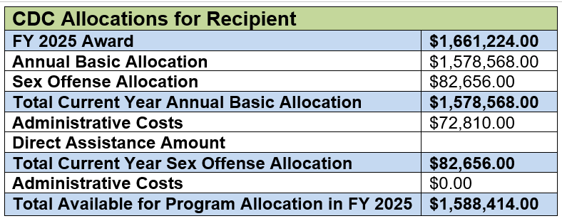
AP6
Program
Budget Spenddowns
Notes:
For convenience, attached is a quick glance of the AP6 - FY25 PHHS Block Grant budget allocation table from the funder, Centers for Disease Control and Prevention (CDC).
AP& will return to level funding 1.4m

Slide 9
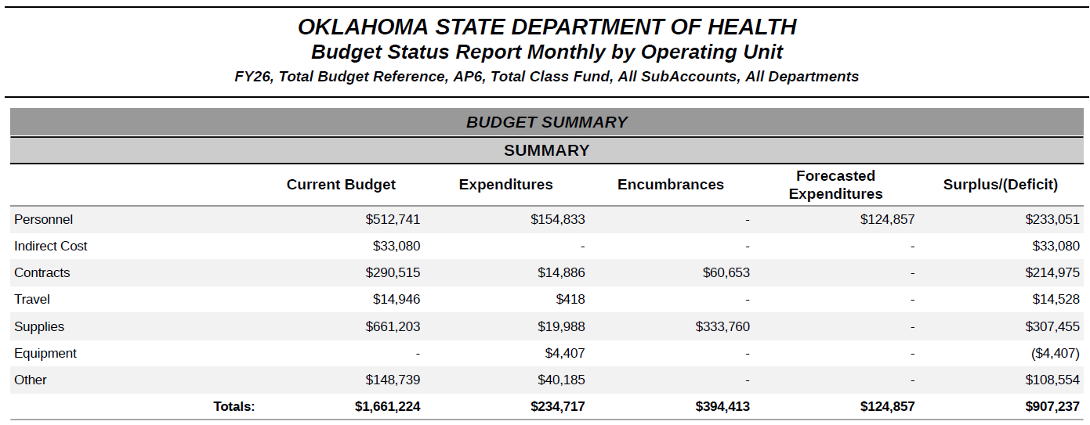
AP6 PHHS Block Grant Budget Spend-down Update FFY 2026
Notes:
Also enclosed is a snapshot of the overall OSDH PHHS Block Grant budget for the AP6. (FFY 2026- Oct2025 thru Sep2026)
The PHHS Block is in the month 5 of its 12- month grant cycle. Based on projection of the timeline Per the March 2026 BSR (budget status report) Summary, provided here is the combined summary that reflect roughly $907,237 in unspent funds and 334 per the encumbrance sections.
Each program is strongly encouraged to spenddown obligated funds ASAP, as funding is subject to change and to ensure that all expenditure are captured timely and accurately.
This year will be return to initiating a surplus funding stream to capture the on the back end of the grant cycle since this grant budget period operation on the Federal Fiscal Year and not the SFY.
Ms. Lewis is present to provide additional insight if you have any additional questions or if she would like to provided her thoughts on this matter.
Please note that the BC will be addressing all surplus funding in the month of APRIL and May 2026 at the monthly Program update meetings, to ensure accuracy.
The next several slides will provide you a snapshot of each the 20 program recipients' budget. Starting with the OSDH Public Health Labs

Slide 10
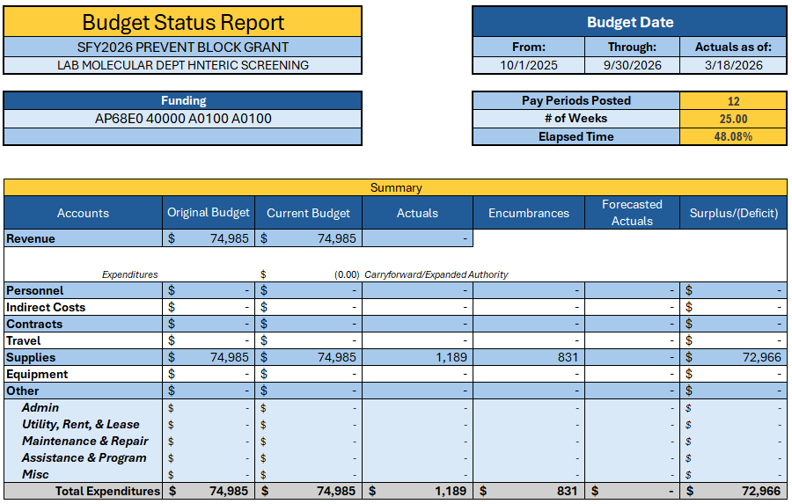
OSDH PHL Molecular
Notes:
OSDH PHL Molecular funding totaled 74985 – at this point only approx. $2,000 expenses have been processed for payment and a potential surplus of $72,966 remaining
Program Goal:
The OSDH PHL Molecular Department aims to reduce the number of infections by Salmonella utilizing PCR screening of stool specimen submitted for testing to quickly detect potential outbreaks and to inform patient management and contact investigations.

Slide 11
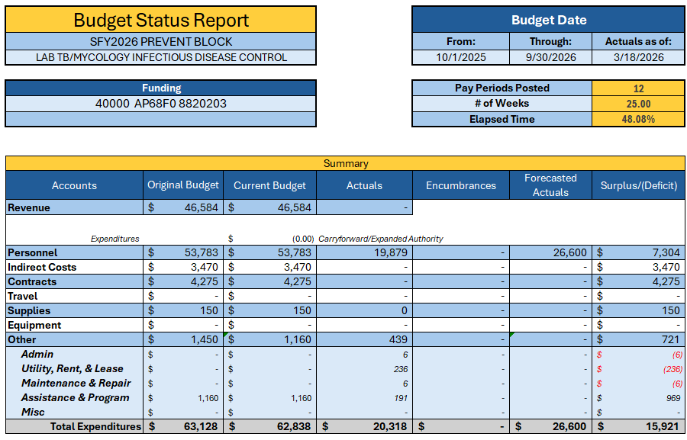
OSDH PHL TB/Mycology
Notes:
OSDH PHL TB/Mycology – at this point only approx. $20,318 actual expenses have been processed for payment and $26,600 forecasted and a potential surplus of $15,921.
Program Goal:
The OSDH PHL TB/Mycology Department will reduce tuberculosis cases by decreasing the average time between specimen submission and result reporting for specimens sent for acid-fast smear and culture, so that the results can be used to inform patient management and contact investigations to contain and prevent potential outbreaks.

Slide 12
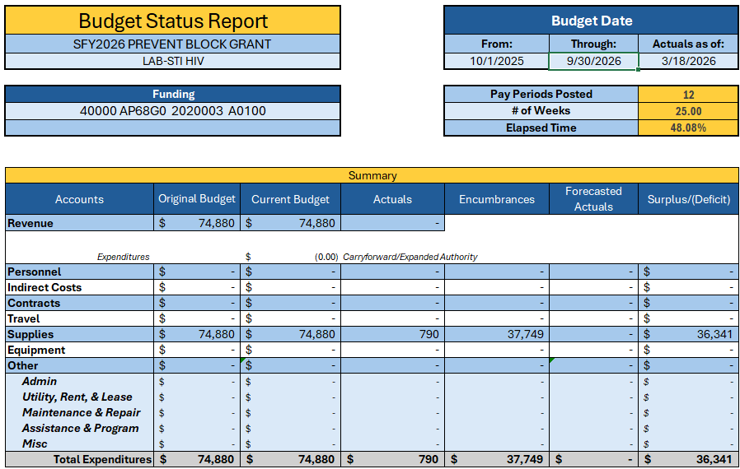
OSDH PHL STI/ HIV
Notes:
OSDH PHL STI-HIV funding totaled 74,880– at this point only approx. $37,749 total expenses have been processed for payment of the $74,880 awarded and a potential surplus of $36,341.
Program Goal:
The OSDH PHL STI Department will achieve at least a rate of 95% meets turn-around time for HIV specimens between 10/2025 to 09/2026.

Slide 13

OSDH PHL Microbiology
Notes:
OSDH PHL Microbiology funding totaled $73,619 – at this point only approx. $1,701 total expenses have been processed for payment of the $73,619 awarded and a potential surplus of $65,877.
Program Goal:
The OSDH PHL Microbiology department will reduce infections caused by Shiga toxin-producing E. coli by utilizing sequencing information from isolates submitted to and clinical samples isolated by the laboratory to identify outbreaks, so that appropriate action can be taken to identify and eliminate the source of the outbreak.

Slide 14
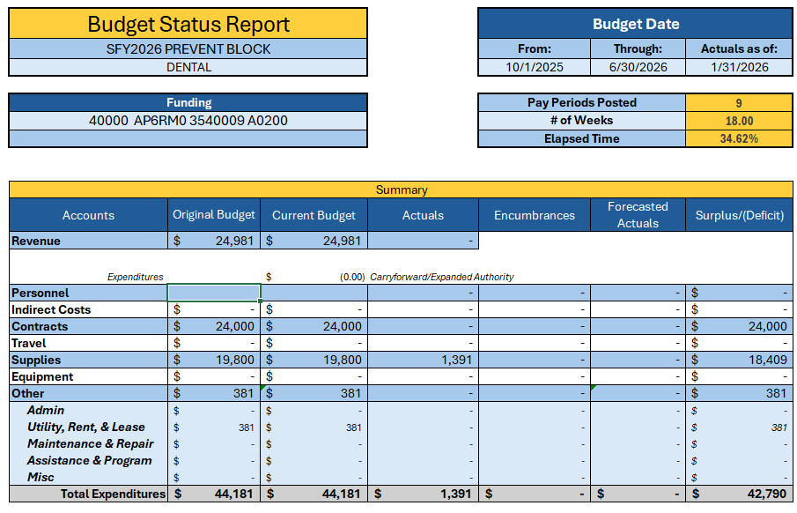
Oral Health Outreach Project
Notes:
Oral Healthy funding totaled $44,181 at this point only approx. $1,391 total expenses have been processed for payment and a potential surplus of $42,790.
Program Goal:
Is to increase access to dental caries prevention programs and increase the proportion of children, adolescents, and adults who use the oral health system.

Slide 15

A Way to Wellness+
Notes:
A Way to Wellness program funding totaled $29,997– has no current expenses has been reported at this time. The Program has a pending budget revision request that is on the agenda today, that will be addressed later in the presentation.
Program Goal:
To reduce 3-5% body fat over and eight-week period by implementing healthy choices for participants.

Slide 16

South Central Oklahoma Healthy Youth Initiative-D8
Notes:
South Central OK , the programs correct total is $41,723 and $22,796 was modified in Sept2025. Info reported and pending corrections new BA for the Block Grant
Program Goal:
The goal of the Southcentral Oklahoma Healthy Youth Initiative is to increase the number of rural and low-income children pre-K – 12 grades who receive evidence-based nutritional, physical, social and emotional education that incorporates physically skilled based activities.

Slide 17

CATCH – NE Oklahoma CATCH Coordinated Health Initiative
Notes:
CATCH funding totaled $48,124, at this point only approx. $10,842 expenses that have been processed for payment, with a potential surplus of $20,130.
Program Goal:
The goal of the Northeastern Oklahoma CATCH Coordinated Health Initiative, is to increase the amount of rural and low-income children who attend daycare in District 4 participating in an evidence based physical activity and exercise CATCH Kids Club program.

Slide 18

Community Engagement & Partnership
Notes:
Comm Engmnt - funding totaled $19,500, at this point only approx. $4,407 has been processed for payment, with a potential surplus of $15,093.
This program requested a budget modification as some contractual activities where at no cost.
Program Goal:
Is to strengthen prevention services in Oklahoma by expanding comprehensive training opportunities for internal and external partners by 50% between October 1, 2025, and September 31, 2026

Slide 19

CHW Training
Notes:
Community Health Worker Training funding totaled $170, 000, at this point only approx. $19,243 has been processed for payment, with a potential surplus of $122,204.
Program Goal:
The goal of the program is to develop a standardized Community Health Worker (CHW) curriculum alongside CHWs and subject matter experts

Slide 20
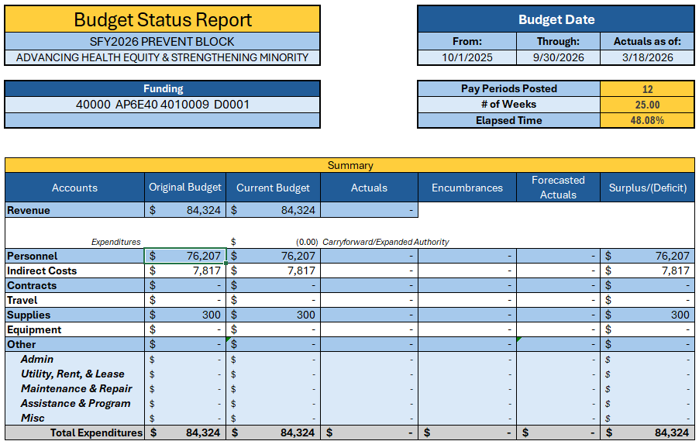
Enhancing Access, Promoting Wellness & Telehealth Initiative
Notes:
Telehealth funding totaled $36,000 at this point no current reported expenses have been processed for payment, with a potential surplus of $36,
Reduced to 36k , Oct 2025, still pending correction
Program Goal:
The program goal is to utilize existing staff to provide training, resources and collaborative efforts with CHDs, healthcare providers, and businesses to increase the use of telehealth services to improve health outcome by reducing travel and costs to access healthcare for Oklahomans.

Slide 21
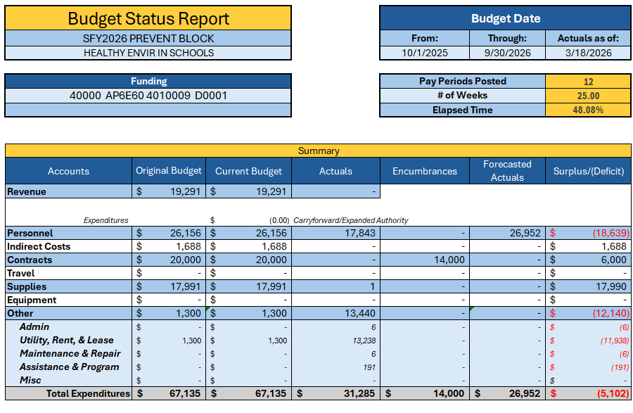
Improving School Health Statewide
Notes:
School Health - funding totaled $67,135, at this point only approx. $31,285 has been processed for payment, with a potential surplus of $-5,102. There is a FTE coding discrepancies that is pending reconciliation.
Program Goal:
The OSDH PHL STI Department will achieve at least a rate of 95% meets turn-around time for HIV specimens between 10/2025 to 09/2026.

Slide 22
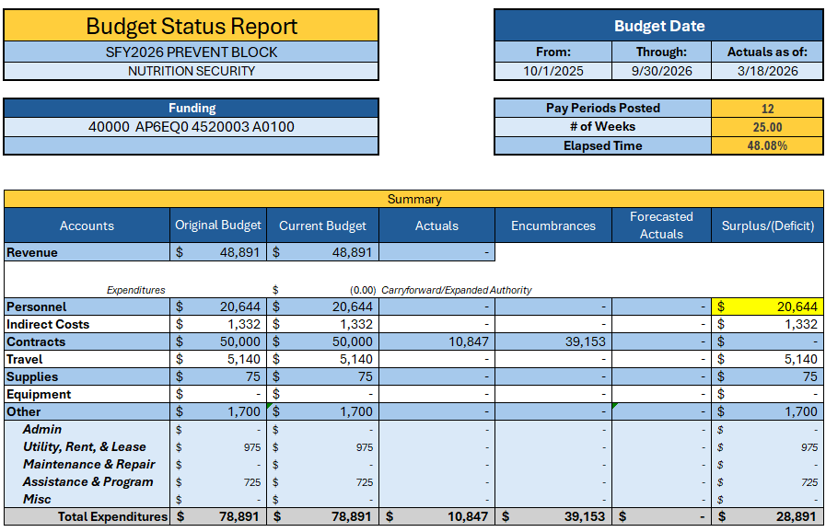
Nutrition Security
Notes:
Nutrition Security - funding totaled $78891 at this point only approx. $10,847 has been processed for payment, with a potential surplus of $28,891.
2 staff member that are required to code but missing from the report- program states they coding and capturing their booked cost correctly
Program Goal:
To partner with the two Feeding America associated food banks that serve Oklahoma to reduce food insecurity and health disparities throughout the state.

Slide 23
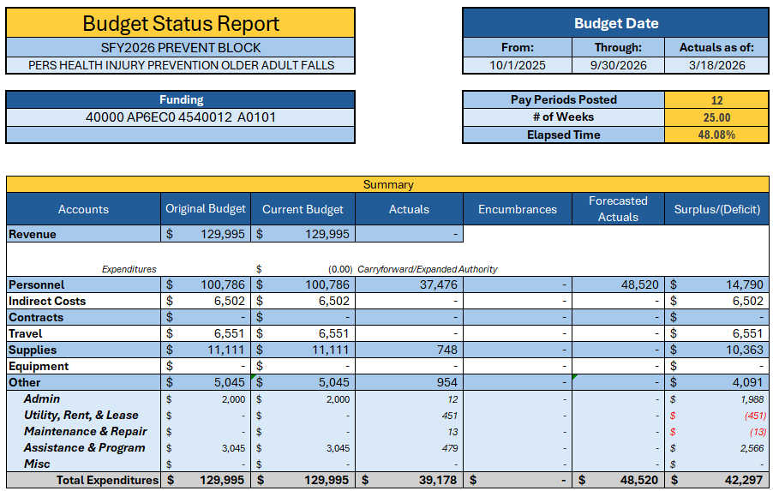
Healthy Aging and Injury Prevention
Notes:
Aging funding totaled $129,995, at this point only approx. $39,178 has been processed for payment, with a potential surplus of $42,297.
Also known as Older Adults Program Goal:
Engage state and community partners across sectors to implement strategies to reduce the number of falls leading to injury death, promote healthy aging, and improve health outcomes among persons 65 years and older statewide.

Slide 24

Sexual Assault Training & Surveillance
Notes:
Sexual Assault funding totaled $82,656 the PHHSBGs mandatory set-a-side allotment. At this point only approx. $7083 has been processed for payment, with a potential surplus of $75,573.
Program Goal:
The IPS will collaborate with the OSDH Nursing Service and public health nurses across the state to implement and conduct training related to the topic of sexual violence in Oklahoma; implement surveillance of adverse childhood experiences (ACEs) to enhance the understanding of the connection between ACEs and sexual violence in Oklahoma.

Slide 25

Child Passenger Safety Program
Notes:
CPS funding totaled $300,330 at this point only approx. PO in place for that 300k with a potential surplus of $0.
300,330 is the correct Budget funding total - $21,796 was given to D8
Program Goal:
Distribute an average of 300 child safety seats monthly to participating sites statewide.

Slide 26

Suicide Prevention & Surveillance
Notes:
Suicide funding totaled $102,278, at this point only approx. $21,621 has been processed for payment, with a potential surplus of $80656.
Program Goal:
The IPS will use the project period to continue building capacity for suicide prevention across the state that is aligned with the 2024 National Strategy for Suicide Prevention, with an added focus on the older adult population, and enhance existing suicide surveillance with data on adverse childhood experiences and suicide attempts and ideation through the Behavioral Risk Factor Surveillance System (BRFSS).

Slide 27

Partner-Inflicted Brain Injury (PIBI) Training & Surveillance
Notes:
PIBI funding totaled $168,901 at this point only approx. $20,493 has been processed for payment, with a potential surplus of $23,871.
Program Goal:
To Increase awareness of and accommodations and resources for partner-inflicted brain injury among domestic violence service providers and allied professionals. Implement surveillance of adverse childhood experiences to enhance the understanding of the connection between ACEs and intimate partner violence in Oklahoma.

Slide 28

CHO- Certified Healthy Oklahoma Statewide Technical Assistance
Notes:
CHO funding totaled $40020 at this point only approx. $4,040 has been processed for payment, with a potential surplus of $35,980.
Program Goal:
The program goal is to increase awareness and technical assistance for Certified Healthy Oklahoma, including businesses, campuses, communities, congregations, early childhood programs, and schools.

Slide 29
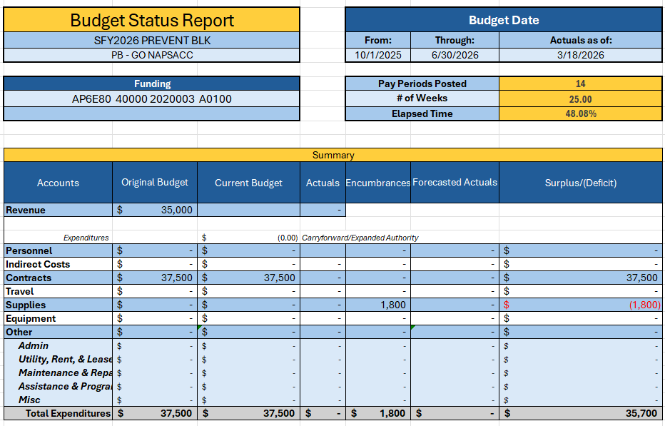
Go NAPSACC Technical Assistance
Notes:
GoNAPSacc funding totaled $37,500, at this point there is only a discrepancy $1800, no current expenses reported and this is pending reconciliation
Program Goal:
The program goal would be to increase by 10 the number of childcare providers making a policy, practice, or environmental change.

Slide 30
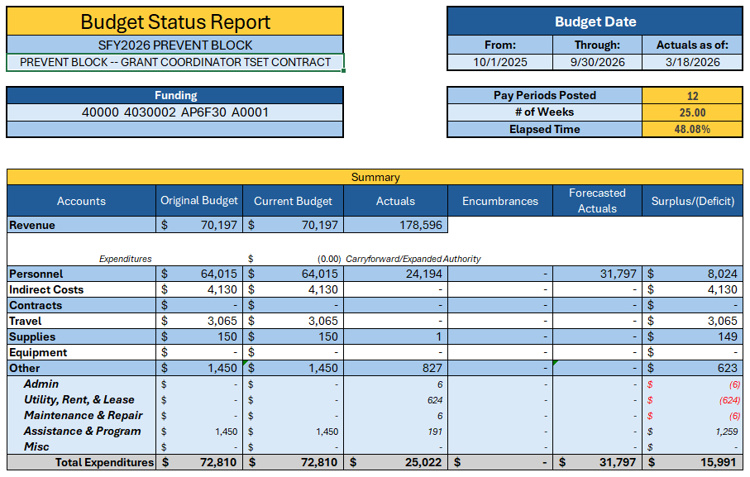
PHHS Block Grant – Gen Adm Coordinator
Notes:
Gen Adm- PHHS BG Coordinator - funding totaled $72,810 at this point only approx. $25,022 has been processed for payment, with a potential surplus of $15,991.

Slide 31
AP6
Program
Budget Revision
Notes:
The next slides will cover AP6 Budgets revision, which include programs request for modifications or revisions and PHHS block grant request to redirect funding

Slide 32
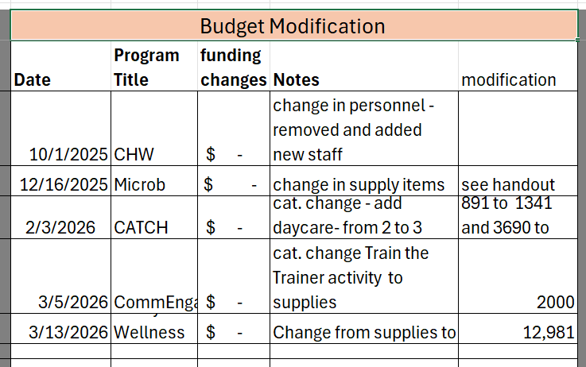
AP6 Budget Modifications
Request:
CHW Training – new staff. No additional funds required
PHL Microbiology - supply cost change. No additional funds required
CATCH – Requested to add one additional daycare. No additional funds required
Community Engagement – request to add supplies item line. No additional funds required
A Way to Wellness – Pending new category request, equipment. No additional funds required
Notes:
Modified budgets;
CHW
Removed and replace new staff members 10/2025- No change in funding requirements and WP modified.
PHL – change in supplies cost- No change in funding requirements
CATCH
Program had a cost increase to 1845x3= 5535 kits and was able to secure a third daycare CATCH Kid activity packet $1341 modification. Marketing supplies in the sum of $2500- No change in funding requirements
Community Engagement
$2,000 category change
Program secured a presenter at no cost, moving funds to a previously required budget line item, training supplies- No change in funding requirements
One budget revision’
A Way to Wellness Pending APPROVAL
Budget- New budget line item - Equipment items:
Mobile workstation with drawer for nurse - $610
5-Leg pneumatic stool with backrest for nurse - $650
Power 500 exam table with stirrups, backrest and footrest - $3,200
Phlebotomy chair for blood draw - $1,100
InBody body scale analyzer - $7,420.50
Total= 12,980.50

Slide 33
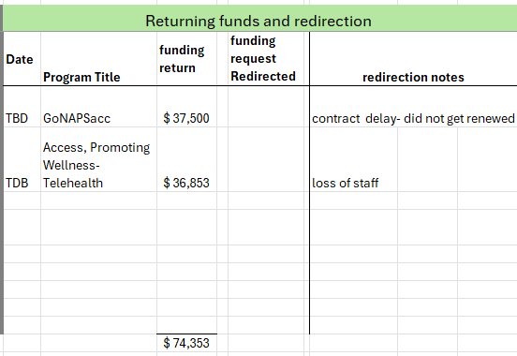
Budget Redirections (Revision)
Enhancing Access, Promoting Wellness & Telehealth - $36,853
GoNAPSACC – $37,500
Notes:
At this stage of the PHHS Block Grant budget timeline the only program with surplus funding by need to redirect their funding to other existing programs area:
Go NAPSacc
contract delay- they are pending direction of leadership as this contract did not get renewed
Enhancing Access to Telehealth
loss of staff

Slide 34

5 minutes
Notes:
Break time

Slide 35
Proposal Request- AP7
FY26
Program Year
_______
Review and/or Approval
Notes:
The Proposal –application material was shared via email on 3/23/2026 and the funding.
Normally the BC will host a pre- Application/Proposal meeting on Feb to expedite the AC regular meeting in March for everyone in attendance to have the opportunity to get a brief overview of the PHHS BG application process and evaluation tool. Please forgive circumstances that delayed that process.
To expedite this meeting the Proposal evaluation Proposal Evaluation forms were sent via email for ranking and to be discussed today during the March’s AC meeting to identify the Block Grant awardees for FFY26.
Next step is the Proposal evaluation scores and funding recommendations.
DEMO the excel files

Slide 36
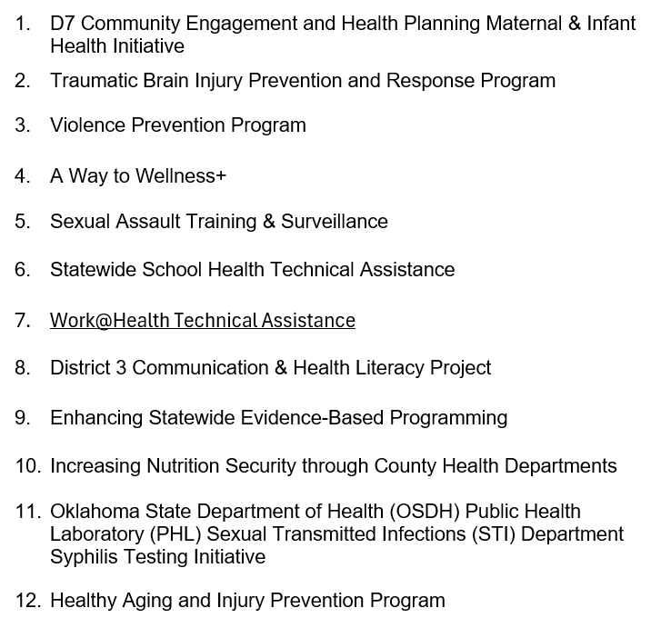
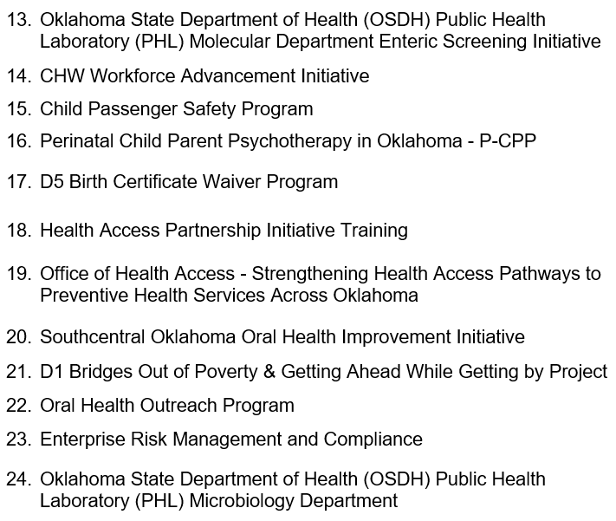
FY26 PHHS Block Grant Programs
Notes:
The Annual PHHS Block proposal request had a total of 24 program requesting funding for the FY26 grant period. The next several slides will provide a overview of the quested work plans and budget total, The team will review the data to redetermine funding allocation based on the state needs, plan for public health,

Slide 37
D7 Community Engagement and Health Planning Maternal & Infant Health Initiative
Budget Request: $370,778 – Start up FTEs: 9 Other: Supplies / Travel / Equipment –portable ultrasound units / Other – staff certifications, toolkits, curriculum
Healthy People 2030: Prevent pregnancy complications and maternal deaths and improve women’s health before, during, and after pregnancy. Reduce the rate of fetal deaths at 20 or more weeks of gestation – MICH-01
Program Goal:
To reduce infant mortality and improve maternal health outcomes in District 7 through a coordinated, three-pronged preventive health approach that integrates physical health support, education, and nutrition, delivered through trusted community-based systems and mobile outreach.
Notes:
Maternal & Infant Health Initiative
Budget Request: $$370,778 – Start up FTEs: 9 Other: Supplies / Travel / Equipment / Contractual
Healthy People 2030:
Program Goal:
To reduce infant mortality and improve maternal health outcomes in D7 through a coordinated, three-pronged preventive health approach that integrates physical health support, education, and nutrition, delivered through trusted community-based systems and mobile outreach.
Start up - FTEs: 0 existing staff Other: Supplies/ ACEs Questions / Contractual
Start up FTEs: 9 Other: Supplies / Travel / Equipment / Contractual

Slide 38
Traumatic Brain Injury (TBI) Prevention & Response Program
Budget Request: $124,044 – Start up FTEs: 2 existing staff Other: Supplies / Contractual / Data Cost/ BRFSS Questions/ Other – bicycle helmets, print cost
Healthy People 2030: Reduce fatal traumatic brain injuries – IVP-05
Program Goal:
This program aims to decrease TBI-related morbidity and mortality, with a special focus on children and those impacted by IPV statewide.
Notes:
Traumatic Brain Injury aka PIBI
Budget Request: $ – Start up FTEs: 0 Other: Supplies / Travel
Healthy People 2030: Reduce fatal traumatic brain injuries – IVP-05
Program Goal: This program aims to decrease TBI-related morbidity and mortality, with a special focus on children and those impacted by IPV statewide.

Slide 39
Violence Prevention Program
Budget Request: $169,322 – Enhance/expand program FTEs: 1 vacant position Other: Supplies/ BRFSS ACEs Questions / Other – gun locks, print cost
Healthy People 2030: Reduce firearm-related deaths – IVP-13
Program Goal:
This program aims to decrease violence-related morbidity and mortality, with a special focus on firearm-related injuries and deaths statewide and enhance existing suicide mortality surveillance with data on suicide attempts and ideation, and firearm safety through the Behavioral Risk Factor Surveillance System (BRFSS).
Notes:
Violence Prevention Program
Budget Request:$169322 (82,656)– Enhance or expand the program FTEs: 1 existing staff Other: Supplies/ ACEs Questions / Contractual
Healthy People 2030:Reduce firearm-related deaths – IVP-13
Program Goal:
This program aims to decrease violence-related morbidity and mortality, with a special focus on firearm-related injuries and deaths statewide, and enhance existing suicide mortality surveillance with data on suicide attempts and ideation, and firearm safety through the Behavioral Risk Factor Surveillance System (BRFSS).

Slide 40
A Way to Wellness +
Budget Request: $32,822 – Start up FTEs: 0 Other: Supplies / Contractual / Equipment- Exam Table, Phlebotomy chair
Healthy People 2030: Reduce the proportion of adults with high blood pressure - HDS-04
Program Goal:
To reduce 3-5% body fat over and eight-week period by implementing healthy choices for participants.
Notes:
A Way to Wellness
Budget Request: $43,478 – Start up FTEs: 0 Other: Supplies / Travel
Healthy People 2030: Reduce the proportion of adults with high blood pressure - HDS-04
Program Goal:
To reduce 3-5% body fat over and eight-week period by implementing healthy choices for participants.

Slide 41
Sexual Assault Training & Surveillance
Budget Request: $85,680 (82,656)– Start up FTEs: 0; Other: Contractual / Other - ACEs BRFSS Questions, print cost
Healthy People 2030: Reduce contact sexual violence — IVP D05
Program Goal:
The IPS will collaborate with sexual violence experts across the state to implement and conduct training related to the topic of sexual violence in Oklahoma and will contribute to surveillance of sexual violence in Oklahoma.
Notes:
Sexual Assault Training & Surveillance
Budget Request: $85,680 but PHHS block GRANT SETASIDE TOTAL IS (82,656) Program total $3,024 – Start up FTEs: 0 existing staff Other: Supplies/ ACEs Questions / Contractual
Healthy People 2030: Reduce contact sexual violence — IVP D05
Program Goal:
The IPS will collaborate with sexual violence experts across the state to implement and conduct training related to the topic of sexual violence in Oklahoma and will contribute to surveillance of sexual violence in Oklahoma.

Slide 42
School Health Technical Assistance- Statewide
Budget Request: $76,029 – Enhance or expand FTEs: 1 existing staff
Other: Supplies/ Contractual/ Other – Motor Pool
Healthy People 2030: Reduce the proportion of children and adolescents with obesity — NWS 04
Program Goal:
The program goal would be to provide 40 additional lessons to schools across the State of Oklahoma.
Notes:
Improving School Health Statewide
Budget Request: $76,029 – Enhance or expand FTEs: 1 existing staff
Other: Supplies/ IT/ Travel /Contractual
Healthy People 2030: Reduce the proportion of children and adolescents with obesity — NWS 04
Program Goal:
The program goal would be to provide technical assistance to 40 schools across the State of Oklahoma.

Slide 43
Work@Health Technical Assistance
Budget Request: $10,950 – Enhance or expand FTEs: 0; Other: Supplies/ Contractual /Other - Motor Pool
Healthy People 2030:
Increase the proportion of worksites that offer an employee health promotion program — ECBP‑D03
Program Goal:
Increase by 10 the number of employers completing a Work@Health training.
Notes:
Work@Health
Budget Request: $10950 – Enhance or expand FTEs: 0 staff
Other: Supplies/ Contractual/ Motor Pool
Healthy People 2030: Increase the proportion of worksites that offer an employee health promotion program — ECBP‑D03
Program Goal:
Increase by 10 the number of employers completing a Work@Health training.

Slide 44
District 3 Communication & Health Literacy Project
Budget Request: $62,001 – Enhance or expand FTEs: 0; Other: Supplies
Healthy People 2030:
Increase the health literacy of the population — HC/HIT‑R01
Program Goal: To focus on health literacy needs for internal and external populations. We will educate our staff to become a health literate organization with a workforce well trained in health literacy issues, being trauma informed, and strong communication and leadership skills to ensure health literacy is improved internally to assist with necessary skills to affect change externally. We will utilize our collaborative network of partners to provide relevant and adapted materials and education to our communities about the preventative services we provide in effort to reduce barriers faced for individuals with low health literacy.
Notes:
Improving School Health Statewide
Budget Request: $62,001 – Enhance or expand FTEs: 0;
Other: Supplies
Healthy People 2030: Increase the health literacy of the population — HC/HIT‑R01
Program Goal:
This grant will focus on health literacy needs for internal and external populations. We will educate our staff to become a health literate organization with a workforce well trained in health literacy issues, being trauma informed, and strong communication and leadership skills to ensure health literacy is improved internally to assist with necessary skills to affect change externally. We will utilize our collaborative network of partners to provide relevant and adapted materials and education to our communities about the preventative services we provide in effort to reduce barriers faced for individuals with low health literacy.

Slide 45
Enhancing Statewide Evidence-Based Programming
Budget Request: $26,236 – Enhance or expand FTEs: 0; Other: Supplies
Healthy People 2030: Reduce the proportion of adults with obesity — NWS‑03
Program Goal:
To enhance the Evidence-Based programming being offered to Oklahoman adults through OSDH.
Notes:
Community Engagement & Partnership Community of Practice Training
Budget Request: $27,000 – Enhance or expand FTEs: 0 existing staff
Other: Supplies/ Travel / Contractual
HP 2030: Reduce the proportion of adults with obesity — NWS‑03
Program Goal:
The goal of the program is to enhance the programming being offered to Oklahoman adults through OSDH.

Slide 46
Increasing Nutrition Security through CHDs
Budget Request: $50,000 – Enhance or expand FTEs: 0; Other: Contractual
Healthy People 2030: Reduce household food insecurity and hunger – NWS01
Program Goal:
To continue partnership with the food banks and county health departments to provide more nutritious food to individuals that are nutrition insecure.
Notes:
Nutrition Security Budget Request: $50, 000 – Enhance or expand FTEs: 1 existing staff Other: Supplies/ IT/ Travel/Contractual
HP 2030: To Reduce household food insecurity and hunger – NWS01
Program Goal:
Continue partnership with the food banks and county health departments to provide more nutritious food to individuals that are nutrition insecure.

Slide 47
OSDH PHL -
Sexual Transmitted Infections (STI) Department Syphilis Testing Initiative
Budget Request: $106,679 – Maintain existing program (as is) FTEs: 0; Other: Supplies/ Contractual
Healthy People 2030: Reduce congenital syphilis — STI-04
Program Goal:
The OSDH PHL STI Department will achieve at least a rate of 95% of samples that meet our established turn-around time for Syphilis specimens between 10/2026 to 9/2027.
Notes:
(STI) Department Syphilis Testing Initiative
Budget Request: $106,679 – Maintain existing program (as is) FTEs: 0 staff Other: Supplies /Contractual
Healthy People 2030:
Reduce congenital syphilis — STI-04
Program Goal:
The OSDH PHL STI Department will achieve at least a rate of 95% meets turn-around time for HIV specimens between 10/2025 to 09/2026.

Slide 48
Healthy Aging and Injury Prevention
Budget Request: $200,720 – Enhance or expand FTEs: 3 existing staff Other: Supplies/ Data Cost /Other – print cost
Healthy People 2030: Reduce fall-related deaths among older adults – IVP-08
Program Goal:
Engage state and community partners across sectors to implement strategies to reduce injury-related morbidity and mortality among adults 65 years and older statewide.
Notes:
Aging and Injury Prevention
Budget Request: $200,720 – Enhance or expand FTEs: 3 existing staff Other: Supplies/ IT/other
Healthy People 2030: Reduce fall-related deaths among older adults – IVP-08
Program Goal:
Engage state and community partners across sectors to implement strategies to reduce the number of falls leading to injury death, promote healthy aging, and improve health outcomes among persons 65 years and older statewide.

Slide 49
OSDH PHL - Molecular Department Enteric Screening Initiative
Budget Request: $100,037 – Maintain existing FTEs: 0; Other: Supplies
Healthy People 2030: Reduce infections caused by Salmonella - FS-04
Program Goal:
The OSDH PHL Molecular Department aims to reduce Salmonella infections by utilizing PCR screening of submitted stool specimens for rapid detection, followed by serotyping of identified Salmonella isolates, enabling early identification of potential outbreaks and supports timely patient management and contact investigations.
the number of infections by Salmonella utilizing PCR screening of stool specimen submitted for testing to quickly detect potential outbreaks and to inform patient management and contact investigations.
Notes:
OSDH PHL - Molecular Department Enteric Screening Initiative
Budget Request: $100,037 FTEs: 0 - Other: Supplies
Healthy People 2030: Reduce infections caused by Salmonella - FS-04
Program Goal:
The OSDH PHL Molecular Department aims to reduce the number of infections by Salmonella utilizing PCR screening of stool specimen submitted for testing to quickly detect potential outbreaks and to inform patient management and contact investigations.

Slide 50
CHW Workforce Advancement Initiative
Budget Request: $203,715 – Enhance or expand FTEs: 2 existing staff Other: Supplies/ Data Cost/ Contractual/ Other – Motor Pool
Healthy People 2030: Increase the proportion of public health workers who receive continuing education on public health competencies - PHI 08
Program Goal:
To strengthen the statewide Community Health Worker workforce by expanding access to high quality training and professional development that improves their ability to serve communities with the greatest health disparities.
Notes:
Oklahoma Community Health Workers Training Program: Building a Unified & Sustainable Workforce
Budget Request: $203, 715 – Enhance or expand FTEs: 2 existing staff Other: Supplies/ IT/ Travel /Contractual
Healthy People 2030: Increase the proportion of public health workers who receive continuing education on public health competencies - PHI 08
Program Goal: The goal of the program is to strengthen the statewide Community Health Worker workforce by expanding access to high quality training and professional development that improves their ability to serve communities with the greatest health disparities.

Slide 51
Child Passenger Safety Program
Budget Request: $300,000 – Maintain existing FTEs: 0 Other: Supplies
Healthy People 2030: Reduce the proportion of deaths of car passengers who weren't buckled in — IVP‑07
Program Goal:
Distribute an average of 264 child safety seats monthly to participating sites statewide.
Notes:
Child Passenger Safety Program
Budget Request: $299980 – Maintain existing FTEs: 0 Other: Supplies
Healthy People 2030: To Reduce the proportion of deaths of car passengers who weren't buckled in — IVP‑07
Program Goal:
Distribute an average of 264 child safety seats monthly to participating sites statewide.

Slide 52
Perinatal Child- Parent Psychotherapy in Oklahoma
Budget Request: $106,857 – Enhance or expand the program FTEs: 1 Other: Supplies/ Contractual / Data Cost
Healthy People 2030: Increase the proportion of women who get screened for postpartum depression — MICH‑D01
Program Goal:
To improve maternal and infant health outcomes in Oklahoma by expanding access to trauma-informed perinatal mental health care through implementation of Perinatal Child-Parent Psychotherapy (P-CPP) by increasing screening, treatment, workforce capacity to reduce untreated depression, substance use, and trauma-related risks that contribute to maternal mortality, poor birth outcomes, and disrupted parent-infant attachment.
Notes:
P- CPP
Budget Request: $106,857 – Enhance or expand the program FTEs: 1 Other: Supplies/ Contractual / Data Cost
Healthy People 2030: Increase the proportion of women who get screened for postpartum depression — MICH‑D01
Program Goal:
To improve maternal and infant health outcomes in Oklahoma by expanding access to trauma-informed perinatal mental health care through implementation of Perinatal Child-Parent Psychotherapy (P-CPP) by increasing screening, treatment, workforce capacity to reduce untreated depression, substance use, and trauma-related risks that contribute to maternal mortality, poor birth outcomes, and disrupted parent-infant attachment.

Slide 53
D5 Birth Certificate Waiver Program
Budget Request: $23,000 – Enhance or expand FTEs: 0; Other: Supplies/ Equipment – Birth Certificate portal
Healthy People 2030: SDOH-01 Reduce the proportion of people living in poverty - SDOH-01
Program Goal:
Increase the stability of individuals experiencing homelessness who lack an Oklahoma birth certificate through establishing as a client with a Community Health Worker (CHW), completing a PRAPARE assessment for additional health and health related social needs and securing a birth certificate at no cost.
Notes:
Improving School Health Statewide
Budget Request: $69,657 – Enhance or expand FTEs: 1 existing staff
Other: Supplies/ IT/ Travel /Contractual
Healthy People 2030: Reduce the proportion of children and adolescents with obesity — NWS 04
Program Goal:
The program goal would be to provide technical assistance to 30 schools across the State of Oklahoma.

Slide 54
Health Access Partnership Initiative Training
Budget Request: $76,675 – Enhance or expand the program FTEs: 0 Other: Contractual/ Other – Training and Facilitation
Healthy People 2030: Expanding community support networks through partnerships (SDOH-04)
Program Goal:
To improve access to services through coordinated partnerships and training.
Notes:
Partner-Inflicted Brain Injury Training & Surveillance
Budget Request: $72,504 – Maintain existing (as is) FTEs: 1 existing staff Other: Supplies/ IT/ Travel /Contractual
HP2030: Reduce intimate partner violence – IVP D04
Program Goal:
To

Slide 55
Office of Health Access - Strengthening Health Access Pathways to Preventive Health Services Across Oklahoma
Budget Request: $125,000 – Enhance or expand FTEs: 0 Other: Contractual /Other – Training and Facilitation
Healthy People 2030: Increase the proportion of adults whose health care providers involved them in decisions as much as they wanted - HC/HIT-01
Program Goal:
Improve health literacy related preventive and primary care services by strengthening clear communication, navigation support, and referral coordination across OSDH and community partner networks.
Notes:
Office of Health Access - Strengthening Health Access Pathways to Preventive Health Services Across Oklahoma
Budget Request: $125,000 – Enhance or expand FTEs: 0 existing staff Other:
Healthy People 2030: Increase the proportion of adults whose health care providers involved them in decisions as much as they wanted - HC/HIT-01
Program Goal:
Improve health literacy related preventive and primary care services by strengthening clear communication, navigation support, and referral coordination across OSDH and community partner networks.

Slide 56
Southcentral Oklahoma Oral Health Improvement
Budget Request: $36,100 – Start up FTEs: 0; Other: Supplies/ Contractual
Healthy People 2030: Reduce the proportion of people who can't get the dental care they need when they need it — AHS 05
Program Goal:
To increase the proportion of youths and adults’ access to the overall health system and knowledge on preventative health measures.
Notes:
Southcentral Oral Health Outreach
Budget Request: $36,100 – Start up FTEs: 0; Other: Supplies/ Contractual
Healthy People 2030: Reduce the proportion of people who can't get the dental care they need when they need it — AHS 05
Program Goal:
To increase the proportion of youths and adults’ access to the overall health system and knowledge on preventative health measures.

Slide 57
D1 Bridges Out of Poverty & Getting Ahead While Getting By Project
Budget Request: $28,000 – Start up of a new program FTEs: 0; Other: Supplies/ Other – Training workshop
Healthy People 2030: Reduce the proportion of people living in poverty - SDOH-01
Program Goal:
To reduce poverty-related health disparities in D1 by building local capacity to deliver evidence-informed poverty reduction education that improves economic stability and access to health-promoting resources.
Notes:
Bridges Out of Poverty
Budget Request: $28,000 – Start up of a new program FTEs: 0; Other: Supplies/ Other – Training workshop
Healthy People 2030: Reduce the proportion of people living in poverty - SDOH-01
Program Goal:
To reduce poverty-related health disparities in D1 by building local capacity to deliver evidence-informed poverty reduction education that improves economic stability and access to health-promoting resources.

Slide 58
Oral Health Outreach Project
Budget Request: $50,200 – Enhance or expand FTEs:0; Other: Supplies/ Other – Motor Pool , Dental Mobile Smiles Van
Healthy People 2030: Increased use of oral health care system-OH-08
Program Goal:
To increase use of the oral health care system for children, adolescents and adults.
Notes:
Oral Health Outreach Project (Fluoride Varnish)
Budget Request: $50,200 – Enhance or expand FTEs: 0 Other: Supplies – FV training and education will be provided
HP 2030: to Increased use of oral health care system-OH-08
Program Goal:
Is to increase access to dental caries prevention programs and increase the proportion of children, adolescents, and adults who use the oral health system.

Slide 59
Enterprise Risk Management and Compliance
Budget Request: $249,156 – Start up of a new program FTEs: 0; Other: Supplies/ Contractual (3yr)
Healthy People 2030: Public Health Infrastructure – General – Explore quality improvement as a way to increase efficiency and effectiveness in health departments – PHI-R07.
Program Goal:
The main program goal would be to establish a comprehensive enterprise risk management and compliance system across the OSDH to reduce regulatory noncompliance, improve data accuracy and security, ensure timely identification and remediation of risks to support effective, transparent, and accountable public health operations.
Notes:
Enterprise Risk Management and Compliance
Budget Request: $249,156 – Start up of a new program FTEs: 0; Other: Supplies/ Contractual (3yr)
Healthy People 2030: Public Health Infrastructure – General – Explore quality improvement as a way to increase efficiency and effectiveness in health departments – PHI-R07.
Program Goal:
The main program goal would be to establish a comprehensive enterprise risk management and compliance system across the OSDH to reduce regulatory noncompliance, improve data accuracy and security, ensure timely identification and remediation of risks to support effective, transparent, and accountable public health operations.

Slide 60
OSDH PHL -Microbiology Department
Budget Request: $99,995 – Maintain existing FTEs: 0; Other: Supplies
Healthy People 2030: Reduce infections caused by Shiga toxin-producing E. coli - FS-02
Program Goal:
The OSDH PHL Microbiology department will reduce infections caused by Shiga toxin-producing E.coli by utilizing sequencing information from isolates submitted to and clinical samples isolated by the laboratory to identify outbreaks, so that appropriate action can be taken to identify and eliminate the source of the outbreak.
Notes:
OSDH PHL -Microbiology Department Enteric Culture Initiative
Budget Request: $99,995 – Maintain existing FTEs: 5 existing staff Other: Supplies/ IT/ Travel / Contractual
Healthy People 2030: Reduce infections caused by Shiga toxin-producing E. coli - FS-02
Program Goal:
The OSDH PHL Microbiology department will reduce infections caused by Shiga toxin-producing E. coli by utilizing sequencing information from isolates submitted to and clinical samples isolated by the laboratory to identify outbreaks, so that appropriate action can be taken to identify and eliminate the source of the outbreak.

Slide 61

Notes:
Open for questions at this time
Just completed the FY25 – AP6 WP and budget application material
5 min Break before discussion of the budget recommendations.

Slide 62
5 minutes

Slide 63
AP7
Discussion
Committee Meetings
-
Funding Recommendations
Notes:
During the Application/Proposal meeting on Feb 2025 everyone in attendance had the opportunity to get a brief overview of the PHHS BG application process and evaluation tool.
To expedite this meeting the Proposal evaluation Proposal Evaluation forms were sent via email for ranking and to be discussed today during the March’s AC meeting to identify the Block Grant awardees for FFY26.
Next step is the Proposal evaluation scores and funding recommendations.
DEMO the excel files

Slide 64

Committee Meetings
Meeting requirement(s):
No less than twice each federal fiscal year – regular meeting
Public Hearing - annual
Meeting purpose:
Review drafted proposed program work plans & budgets
Evaluate, Score Annual Proposal Requests/Application
and make recommendations
Oklahoma State Department of Health | Preventive Health and Health Services Block Grant | 2026
Notes:
The Purpose and focus of the meetings will be to:
Plan and discuss the development of program work plans,
Evaluate and Score Annual Proposal Requests/Application
Review drafted proposed program work plans & budgets
AT OSDH -PHHS BG Advisory committee Regular Meetings-
are typically held in the calendar months of March and December.
The meetings will allow the Committee to either
plan/discuss the development of the proposed work plan –the Healthy People 2030 objectives and activities or
to review a DRAFT of proposed objectives and activities of the work plan that will be submitted to CDC. For the final meeting, work plans and budgets with the appropriate allocation amounts will be presented to the Advisory Committee for any final recommendations
The meeting in DEC starts the FFY and the final meeting is held in March, were work plans and budgets with the appropriations totals or amounts will be presented to the Advisory Committee for any final recommendations, the commissioner will provide OSDH final approval on those AC recommendations.
February – for a smoother transition of the annual proposal/application, a virtual teams meeting will be held to discuss the proposals/application
May - will be the Public Hearing
Calendar invites will be sent for each events.
AC members The Advisory Committee
42 U.S. Code §300w–4 -Application for payments; State plan
Section 1905 (d) (1-4)

Slide 65
PHHS Block Grant Authorizing Legislation
United States Code (USC)
Title 42: The Public Health and Welfare, Chapter 6A, Public Health Service, Subchapter XVII –Block Grants
Part A: Preventive Health and Health Services Block Grant
Section: 300w-1 to 300w-10
The Advisory Committee
42 U.S. Code §300w–4 -Application for payments; State plan
Section 1905 (d) (1-4)
Public Hearing
Section 1905 (c) (1) (A)
Oklahoma State Department of Health | Preventive Health and Health Services Block Grant | 2024
Notes:
The PHHSBG legislation is
Title 42: The Public Health and Welfare, Chapter 6A, Public Health Service, Subchapter 17 –Block Grants
Part A: Preventive Health and Health Services Block Grant
Section: 300w-1 to 300w-10
The Advisory Committee is under 300-4
Public Hearing is in section 1905c1a

Slide 66
Advisory Committee Duties
To hold Public Hearings on the State Plan
To make recommendations pursuant to subsection regarding the development and implementation of such plan, including recommendations on:
the conduct of assessments of the public health.
which of the activities authorized in section 300w-3 of this title should be carried out in the State;
the allocation of payments made to the State under section 300w-2 of this title;
the coordination of activities carried out under such plan with relevant programs of other entities; and
the collection and reporting of data in accordance with section 300w-5(a) of this title.
Notes:
Just is brief background regarding the AC duties,

Slide 67
2026 PHHS Block Grant Advisory Committee Dates
April 27, 2026 @ 3:30pm
Funding recommendations
May 06, 2026 @ 2:00pm
AP7 Public Hearing of the FY26 Work Plans & Budgets
December 02, 2026 @ 2:00pm
APR Interim and Final APR FY25 Update
Budget Revision and Spenddown
Success Stories
FY26 Work Plan Update
Notes:
April 27, funding recommendations . Upon AC recommendations the documents will be shared with the commissioner for final approval
May 7 Public Hearing
Dec 3, AC meeting

Slide 68
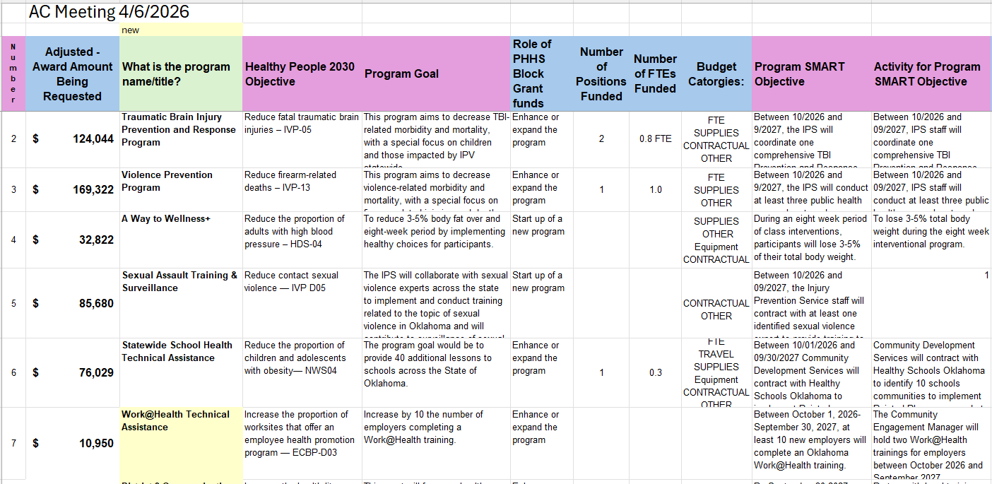
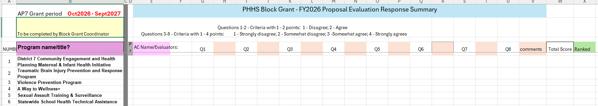
Funding Recommendations
Notes:
Evaluation and scoring – 30day timeline email sent 3/23 and to be return on 4./2 to expedited the process. The recommendation mtgs will be conducted on 4/27/2026 to allow AC team to review the data and the opportunity to evaluate a score the application material. Upon receipt of all the forms, I will share the information via email. And forward the recommendations to the commissioner if approved by the team.
Special mtg can be conducted if required:
I will conduct a special meeting if required or a TEAMs meeting to finalize the funding totals and program awardees.

Slide 69
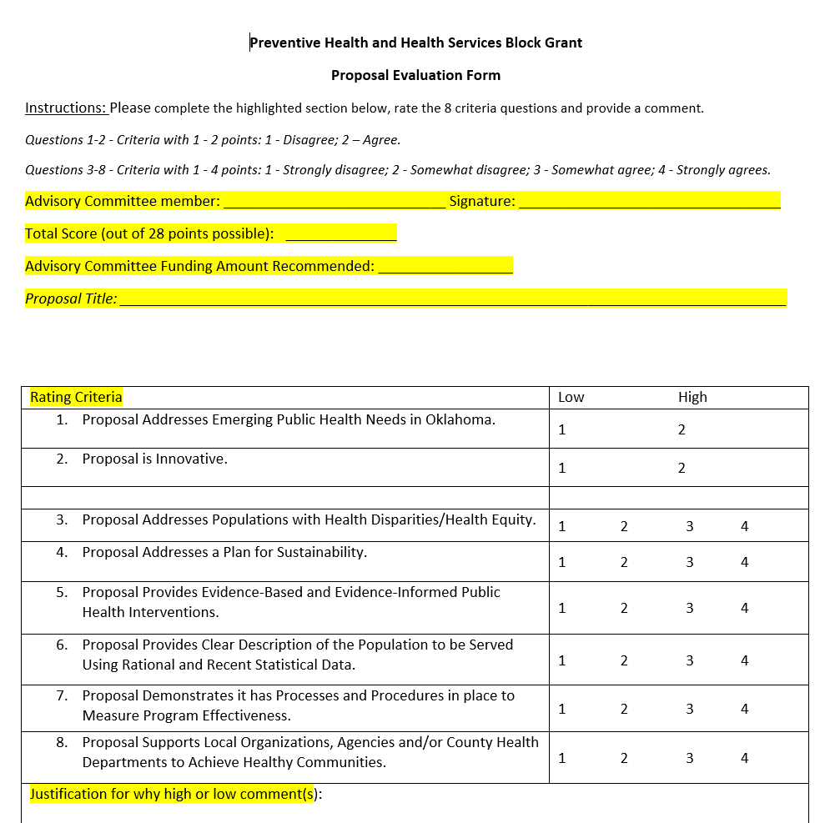
Evaluation Scoring Document
Notes:
This is also a snapshot of the Evaluation scoring document
Complete the form and the highlighted sections. Questions 1-2, Questions 3-8, and add comments on the bottom portion of the form, also question number. Strikethrough for Q3 . Form being revised per EO
AC instructed to recuse themselves if the manager a program(s)
DEMO at the end

Slide 70
AP6 Next Steps
and
Updates
Notes:
During the Application/Proposal meeting on Feb 2025 everyone in attendance had the opportunity to get a brief overview of the PHHS BG application process and evaluation tool.
To expedite this meeting the Proposal evaluation Proposal Evaluation forms were sent via email for ranking and to be discussed today during the March’s AC meeting to identify the Block Grant awardees for FFY26.
Next step is the Proposal evaluation scores and funding recommendations.
DEMO the excel files

Slide 71
Next steps:
Funding Recommendations:
April 27, 2026
Public Hearing: Proposal Request
May 6, 2026
Budget Revision:
May-June 2026
Advisory Committee Meetings:
December 2, 2026
To learn more about the PHHSBG, please visit our SharePoint page or public webpage.
Notes:
Next steps:
Funding recommendations: April 2026 follow up meeting to address
Public Hearing: Proposal Request May 6, 2026
AP6 or AP7 Budget Revision: May-June 2026
Advisory Committee Meetings: December 2, 2026
The proposals will be exported to an excel spread sheet, were be discussed via a TEAMs meeting in February 2025 (virtual option only). excel spread sheet
The Evaluation tool was sent via email for ranking /score the application, after scoring and ranking of the applications/proposals discussed during the AC meeting in March to identify the Block Grant awardees for FY25 will be addressed.
The proposal request forms, and the budget justifications are due no later than February 10, 2025. The proposal request and budget justification will also be available on Health Hub, and on the Prevent Block SharePoint site
Office hours are
January 9, 2025 at 10:00 am,
January 24, 2025 at 1:00 pm and
February 7, 2025 at 10:00 am.

Slide 72
Final Funding Recommendations – Commissioner by April 28, 2026
Notice of Funding Approval or Denial
April 30, 2026
PHHS BG Office Hour – Work Plan/Budget
May 1, 2026, & May 18, 2026
Approved Budget to Finance & Grants Accounting
May 15, 2026
Notes:
Events that has taken place:
Dec2025 - Communication request
Jan2026 – Office Hour- Proposal request
Feb 2026 - Annual proposal request/ application for AP7- FY26 workplan and budget cycle
Feb2026 – Office Hours
Upcoming events ;
Final Funding Recommendations – Commissioner - by April 28, 2026
Notice of Funding Approval or Denial - April 30, 2026
PHHS BG Office Hour – Work Plan/Budget - May 1, 2026, & May 18, 2026
Approved Budget to Finance & Grants Accounting - May 15, 2026
Tentative dates, notes dates are subject to change if we experience any delayed submissions or timelines

Slide 73
Notes:
Any additional Questions at this point

Slide 74

To learn more about the PHHSBG, please visit our SharePoint page or public webpage.
Notes:
Thank you for your time and wisdom

Slide 75
Closing Remarks and Adjournment
Notes:
Closing remarks –
Chair to call the meeting to end and note the time.

