Slide 1
Immunization Service Provider Call
October 2024
Please place your name, and provider in the chat.
Notes:
Good afternoon, welcome everyone. If you have not yet, please be sure to place yours and your provider name in the chat. Let’s go ahead and get started. My name is Rishu Garg and I am the Adul Immunization Coordinator for the immunization program here at OSDH. Thank you for joining us today, especially on a Friday before a holiday weekend ☺ We will try to be good stewards of your time today.

Slide 2
Agenda
Flu Data - Martin and Bethany
COVID-19 Updates - Margaret Archer
Vaccine Ordering Updates- Teja
Life as an IFC- Lisa
Guest Speaker
  India G. Scales, PharmD
  Medical Science Liaison
  AstraZeneca Pharmaceuticals
Looking Forward

Slide 3
Oklahoma Flu Rates 2021-2024
10/04/2024

Slide 4
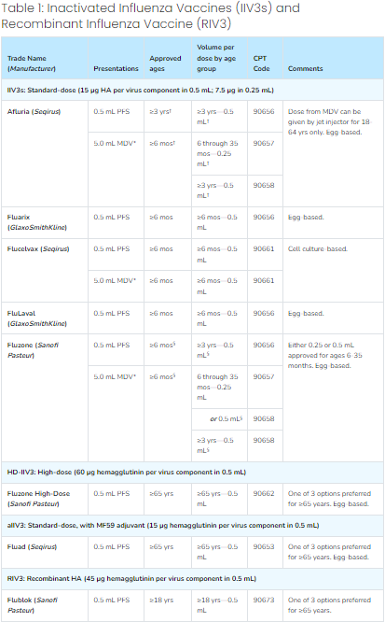
Flu Vaccinations and Recommendations
Flu seasons are counted from July 01 of one year through June 30 the following year (ie: the most recent season was July 01, 2023-June 30, 2024). However, peak flu activity is October-May, according to the CDC (CDC Flu Season)
The CDC recommends a flu vaccination for everyone over the age of 6 months in the United States (CDC Flu Recommendations)
  There are caveats to some recommendations based on patient immune or allergy response
There are a variety of Flu vaccines available with different formulas to accommodate age/immune/allergy needs (Immunization Recommendations)

Slide 5
CDC FluVaxView Rates 2020-2023
By Season
  The 18-64 year old rates are the lowest across all 3 seasons.
  6 month -17 years and 65+ years had higher rates, with the older group being the highest
By Age
  All of the age groups have remained relatively similar over all 3 years, respectively
  Rates by age decreased slightly from each Flu Season to the next

Slide 6
OSIIS Flu Rates 2022-2024
By Season
  Follows the same trends as the CDC rates
By Age
  Also follow the same trends as the CDC rates
Differences
  30-40% lower than CDC Estimates for the 2022-2023 Season (the only one shared between the CDC and OSIIS data collected
  No way to check most recent season against CDC numbers, since they haven’t published 2023-2024 yet

Slide 7
CDC FluVaxView Rates by County
Coverage Estimate 2018-19 (%) |  |  | Coverage Estimate 2019-20 (%) |  |  | Coverage Estimate 2020-21 (%)
Top Ten |  |  | Top Ten |  |  | Top Ten
Garfield County | 49.4 |  | Pontotoc County | 51.0 |  | Washington County | 48.0
Cleveland County | 48.1 |  | Grady County | 50.3 |  | Logan County | 47.2
Pottawatomie County | 48.0 |  | Blaine County | 50.3 |  | Noble County | 45.9
Washington County | 48.0 |  | Noble County | 49.5 |  | Cimarron County | 45.4
Canadian County | 47.0 |  | Kingfisher County | 49.2 |  | Pontotoc County | 45.2
Johnston County | 47.0 |  | Cimarron County | 49.1 |  | Roger Mills County | 44.8
McClain County | 46.8 |  | Grant County | 49.0 |  | Grady County | 44.6
Grant County | 46.6 |  | Cleveland County | 48.5 |  | Carter County | 44.1
Lincoln County | 46.5 |  | Oklahoma County | 48.1 |  | Pittsburg County | 43.9
Noble County | 46.5 |  | McIntosh County | 48.1 |  | Cleveland County | 43.7
Bottom Ten |  |  | Bottom Ten |  |  | Bottom Ten
Texas County | 35.7 |  | Texas County | 37.4 |  | Texas County | 26.2
Comanche County | 37.9 |  | Woodward County | 38.2 |  | Le Flore County | 32.3
Beaver County | 38.6 |  | Beckham County | 39.8 |  | Pushmataha County | 34.2
Beckham County | 39.3 |  | Caddo County | 40.5 |  | McCurtain County | 34.4
Kingfisher County | 39.8 |  | Seminole County | 41.7 |  | Seminole County | 34.5
Muskogee County | 39.8 |  | Sequoyah County | 42.1 |  | Adair County | 35.1
Cherokee County | 39.9 |  | Okmulgee County | 42.1 |  | Haskell County | 36.2
Ottawa County | 40.0 |  | Craig County | 42.1 |  | Atoka County | 36.2
Greer County | 40.3 |  | Bryan County | 42.6 |  | Beckham County | 37.0
Okfuskee County | 40.5 |  | Kay County | 42.6 |  | Wagoner County | 37.1
The top and bottom 10 Counties for Flu Vaccination rates fluctuates from year to year. There are a few that have remained constant.
Highest rates between 40% and 50%. Lowest rates between 26% and 43%
*CDC Rates by county only include ages 18+ and the most recent year included is Season 2020-2021

Slide 8
OSIIS Flu Rates by County
Coverage Estimate 2022-23 (%) |  |  | Coverage Estimate 2022-23 (%)
Top Ten |  |  | Top Ten
Oklahoma County | 35.2 |  | Oklahoma County | 34.9
Noble County | 29.7 |  | Custer County | 29.3
Craig County | 29.1 |  | Jackson County | 28.7
Custer County | 28.8 |  | Cherokee County | 28.1
Pontotoc County | 27.7 |  | Noble County | 27.9
Seminole County | 27.6 |  | Craig County | 27.5
Jackson County | 27.3 |  | Pontotoc County | 27.1
Stephens County | 27.2 |  | Seminole County | 26.6
Cherokee County | 27.0 |  | Stephens County | 26.1
Blaine County | 25.2 |  | Okfuskee County | 23.7
Bottom Ten |  |  | Bottom Ten
Osage County | 9.4 |  | Latimer County | 8.9
Latimer County | 9.2 |  | Atoka County | 8.0
McCurtain County | 8.9 |  | Hughes County | 7.4
Hughes County | 7.1 |  | Greer County | 7.1
Grady County | 7.0 |  | Grady County | 6.7
Wagoner County | 3.8 |  | Wagoner County | 4.2
Dewey County | 3.7 |  | Dewey County | 3.0
Washita County | 2.5 |  | Washita County | 2.4
Cimarron County | 1.3 |  | Cimarron County | 1.6
Roger Mills County | 0.3 |  | Roger Mills County | 0.3
The top and bottom 10 Counties for Flu Vaccination rates fluctuates from year to year. In OSIIS, the top and bottom counties remained mostly the same
Highest rates between 40% and 50%. Lowest rates between 26% and 43%
Compared to top 10 from CDC, OSIIS was 10-20% lower, and the same for the lowest 10
*Numerator is from OSIIS; denominator is from 2020 Census data for all OSIIS rates

Slide 9
COVID-19 Vaccine Updates
Margaret Archer, MPH
Notes:
Thank you Martin,
Good afternoon everyone! As I’m sure you’re aware, the COVID-19 vaccines for 2024-2025 have arrived and I have some updates to share with you today.

Slide 10
COVID-19 Vaccine Ordering in OSIIS
OSIIS offers all 6 Updated COVID-19 2024-2025 Vaccine formulations across all age groups.
The timeframe for providers to place orders is Tuesday through Monday.
The minimum order quantity for all vaccine presentations is 10 doses, except for Pfizer 6m-4yrs, which is 30 doses.
To minimize vaccine wastage, place smaller, more frequent orders, limiting quantities to an amount that can be utilized within 2 weeks.
Ensure you select the appropriate funding source (317 or VFC) before placing your order.
The estimated shipping timeframe for all vaccines ordered is 3-5 days.
Refer to the following links to ensure the proper administration, storage, and viability of vaccines.
  Moderna Expiry Lookup Tool
  Pfizer 6m-4y; 5-11y Formulation and Dosing Guide
  Pfizer COMIRNATY 12+ Formulation and Dosing Guide
  Pfizer COVID-19 Vaccines General Information
  Novavax Expiry Info
  Interim Clinical Considerations for Use of COVID-19 Vaccines in the US - CDC
Remember to regularly check the OSIIS homepage to stay informed on the latest news updates regarding COVID-19 Vaccines.
Notes:
The ordering process for covid vaccines in osiis has not changed significantly.
-OSIIS offers all 6 updated covid vaccine formulations across all age groups.
-The ordering time frame remains the same; all orders placed by close of business on Monday will be processed the following Tuesday.
-The minimum order quantity for all vaccine presentations is 10 doses, except for Pfizer 6m-4yrs, which is 30 doses.
-To minimize vaccine wastage, we are encouraging providers to place smaller, more frequent orders and limit quantities to an amount that can be utilized within 2 weeks.
-When placing your order, please ensure that you select the appropriate funding source: 317 or VFC
- And the shipping timeframe for vaccine orders is 3-5 days under normal circumstances. However, there is always the possibility of shipment delays, especially as we approach the winter season
I’ve included several links to more comprehensive informational guides and tools for your reference.
informed by regularly checking the OSIIS homepage for the latest updates on COVID-19 vaccines.
Utilize the following links to ensure the proper administration, storage, and viability of the vaccines you have ordered.
As a reminder, please remember to regularly check the OSIIS homepage for news updates related to COVID-19 Vaccines.
If anyone has any questions or concerns, please feel free to reach out to me directly, I will post my email address in the chat. Thank you!
The following updated 2024-2025 COVID-19 Vaccines are now available to order in OSIIS.
· COVID-19 (MOD) 12+yrs | SPIKEVAX 2024-25 12yr+(10x 0.5mL syringes)
· COVID-19 (MOD) 6m-11y | Moderna COVID 2024-25 6m-11yr (10x0.25mL syringes)
· COVID-19 (PFR) 12+yrs | COMIRNATY 2024-2025 12yr+ (10 x 0.3 mL syringes)
· COVID-19 (PFR) 5 thru 11y | Pfizer COVID 2024-2025 5-11yr (10 x 0.3mL vials)
· COVID-19 (PFR) 6m-4y | Pfizer COVID 2024-2025 6m-4yr (10 MDV)
· The minimum order quantity for all vaccine presentations is 10 doses, except for Pfizer 6m- 4yrs, which is 30 doses.
· Ensure you select the appropriate funding source (317 or VFC) before placing your order.

Slide 11
COVID-19 Vaccines Available in OSIIS
CVX | Name on OSIIS ordering page | NDC | Manufacturer | Doses per Package
308 | Pfizer COVID 2024-2025 6m-4yr (10 MDV) | 59267-4426-02 | PFIZER, INC. | 30
309 | COMIRNATY 2024-2025 12yr+ (10 x 0.3 mL syringes) | 00069-2432-10 | PFIZER, INC. | 10
310 | Pfizer COVID 2024-2025 5-11yr (10 x 0.3mL vials) | 59267-4438-02 | PFIZER, INC. | 10
311 | Moderna COVID 2024-25 6m-11yr (10x0.25mL syringes) | 80777-0291-80 | MODERNA | 10
312 | SPIKEVAX 2024-25 12yr+(10x 0.5mL syringes) | 80777-0110-93 | MODERNA | 10
313 | Novavax COVID-19 2024-2025 (10 x 0.5 mL syringes) | 80631-0107-10 | NOVAVAX | 10
Notes:
They are Grouped by CVX code and reflect the way the vaccines are listed on the COVID-19 Order form in OSIIS.
I'll give everyone a minute to review this, and today’s presentation slides will be shared so the information in this table will be readily available for your reference.

Slide 12
Novavax Shelf-Life Considerations
The initial expiration date on the current supply is October 31st, 2024.
Novavax is pursuing a shelf-life extension for this and future lots of vaccines and anticipates receiving monthly shelf-life updates throughout the COVID-19 vaccination season.
Given the current shelf life, the CDC will continue to distribute Novavax vaccine up until 18 days before expiry.
Before administering the vaccine, providers should utilize the Novavax Expiration Look-up Tool for the most up-to-date expiry information.
  This look-up tool will be accessible via a QR code located on the outer vaccine carton.
Notes:
(This information is also posted on the OSIIS News Homepage, for reference)
The initial expiration date on the current supply of the updated Novavax vaccine is October 31, 2024.
Novavax is working on extending the shelf life of current and future vaccine lots and anticipates monthly shelf-life updates throughout the COVID-19 vaccination season.
Given the current shelf life, the CDC will continue to distribute Novavax vaccine up until 18 days before expiry.
As a reminder, before administer the vaccine, be sure to utilize the expiration look up tool to minimize the risk of vaccine administration errors.
-the look up tool will also be accessible via a QR code located on the outer vaccine carton.

Slide 13
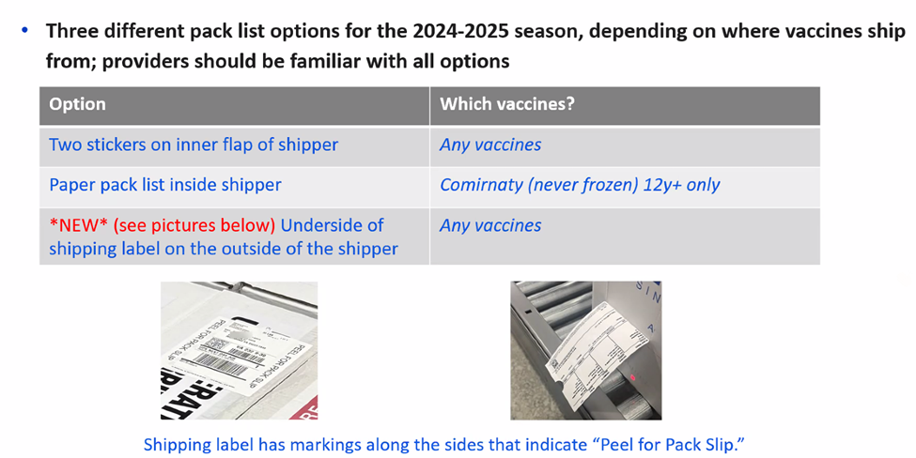
Pfizer Pack List Updates: Options
Notes:
Here are a few Pfizer Packing List Updates for this season.
There are three different options, depending on where vaccines ship from. (pause)
The chart presented here can help you familiarize yourself with the options, and again these slides will be shared so you can refer to this slide as needed.
Note that there is one new option, which is located on the underside of the shipping label outside the shipper. The shipping label has markings along the side, as shown in the photo.

Slide 14
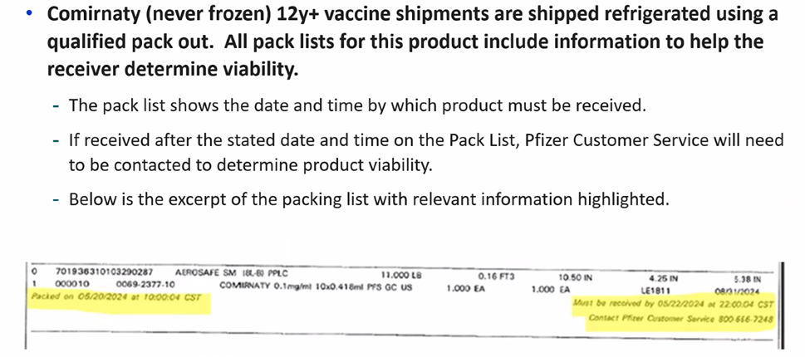
Pfizer Pack List Update: Comirnaty
Pfizer Customer Service: 1-800-879-3477 | Shipment Support: 1-800-666-7248
https://www.cvdvaccine-us.com/
Notes:
There is an additional pack list update for Comirnaty
The Comirnaty (never frozen) formulation shipments are shipped refrigerated using a qualified pack out. (pause)
All pack lists include information to help the receiver determine vaccine viability.
-The pack list shows the date and time the product must be received, and if the product is received after the stated date and time, Pfizer Customer Service will need to be contacted to determine viability.
Below is a (slightly blurry) photo of the packing list with the relevant information highlighted.
I’ve provided the Pfizer customer service contact information, as well as the link to the Pfizer Provider site.
If anyone has any questions regarding any of the information I’ve shared today, feel free to reach out to me directly. I will post my contact information in the chat. And with that, I’ll hand it on over to teja!

Slide 15
Vaccine updates
Sai Teja Paruchuri

Slide 16
Vaccine updates
Flu and RSV vaccines are now available to order in OSIIS for the 2024- 2025 season.
Flu vaccines are shipped as a priority hence vaccines will be delivered the same week they are submitted to CDC.
NDC's for flu are listed below.
NDC | Vaccine brand / Manufacturer | Age Indication
19515-0810-52 | Flulaval TIV (GSK) (0.5mL syr x 10) | 6 months and up
70461-0654-03 | Flucelvax TIV (Seqirus) (0.5 ml syr x 10) | 6 months and up
49281-0424-50 | Fluzone TIV (Sanofi Pasteur) (0.5ml syr x 10) | 6 months and up
66019-0311-10 | FluMist TIV (AstraZeneca) (Sprayer- 10 pack) | 6 months and up

Slide 17
VFC Beyfortus Vaccine information
Beyfortus® is used to help prevent a serious lung disease caused by Respiratory Syncytial Virus (RSV) in:
Newborns and babies under 1 year of age born during or entering their first RSV season
Children up to 24 months of age who remain at risk of severe RSV disease through their second RSV season
Prescribing information for Beyfortus- https://products.sanofi.us/beyfortus/beyfortus.pdf
NDC | Vaccine brand/ Manufacturer | Age indication
49281-0575-15 | Beyfortus/ Sanofi Pasteur ^{(50mg)} | 0- 24 months
49281-0574-15 | Beyfortus/ Sanofi Pasteur ^{(100mg)} | 0- 24 months

Slide 18
Recommended Dosage of BEYFORTUS for the Second RSV Season for Children Who Remain at Increased Risk for Severe RSV Disease
Recommended Dosage of BEYFORTUS for the First RSV Season
Body Weight at Time of Dosing | Recommended Dosage
Less than 5 kg | 50 mg by IM injection
5 kg and greater | 100 mg by IM injection
Child’s Age at Time of Dosing | Recommended Dosage
Up to 24 months of age | 200 mg administered as two IM injections of (2 x 100 mg)

Slide 19
Vaccine updates
Allocations for Td Vaccine: Td vaccine is still available to order but are under allocations put in place by CDC.
Vaccine Shipments:
Any issues with Over-shipments/ Mis-shipments/ Over-orders/ Delivery shortage/ Vaccine spoiled in transit, please report them on the same day to Vaccinehelp@health.ok.gov
For vaccines like MMRV/ Varicella, there is a date mentioned on the shipping label indicating that the vaccine should be received on or by that date or else the vaccine is nonviable.
Please check for that date when you are receiving the vaccine and report immediately to Immunization Services.
Do not reject any vaccine shipments because they are delayed in transit. Accept the shipment and reach out to either your IFC or Vaccinehelp@health.ok.gov so we can report the issue to Mckesson/ Merck accordingly.

Slide 20
Vaccine returns
Once vaccines in your inventory are spoiled/ expired, please submit a return in OSIIS to send the vaccines back to McKesson. Vaccines that are full/ unopened boxes and opened boxes, unopened vials, pre-filled syringes can be returned. This includes:
Routine VFC/317/state vaccines
Flu vaccine
COVID-19 vaccine shipped from Mckesson
Direct-ship vaccine from Merck
Direct-ship COVID-19 vaccine from Pfizer
The best practice is to create a return in OSIIS as soon as the vaccines are expired. Once the returns are processed, you will receive a return label either through email or mail based on the label shipping method you choose.
As soon as you receive a return label, sort the vaccines by NDC, ensure that the vials don't break during shipping: use a bubble wrap/ packing paper; ship the vaccines within 30 days after receiving shipping labels.
Never discard expired vaccine that can be returned to Mckesson.
Please wait until the vaccine is expired to submit a return in OSIIS.

Slide 21
LIFE AS AN IFC
DAILY DUTIES​
​
BY LISA JAMISON, IFC for DELAWARE, NOWATA, OTTAWA, ROGERS AND TULSA COUNTIES​
​

Slide 22
Orientation/Enrollment:
Review Staff roles and responsibilities to the VFC Program such as:
Review what VFC is and the Benefits.
What requirements to meet for eligibility of patient
VFC Staff requirements:
  Temp logs sent by 5th of every month
  You Call the Shots Training on CDC or Monthly Provider Call with OSDH, yearly
  Documentation of Immunizations in OSIIS
  Monthly Reconciliations
  Returns of Vaccines
  Temp Excursions – Human error to Natural Disasters
  When to notify IFC: Address Change, Excursion, Staff Changes
  DDLs, Proper Storage Units
  Explains the QA and unannounced process

Slide 23
Quality Assurance visits are conducted every 2 years at all VFC sites which include:
  Current Key Staff; changes reported
  Check temps of units
  Check that signage is in place such as over outlets; breaker boxes
  Proper Vaccine labeling; VFC differ from Private
  Check for expired vaccine
  Staff understands the eligibility requirements of VFC vaccine
  Emergency Management Plan
  No borrowing from one funding to another
  Ensure all documentation is kept for 3 years
  Proper Units are utilized for storage of vaccine
  Emergency transport of vaccine
  Calibration of DDLs are current

Slide 24
Unannounced visits are conducted on the off years of a Quality Assurance visit pertaining to Storage and Handling such as:
  Temperatures
  Storage Units
  Expired vaccine
  Signage in place
  Calibration Certificates current
  Documentation of Temperatures
  Key Staff Changes
  Vaccines are stored and labeled properly
  Documentation of Shipping labels, Temp logs and VSIRs are kept 3 years

Slide 25
IFCs assist Clinics who are withdrawing from the VFC program:
  Assist with vaccine relocation, if needed
  Close out the VFC Pin Number
  Removing Users from OSIIS access
  Document in OSIIS, Sharepoint and CDC website that this site is no longer a VFC Vaccine Provider.

Slide 26
IFCs behind the scene duties:
  Assist all Staff with concerns/issues in OSIIS
  VFC vaccine issues: delivery, ordering, returning
  Assist with documentation errors
  Educate new staff as needed
  Assist with deliveries received with temps out of range
  Answer all calls and emails promptly
  We enter all visits into the CDC website
  Upload all temp logs, Provider Update forms and various other forms into Sharepoint
  Excel sheet for VSIR documentation and tracking
  Password resets
  Assist with new OSIIS users and updating previous users information
  Thank you!!

Slide 27
FLU
  Dr. India G. Scales, PharmD
  Medical Science Liaison
  AstraZeneca Pharmaceuticals
​

Slide 28
Questions/Suggestions
Looking Forward:
Discuss a topic that interests you
Next Call:
January 10, 2025 at 12pm

