Slide 1
Transmission Based Precautions
Notes:
Good Morning and thank you for taking the time out of your busy schedule to join us today.
My name is Trina White. I am a LTC Infection Preventionist for the Oklahoma State Department of Health.
I have Rhonda McComas, our Lead LTC Infection Preventionist here with me as our co-host.
Today we will be talking about Transmission Based Precautions. I’m sure this will likely be a review for most all of you and won’t take the whole hour, but I did want to make sure there is time at the end to address any questions you may have. You are welcome to put your questions in the chat or you mail email them to HAI@health.ok.gov if that is your preference.

Slide 2
What are Transmission Based Precautions?
Transmission based precautions are the second tier of basic infection control and are to be used in addition to standard precautions for patients who may be infected or colonized with certain infectious agents for which additional precautions are needed to prevent infection transmission.
.
Notes:
Remember: Standard precautions are used for all patient care.
They make use of common-sense practices and personal protective equipment use that protect healthcare providers from infection and prevent the spread of infection from patient to patient.

Slide 3
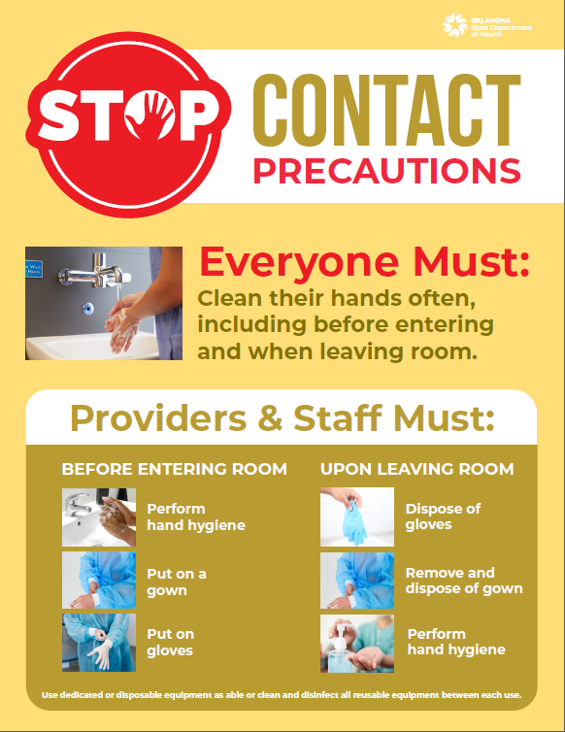
Contact Precautions
Use contact precautions for patients with known or suspected infections that represent an increased risk for contact transmission.
Methods used to contain diseases that are spread by: ~ Direct Contact: Contact with the patient ~ Indirect Contact: Contact with the patient’s environment
      Ensure appropriate patient placement.
      Use personal protective equipment (PPE) appropriately.
      Limit transport and movement of patients.
      Use disposable or dedicated patient care equipment.
      Prioritize cleaning and disinfection of the rooms.
Notes:
Transmission Based Precautions signage available at:
https://oklahoma.gov/health/health-education/acute-disease-service/healthcare-associated-infections-prevention-program.html

Slide 4


Contact Precautions
Gown and gloves at entry point, before contact with a patient or patient’s environment potentially contaminated objects:
– objects, such as tray tables and bedrails
– medical equipment (i.e., Blood pressure cuff)
Dedicated patient equipment is preferred
PPE removed at the point of exit with prompt hand hygiene
Notes:
Adobe File # 331828178

Slide 5
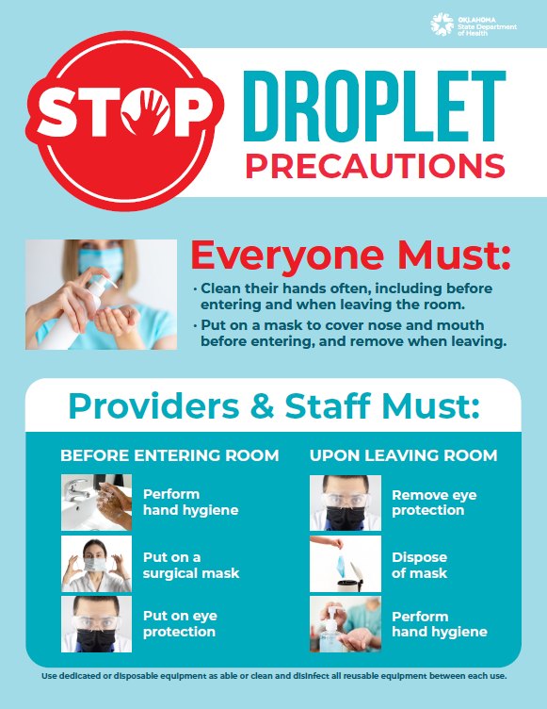
Droplet Precautions
Use droplet precautions for patients known or suspected to be infected with pathogens transmitted by respiratory droplets that are generated by a patient who is coughing, sneezing, or talking.
~ Use source control.
~ Ensure appropriate patient placement.
~ Use personal protective equipment (PPE) appropriately.
~ Limit transport and movement of patients.
Notes:
Transmission Based Precautions signage available at:
https://oklahoma.gov/health/health-education/acute-disease-service/healthcare-associated-infections-prevention-program.html

Slide 6

Droplet precautions
Prevents transmission of diseases spread by large respiratory droplets through coughing, sneezing, or talking.
Some examples of conditions requiring droplet precautions include:
  Seasonal Influenza
  B. Pertussis
  Group A Streptococcus (strep throat)
  Adenovirus
  Rhinovirus
Guideline for Isolation Precautions: Preventing Transmission of Infectious Agents in Healthcare Settings (2007) (cdc.gov)
Notes:
Adobe file # 331027100

Slide 7
Droplet Precautions
A face mask is worn upon entry into the patient room.
Use standard precautions when handling items contaminated with respiratory secretions.
PPE must be removed at the point of exit; do not reuse face masks.
Hand hygiene follows PPE removal.

Slide 8
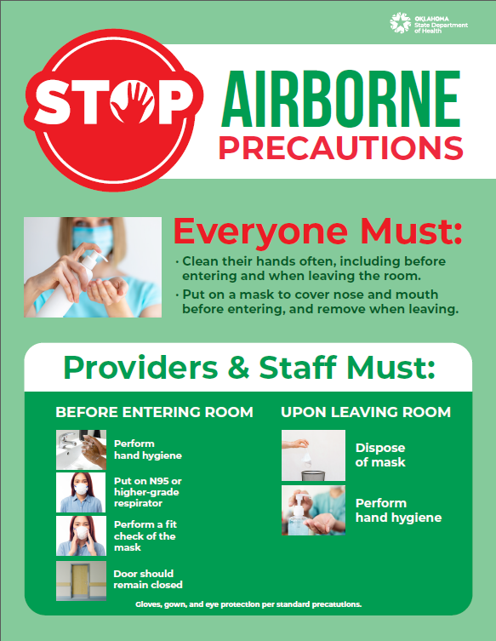
Airborne precautions
Prevents transmission of infectious agents that are very small and remain viable and suspended in the air over long distances.
Use airborne precautions for patients known or suspected to be infected with pathogens transmitted by the airborne route.
~ Source control
~ Ensure appropriate patient placement in an airborne infection isolation room.
~ Restrict susceptible healthcare personnel from entering the room.
~ Use personal protective equipment (PPE) appropriately.
~ Limit transport and movement of patients.
~ Immunize susceptible persons as soon as possible following unprotected contact.
Notes:
Transmission Based Precautions signage available at:
https://oklahoma.gov/health/health-education/acute-disease-service/healthcare-associated-infections-prevention-program.html

Slide 9
Things to remember with isolation patients/rooms:
Isolation signage should be present at entry.
PPE supplies should be well-stocked and easy to access prior to room entry.
Multi-use Medical equipment (i.e., stethoscopes, BP cuffs, etc.) should be dedicated to isolation patient(s).
Alcohol- Based Hand Sanitizer (ABHS) should be readily available for personnel to clean their hands.
Isolation signage should remain in place until after terminal cleaning has been completed by environmental services (EVS) personnel.
Limit transport and movement of patients outside of the room to medically-necessary purposes. (When transport or movement is necessary, ensure the infected or colonized areas of the patient’s body are contained and covered).
Notify accepting facilities and the transporting agency about suspected infections and the need for TBP when patients are transferred.
Notes:
I would also like to remind you / make you aware of CDC’s Appendix A.

Slide 10

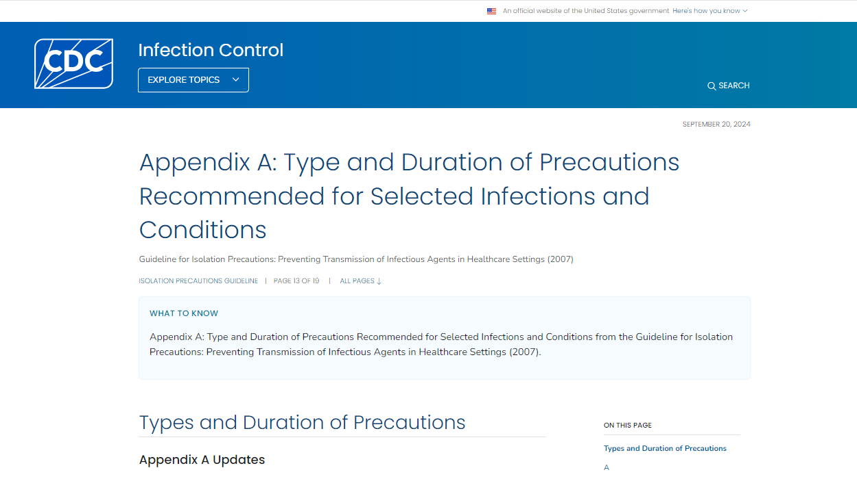
Notes:
In case you aren’t aware, CDC’s Appendix A is a valuable tool you can utilize for Type and Duration of Precautions.

Slide 11

Knowledge Check
Notes:
Adobe File #571720200

Slide 12
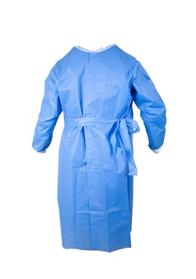
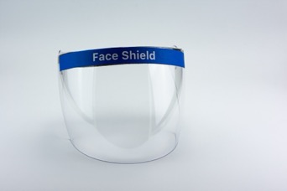
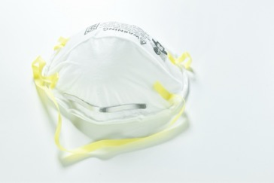
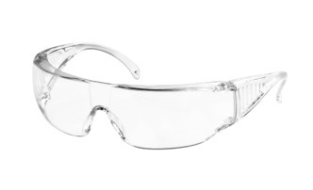
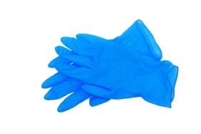
Question #1
Which PPE would you need for COVID isolation room? (Select all that apply)
Gloves
Gown
Eye protection
Respirator (N-95)
All the above
Notes:
Feel free to drop your answer in the chat
Adobe file # 341526820, 319708990, 40921464, 335461172, 482244017, and 329132515

Slide 13
Correct answer:
E. All the above
HCP who enter the room of a patient with suspected or confirmed
SARS-CoV-2 infection should adhere to standard precautions and use:
      use a niosh-approved N95 or equivalent or higher-level respirator
      gown
      gloves
      eye protection
(i.e., Goggles or a face shield that covers the front and sides of the face).
https://www.cdc.gov/covid/hcp/infection-control/index.html

Slide 14

Question # 2
Name one example of a disease requiring airborne precautions.
Notes:
Adobe file # 563280055

Slide 15
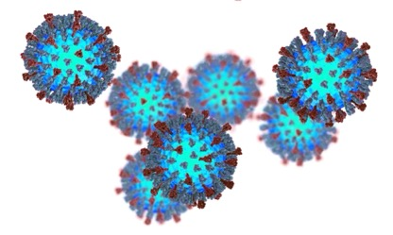

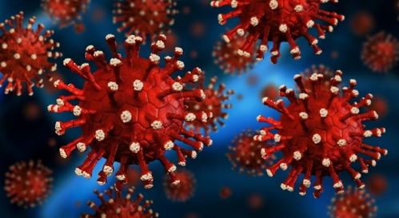
ANSWER(S):
Measles
M. Tuberculosis
Chicken pox
Notes:
Adobe image # 165314477, # 563280055, and # 264838878

Slide 16
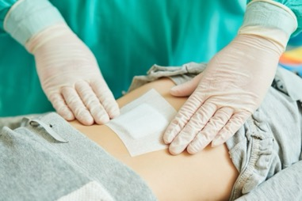
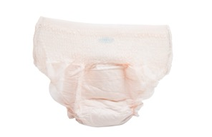


Enhanced Barrier Precautions
What are enhanced barrier precautions?
Enhanced barrier precautions are an infection control intervention designed to reduce transmission of multidrug-resistant organisms (MDRO) in nursing homes.
Enhanced barrier precautions involve gown and glove use during high-contact resident care activities for residents known to be colonized or infected with a MDRO as well as those at increased risk of MDRO acquisition.
Frequently Asked Questions (FAQs) about Enhanced Barrier Precautions in Nursing Homes | LTCFs | CDC
Notes:
These next few slides will provide a little recap, in case you missed the last webinar, which covered EBP.
The recording can be found on the HAI webpage.
Adobe file # 195214603, #409357333, #272572073, and #471882186

Slide 17
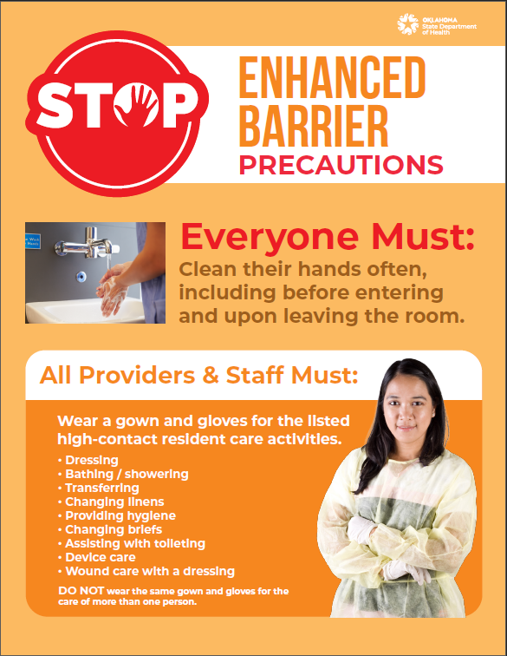
Enhanced Barrier Precautions
Expand the use of PPE and refer to the use of gown and gloves during high-contact resident care activities that provide opportunities for transfer of MDROs to staff hands and clothing.
Examples of high-contact resident care activities requiring gown and glove use for enhanced barrier precautions include:
~ Dressing
~ Bathing/showering
~ Transferring
~ Providing hygiene
~ Changing linens
~ Changing briefs or assisting with toileting
~ Device care or use: central line, urinary catheter, feeding tube, tracheostomy/ventilator
~ Wound care: any skin opening requiring a dressing
Notes:
Transmission Based Precautions signage available at:
https://oklahoma.gov/health/health-education/acute-disease-service/healthcare-associated-infections-prevention-program.html

Slide 18
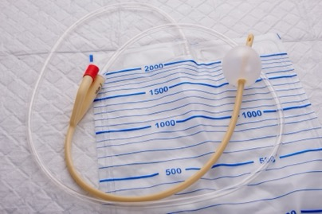
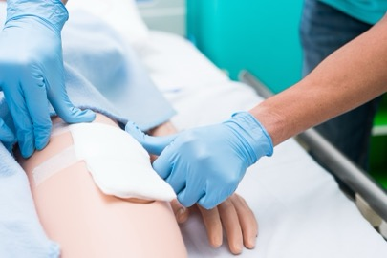
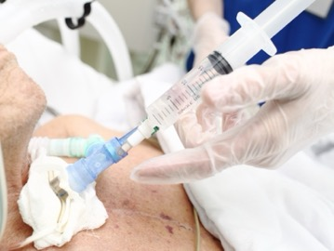
DID YOU KNOW?
Enhanced barrier precautions are recommended for residents with indwelling medical devices or wounds, who do not otherwise meet the criteria for contact precautions, even if they have no history of MDRO colonization or infection and regardless of whether others in the facility are known to have MDRO colonization.
This is because devices and wounds are risk factors that place these residents at higher risk for carrying or acquiring a MDRO and many residents colonized with a MDRO are asymptomatic or not presently known to be colonized.
https://www.cdc.gov/hai/containment/faqs.html
Notes:
Transmission Based Precautions signage available at:
https://oklahoma.gov/health/health-education/acute-disease-service/healthcare-associated-infections-prevention-program.html
Adobe file #211771688 (already on slide), #170040521, and #76630123

Slide 19
Summary:
Contact Precautions – gloves and gown
Droplet Precautions – mask, gloves, and eye protection
Airborne Precautions – Fit tested N-95 or higher
Enhanced Barrier Precautions – gloves and gown
~ Transmission-based precautions include contact, droplet and airborne isolation in general.
~ Appropriate PPE is based upon how an organism can be transmitted.
~ Standard precautions should be used for ALL patients in addition to their transmission-based precautions.

Slide 20
Resources:
Transmission-Based Precautions | Infection Control | CDC
Guideline for Isolation Precautions: Preventing Transmission of Infectious Agents in Healthcare Settings (2007) (cdc.gov)
https://www.cdc.gov/covid/hcp/infection-control/index.html
https://www.cdc.gov/infection-control/hcp/isolation-precautions/appendix-a-type-duration.html
Frequently Asked Questions (FAQs) about Enhanced Barrier Precautions in Nursing Homes | LTCFs | CDC
TBP and EBP signage available at:
https://oklahoma.gov/health/health-education/acute-disease-service/healthcare-associated-infections-prevention-program.html

Slide 21

Questions?
Infectious Disease Prevention and Response
HAI/AR Program
405-426-8710
HAI@health.ok.gov
Notes:
Adobe File #67702018

Slide 22
Thank You!
Notes:
As a reminder, our next topic will be Droplet Precautions on Oct. 30, 2024, at 11:00am. We hope to see you there! Have a great rest of your day.

