Slide 1


April 2nd, 2026
Elevator Summit

Slide 2
Welcome 2026 Participants
Union Reps
IEUC Local – Steven McAnelly, Graham Moore, Brandon Frazier
Elevator/Inspection Companies
American Elevator – Brandan Stout
D&D Elevator – Stephen Sharp
Oklahoma Elevator Inspection Services – Dave Muck
Quality Elevator Inspections – Clay Brantley
Safe Ride Elevator Escalator Inspections LLC – Eddie Wayne Eaton
TK Elevator Corporation – Kevin Richter, Erin Shurley, Matt Bishop, Mike Burns, Mark Fritzler
Tower Solutions Inc. – Drew Rhodes
Reliant Elevator Inspections & Consulting – John Fricke, Shari Fricke

Slide 3
Welcome 2026 Participants
Government
Oklahoma City-County Health Dept – Anna Grilley
Education
Oklahoma State University – Gerald Petre
Construction
Locke Construction Services – Rylan Davenport
Property Management
Oklahoma Property Investors – Kelly Baker

Slide 4
Agenda
Introductions
Program Updates
Statistics
Current Codes
Administrative Rules
Statewide Variances
Contractors Notice
Inspectors Notice
Code Updates
Closing

Slide 5

Labor Commissioner
Leslie Osborn

Slide 6

Jim Williams​
Director, Safety Standards Division SSD James.Williams@labor.ok.gov
Office - (405) 522-5379 ​
Cell - (405) 249-1769
Carrie Wasser
SSD Administrative Supervisor
Carrie.Wasser@labor.ok.gov
Office – (405) 521-6569
Shelly Abernathy
SSD Program Administrator
Shelly.Abernathy@labor.ok.gov
Office – (405) 521-6574
Notes:
Point out that Rhonda and Shelly are administrators from other programs. The sheer volume of work for the Boiler Program is tremendous

Slide 7







Program Updates –
Elevator Program Staff
Neal Petersen
Chief Elevator Inspector
Shelly Abernathy
Program Administrator
Joshua Barton
Deputy Inspector
Dalton Frye
Deputy Inspector
Dylan Grensky
Deputy Inspector
Zac McElyea
Deputy Inspector
Jacob Boston
Deputy Inspector
Notes:
Ralph has been out on medical leave

Slide 8

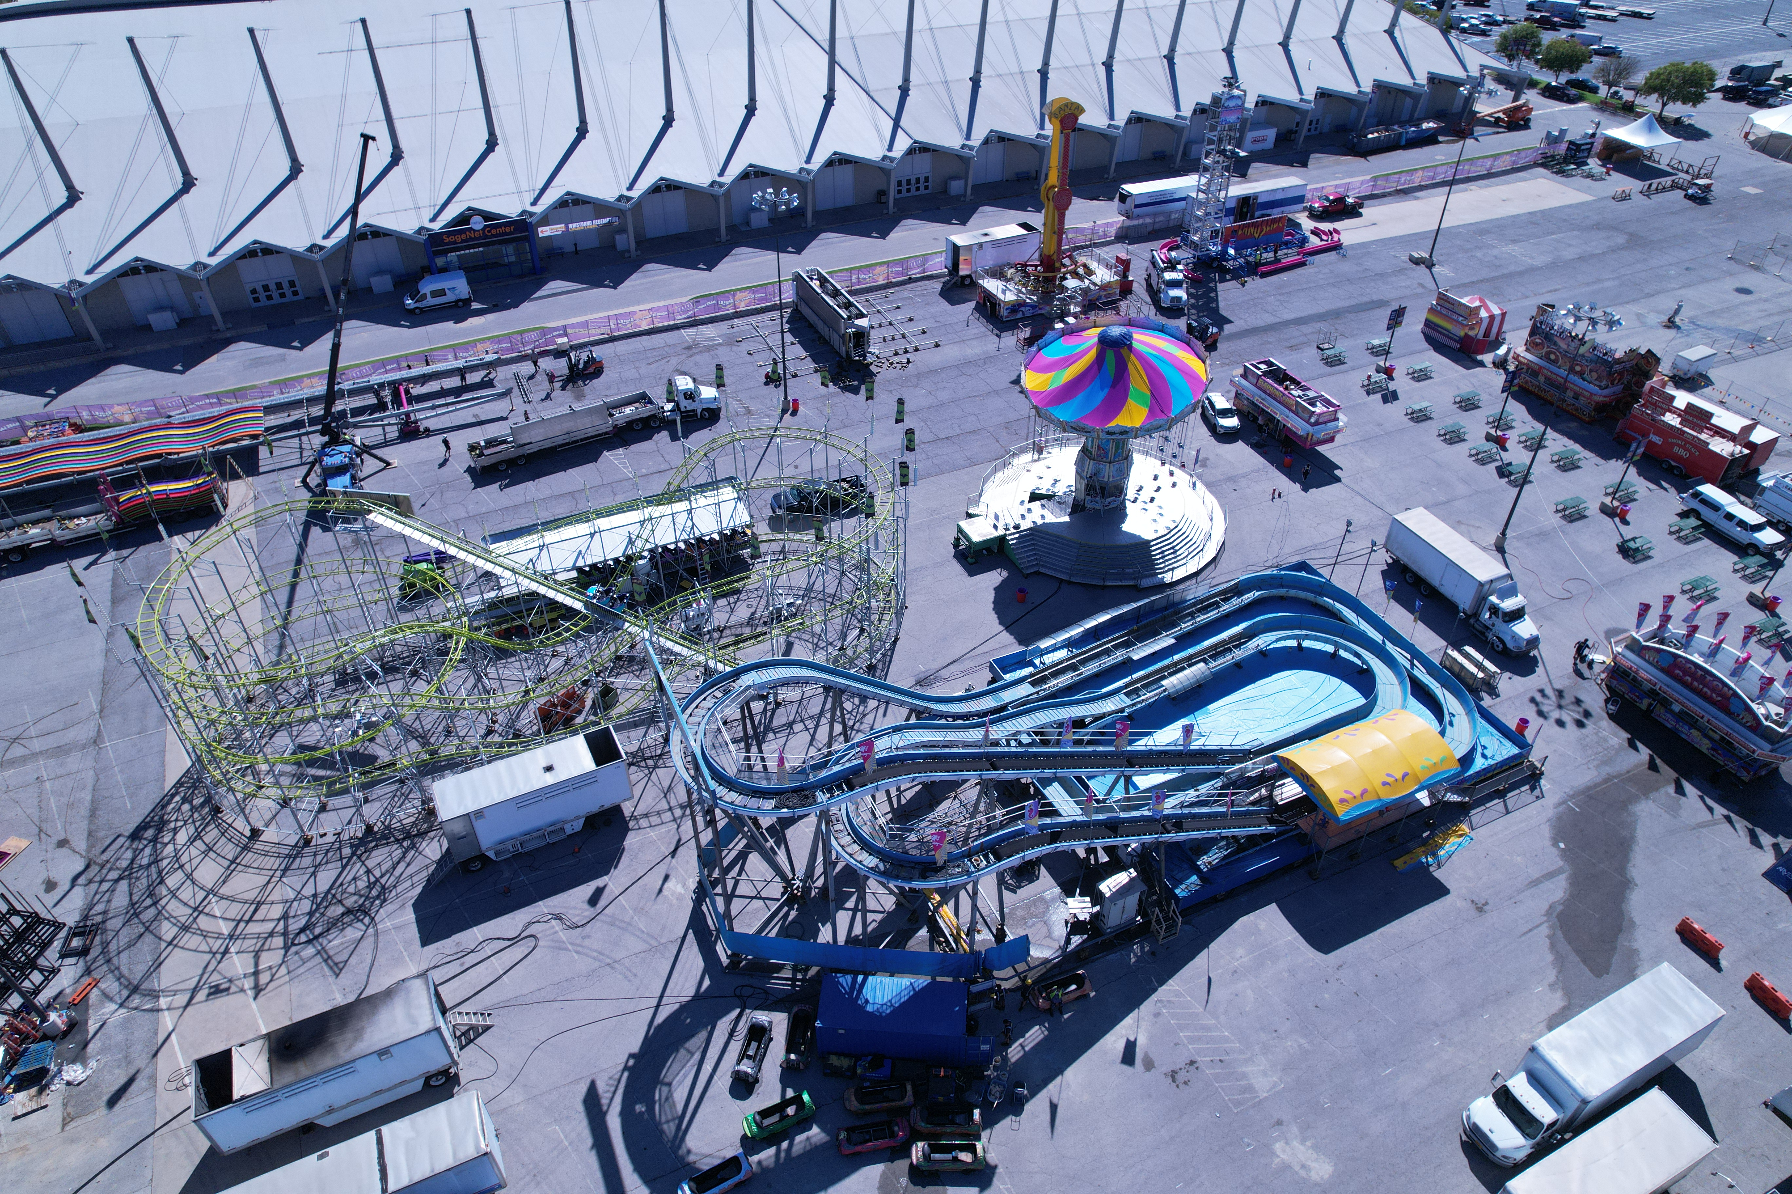
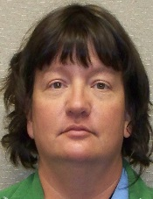
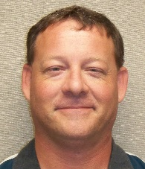

Program Updates –
Elevator Inspector Staff
Allen McElyea, Chief Amusement Ride Inspector Deputy Elevator Inspector
Michelle Field, Deputy Inspector
Mark Morris, Deputy Inspector
Cade Johnson, Deputy Inspector

Slide 9
Program Updates - ​Elevator Inspector Regions ​
​

Slide 10
Elevator Program Statistics through March 2026
Licensed Elevators, Escalators, and Other Devices:
· Passenger Elevators …………………………………………………………………..…………6,141
· Escalator/Moving Walkways ……………………….….…………….………………….……......... 160
· Freight Elevators …………………………………………………………………………….……189
· Temporary/Construction Elevators ……………………………………………………………….. 2
· Limited Use/Limited Application (LU/LA).…………...………….……………………………….... 69
· Platform Lifts …………………………………….…………………………….…………….…….404
· Material Lifts ………………………………………………………………………………………. 2
· Stage Lifts…………………………………………………………………………………………… 1
· Stairway Chairlifts .………………………………………………………………………………… 89
TOTAL: 7,057

Slide 11
Elevator Program Statistics – Inspections
· Inspections Completed ………………………………………………………….................. 5,207
· Re-inspections Completed………………………………………………...………................ 843
· Certificate of Operations Issued …………………………………………….…………….4,892
· New Installations…………………………………………………………………………… 231
TOTAL: 11,173
Violations Cited …………………….………………………………………………………. 8,615

Slide 12
Elevator Program Statistics – Current Active Licenses
· Elevator Mechanic’s Apprentice………………………………………….……………….......... 66
· Elevator Mechanic ………………………………………………………………...…………. 293
· Elevator Contractor ……………………………………………………………...………….....42
· Elevator Inspector ……………………………………………………………………………..37
· Elevator Witness Inspector ………………………………………………………………...........1
TOTAL: 439

Slide 13
Program Updates – Current Events
ODOL is operating with very limited staff
ODOL Elevators is getting new data system by the end of the year!
City of Oklahoma City has updated their codes/standards to the state requirements
Discussions underway for acceptance of Henning weightless testing system
State of Emergency for mechanics – ODOL allowing emergency licensing provisions
ODOL considering our policy on adopting new codes
Notes:
Point out that Rhonda and Shelly are administrators from other programs. The sheer volume of work for the Boiler Program is tremendous

Slide 14

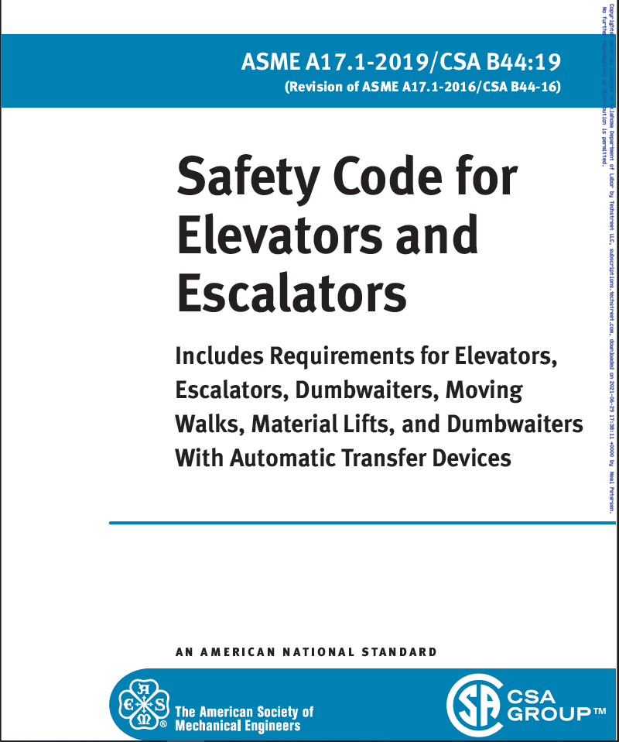
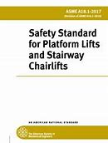

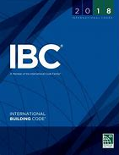
Current Adopted Codes
Safety code for elevators and escalators - ASME A17.1 (2022)
Guide of Inspecting Elevators and Escalators - ASME A17.2 (2023)
Safety code for existing elevators and escalators
(requirements for electric and hydraulic elevators and escalators) - ASME A17.3 (2020)
Elevator suspension guidelines - ASME 17.6 (2017)
Qualified Elevator Inspector guidelines - ASME QEI-1
Safety standards platform and chairlifts - ASME A18.1(2020)
Safety requirements for personnel hoists and employee elevators (ANSI/ASSE) 10.4 (2016)
Gas-powered construction elevators - ANSI 92.10 (Current Edition)
Accessible and Usable Building and Facilities - ANSI A117.1 (Current Edition) (2009)
National Electrical Code - National Fire Protection Association (NFPA) 70 (2023)
International Building Code (IBC) (2018)
International Plumbing Code (IPC) (2018)
International Mechanical Code (IMC) (2018)
Field Employee Safety Handbook (2025)
American National Standards for Transport Platforms, ANSI/SIA A92.10-2009
Oklahoma Administrative Code (OAC) 380:70-3-4(a)

Slide 15
ADMINISTRATIVE ISSUES
-- 3RD Party inspection reports being received with our old address. Please update your
records to reflect our new address: 409 NE 28th St., 3rd Floor, OKC 73105
-- Maintaining records within the MCP at the locations. All tests, alteration/repair permits should be kept.
-- It is good practice to get documentation such as test reports or inspection reports from the location if possible.

Slide 16
ADMINISTRATIVE ISSUES, Continued
-- ODOL made changes to the Elevator Safety Act rules in September 2022:
Definitions- Certificate of Operation, temp changed from 30 days to 60 days [OAC 380:70 Definitions]
Locations Certificate of Operation, to be posted conspicuously In-car or main lobby near adjacent to elevator call station [OAC 380:70-3-8(d)]
Escalator Certificate of Operation, shall be displayed at the base of balustrade at lower level [OAC 380:70-3-8(d)]
Inspectors shall submit reports of inspection to the Department within 30 days changed to within 7 days of the completion of the inspection. [OAC 380_70-11-2(b)]
Report of inspection/test reports shall be provided to owner/operator, contractor or his/her authorized agent changed from 30 days to 7 days. [OAC 380:70-11-2(c)]

Slide 17
ADMINISTRATIVE ISSUES, Continued
-- Upcoming ODOL Changes to the Elevator Safety Act Rules
380:70-5-3. Elevator Inspector's License: Issuance, denial, and renewal
(b) Elevator Certificate Inspector.
(1) Have at least two (2) years of experience as a licensed elevator
witness inspector for elevators, escalators and other such
conveyances; or An individual who has held an elevator mechanic’s
license issued by this department.

Slide 18
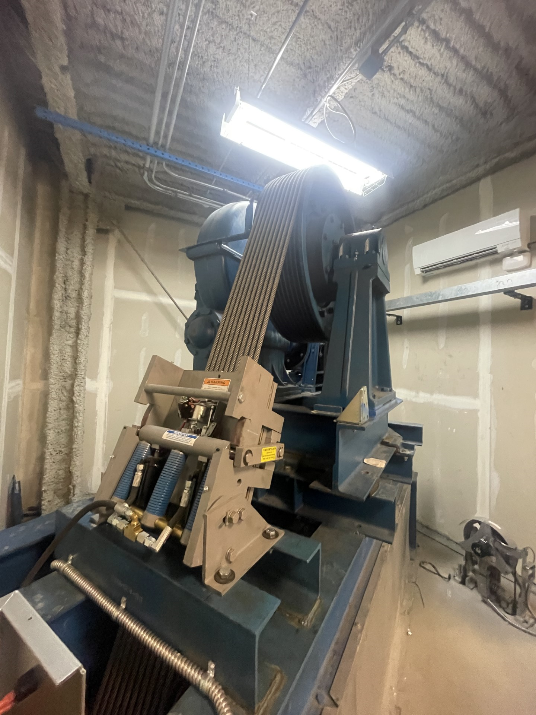
Variance
The Oklahoma Department of Labor (ODOL) has determined that the recently adopted 17.3 code requiring all traction elevators to be provided with means of Emergency Brake, Ascending Overspeed and Unintended Car Movement protection will not be immediately enforced in Oklahoma.
Instead of immediately enforcing the new requirements, ODOL will require that all elevators be brought into compliance by July 1st, 2030.
All elevator owners are hereby required to submit to the Department of Labor a letter of intent, when the updates will be installed on the elevator(s) to bring the elevator(s) into compliance.

Slide 19
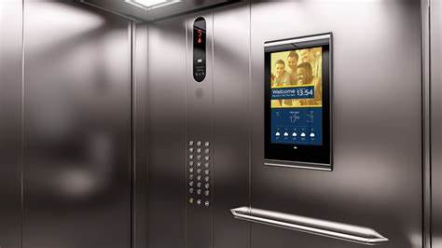
Variance Continued
Elevator Code Variance -
Hearing Impaired Requirements for Elevator Installations/Modernization
With the adoption of ASME 17.1-2022, effective July 1, 2024, the Oklahoma Department of Labor has determined that the elevator communication device for the hearing impaired, as added in ASME 17.1-2019 (ASME 17.1-2.27.1.1.3 Hearing Impaired & IBC 3001.2), will not be enforced on existing elevator installations and modernization projects in Oklahoma until further notice.
Enforcement of this new requirement will resume at a later date, following further review and industry notice.

Slide 20
ContractorS Notice
New installations the installing contractors shall submit detailed plans including code year, references and specification, and bearing a seal of a registered professional engineer familiar with elevators and conveyances. Without these three requirements included the requested permit will be denied
All elevators and conveyances subject to the provisions of the Elevator Safety Act shall have a Maintenance Control Program (MCP) provided by a licensed elevator contractor that conforms to A17.1-8.6 and the Elevator Safety Act (OAC 380:70-11-13)
NTSD Hydraulic test will be full load up and down

Slide 21
Inspectors Notice
Inspectors are responsible for reporting on inspections regarding of the unit “as found” at time of the inspection, without consideration of cost and inconvenience that may be caused as a result of the inspection.
Inspectors should NOT continue to issue a passing inspection of reoccurring violations. The acting inspector has the responsibility to verify every inspection within the code.
*Inspectors shall submit inspection reports soon thereafter, but no longer than 7 days following the completed inspection 380:70-11-1 Elevator Safety Act. Validate the person responsible, name, address, e-mail address, phone number and building location address.

Slide 22
INSPECTORS NOTICE
Inspectors shall refrain from inspecting elevator(s) or conveyance that are operating on a Temporary Certificate of Operation issued by the Department, until all violation(s) listed have been corrected and verified by the assigned inspector.
Inspectors performing a construction only elevator inspection shall inform the Department prior to the inspection.
Inspector shall provide:
Date of inspection
Location
Contractor
Permit number
Inspection and test reports

Slide 23
INPSECTORS NOTICE
Performing category 1, 3, 5 test, must meet or exceed the Department testing standard.
The Certificate of Operation shall be conspicuously displayed in, upon or adjacent to the conveyances for public viewing 380:70-3-8**
Inspectors shall note on inspection reports that electric elevators must comply with 17.3-2020- Elevators to be provided with means of Emergency Brake, Ascending Overspeed and Unintended Car Movement protection by July 1st 2030
*Certificate, shall be displayed In-Car or Main Lobby near elevator.
*Escalator Certificate shall be displayed at the base balustrade at the lower level

Slide 24
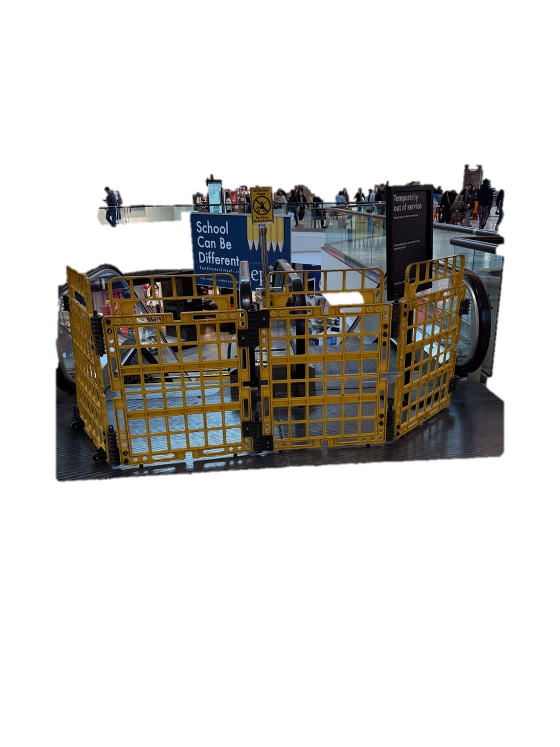
Escalators As Egress
A17.1-2022 code (section 17.1-8.6.11.6.1(b) Stopped escalators shall NOT be used as a means of
access or egress by nonauthorized personnel and shall be
properly barricaded if accessible to the general public to
prevent such use.

Slide 25
Code Updates
Door lock monitoring
Illumination of hoistways
Phase II Flashing hat
Counterweight Overbalance
System to Monitor and Prevent Automatic Operation of the Elevator With Faulty Door Contact Circuits
Aprons (Alterations)
Sump Pump Wiring
Guarded Pit ladders

Slide 26

Door lock Monitoring
8.6.4.24 System to Monitor and Prevent Automatic
Operation of Passenger and Freight Elevators with
Faulty Door Contact Circuits. All automatic passenger
and freight elevators shall comply with 2.26.5.

Slide 27
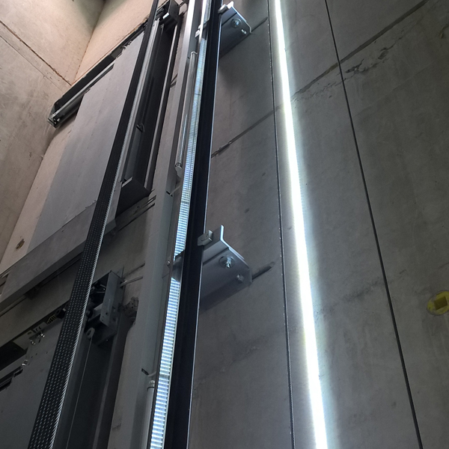
17.1-2022
2.1.7 Illumination of hoistways
Code requires light switches located within the hoistway enclosure and accessible from the pit access door and the top landing. Code also requires an automatic means of control that overrides the light switches, and that will cause the hoistway illumination to turn on when Hoistway access, Inspection operation, or Firefighters’ emergency operation are on enabled or in effect.
Hoistway lighting will be allowed to be wired in a permanently on manner, without the use of light switches at the top and bottom of hoistway, and without being connected to the elevator controller.

Slide 28
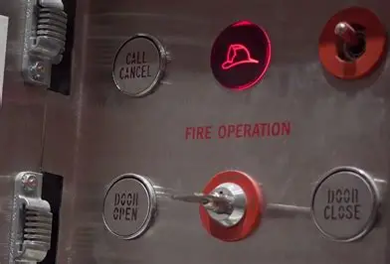
17.1 – 2022
2.27.3.2.6 Flashing Hat
When Phase I Emergency Recall Operation is initiated by a fire alarm initiating device for any of the following locations, as required by 2.27.3.2.3 or 2.27.3.2.4, the visual signal [see 2.27.3.1.6(h) and Figure 2.27.3.1.6] shall illuminate intermittently only in a car(s) with equipment in that location:
(a) machine room
(b) machinery space containing a motor controller or
driving machine
(c) control room
(d) control space
(e) hoistway
If the fire alarm system that includes the fire alarm initiating devices in (a) through (e) is reset, the visual signal [see 2.27.3.1.6(h)] shall not change from illuminating intermittently to illuminating continuously.

Slide 29
Counterweight overbalance
17.1-8.10.2.2.3 (K)
Where applicable, the percent counterweight overbalance
shown on or adjacent to the crosshead data plate
shall be verified by one of the following methods:
(1) placing weight inside the car until it balances the
counterweight (for 2:1 roping, the car and counterweight
sheaves need to be at the same vertical height)
(2) weighing the counterweight and then weighing
the car with the appropriate weight inside the car
(3) using the motor drive data information

Slide 30
MRL control space
illumination at landings
2.11.10.2 Illumination at Landing Sills. The illumination at the landing sills, when an elevator is in service, shall be not less than 100 lx (10 fc).
2.7.9.1 Lighting. Permanently installed electric lighting shall be provided in all machinery spaces,
machine rooms, control spaces, and control rooms. The illumination shall be not less than 200 lx (19 fc) at the floor level,

Slide 31
Door Monitoring
17.3-3.10.12 System to Monitor and Prevent Automatic
Operation of the Elevator With Faulty Door
Contact Circuits
Means shall be provided to monitor the position of
power-operated car doors that are mechanically
coupled with the landing doors while the car is in the
landing zone, in order

Slide 32
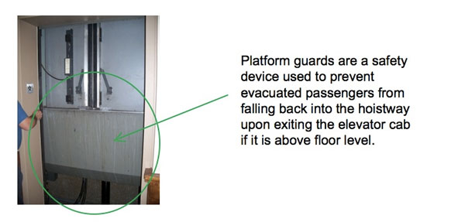
Aprons Alterations
Electric Elevators
Car platform guard (apron) shall conform to 2.15.9 (48”)
only to the extent the existing pit shall permit,

Slide 33
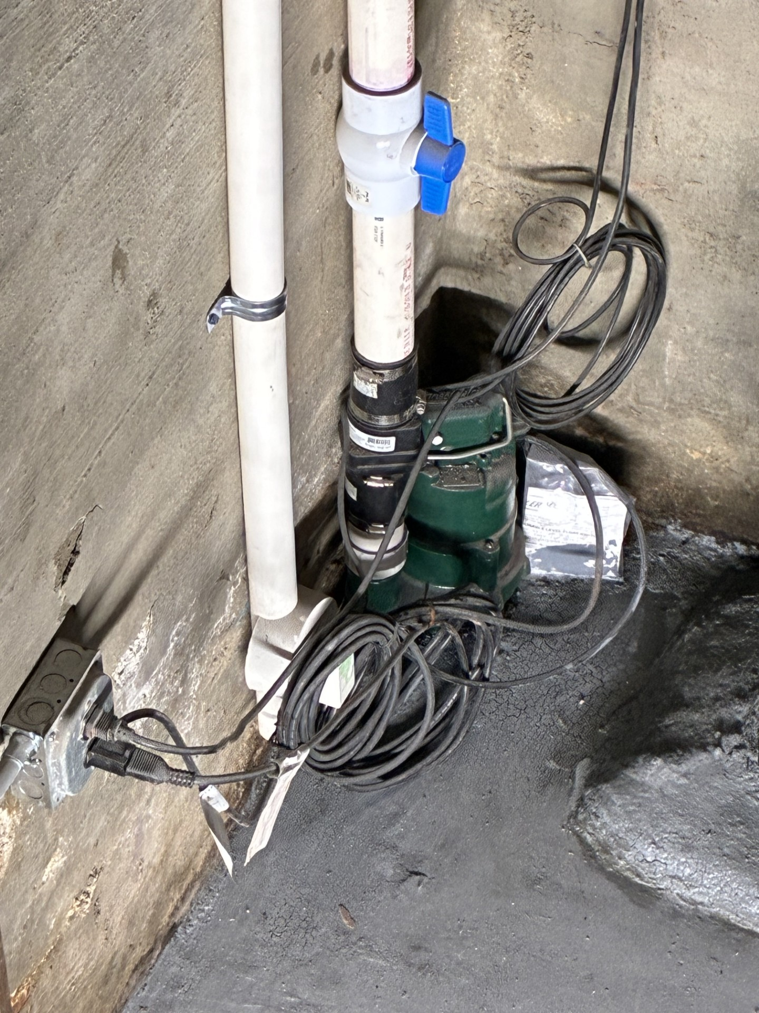
NEC 620.21 (a) (1) (d)
A sump pump or oil recovery pump located in the pit shall be permitted to be cord connected. The cord shall be a hard usage oil-resistant type, of a length not to exceed 1.8 m (6 ft), and shall be located to be protected from physical damage.

Slide 34
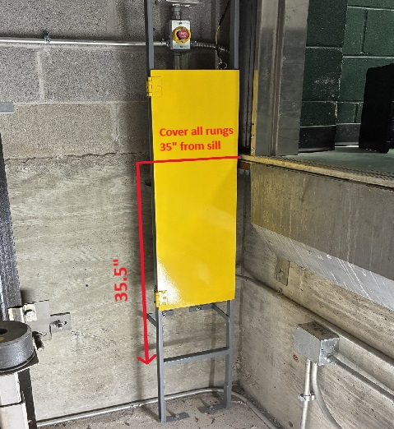
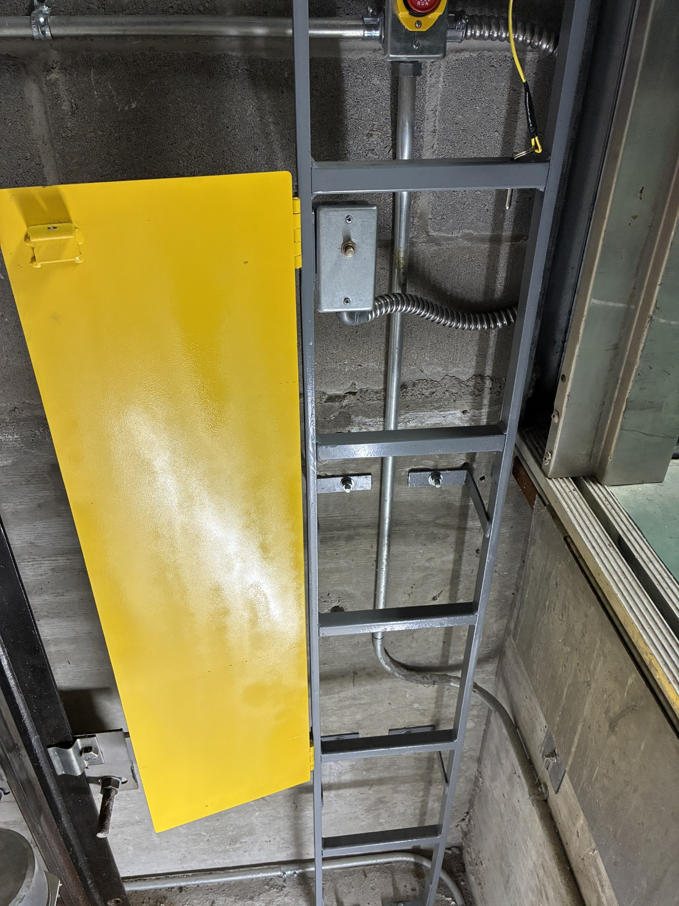
2.2.4.2.7 The ladder shall have a ladder electrical
device (see 2.26.2.38) that shall cause the electric
power to be removed from the elevator driving machine
motor and brake when a person is detected
on the ladder. The device is permitted to detect the
person directly by weight, by movement or removal of
a guard to enable use of the ladder, or by other detection
means. If detecting directly by weight, the device shall
remove power when more than 9 kg (20 lb) is applied
to any rung of the ladder. If a guard or other detection
means is used, the device shall remove power when
the guard is moved or removed, or the other detection
means is opened or activated.

Slide 35
Questions
Update on OKC elevator permit alignment with the state?
How will continuing education be enforced going forward? Must it be done through a certified education program, and how will that roll out be done?
Is it true that Oklahoma is now in a state of emergency for the workforce and can now set temporary mechanics up to help the situation? If so, how or what do the companies need to do to follow the rules?
Why are all new elevator regulations approved at the expense of building owners? Is there no avenue for building owners to object to unfair and costly edicts?

Slide 36
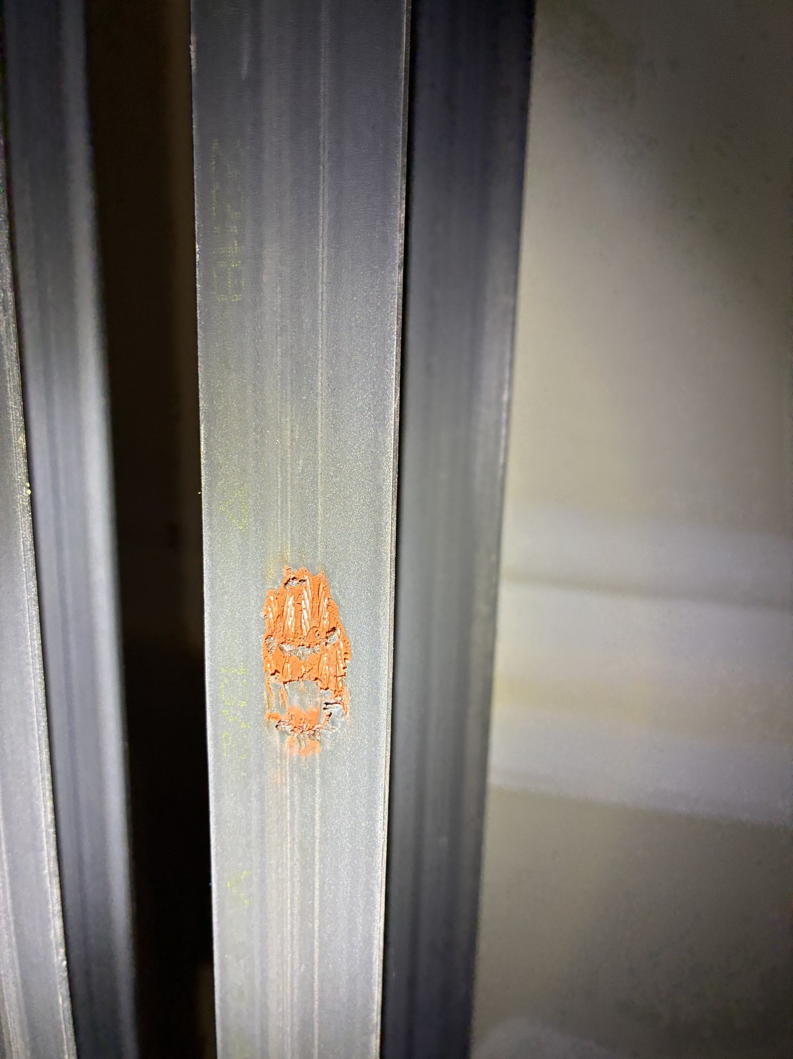

Slide 37
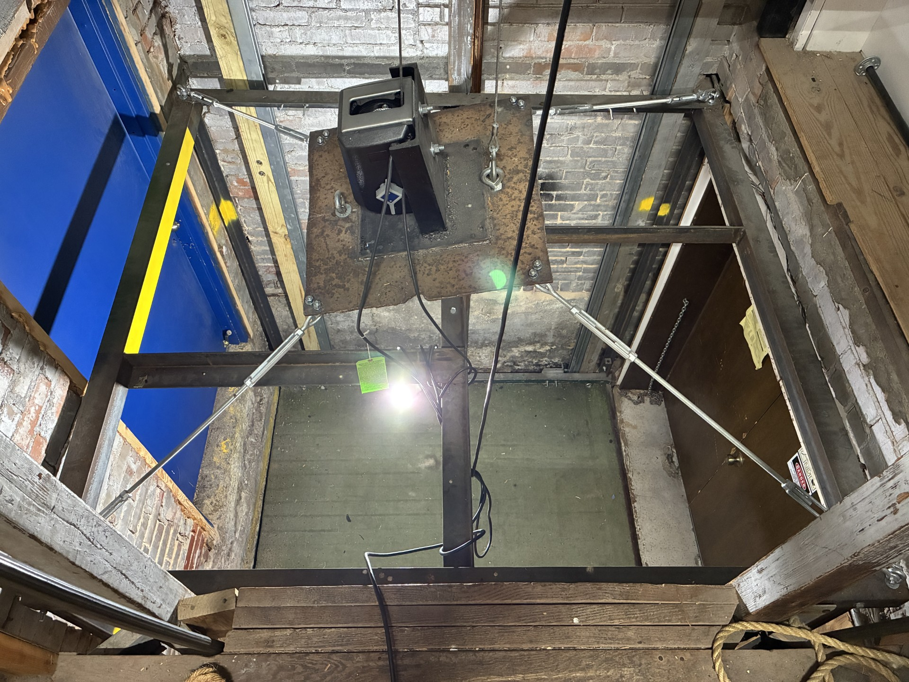

Slide 38
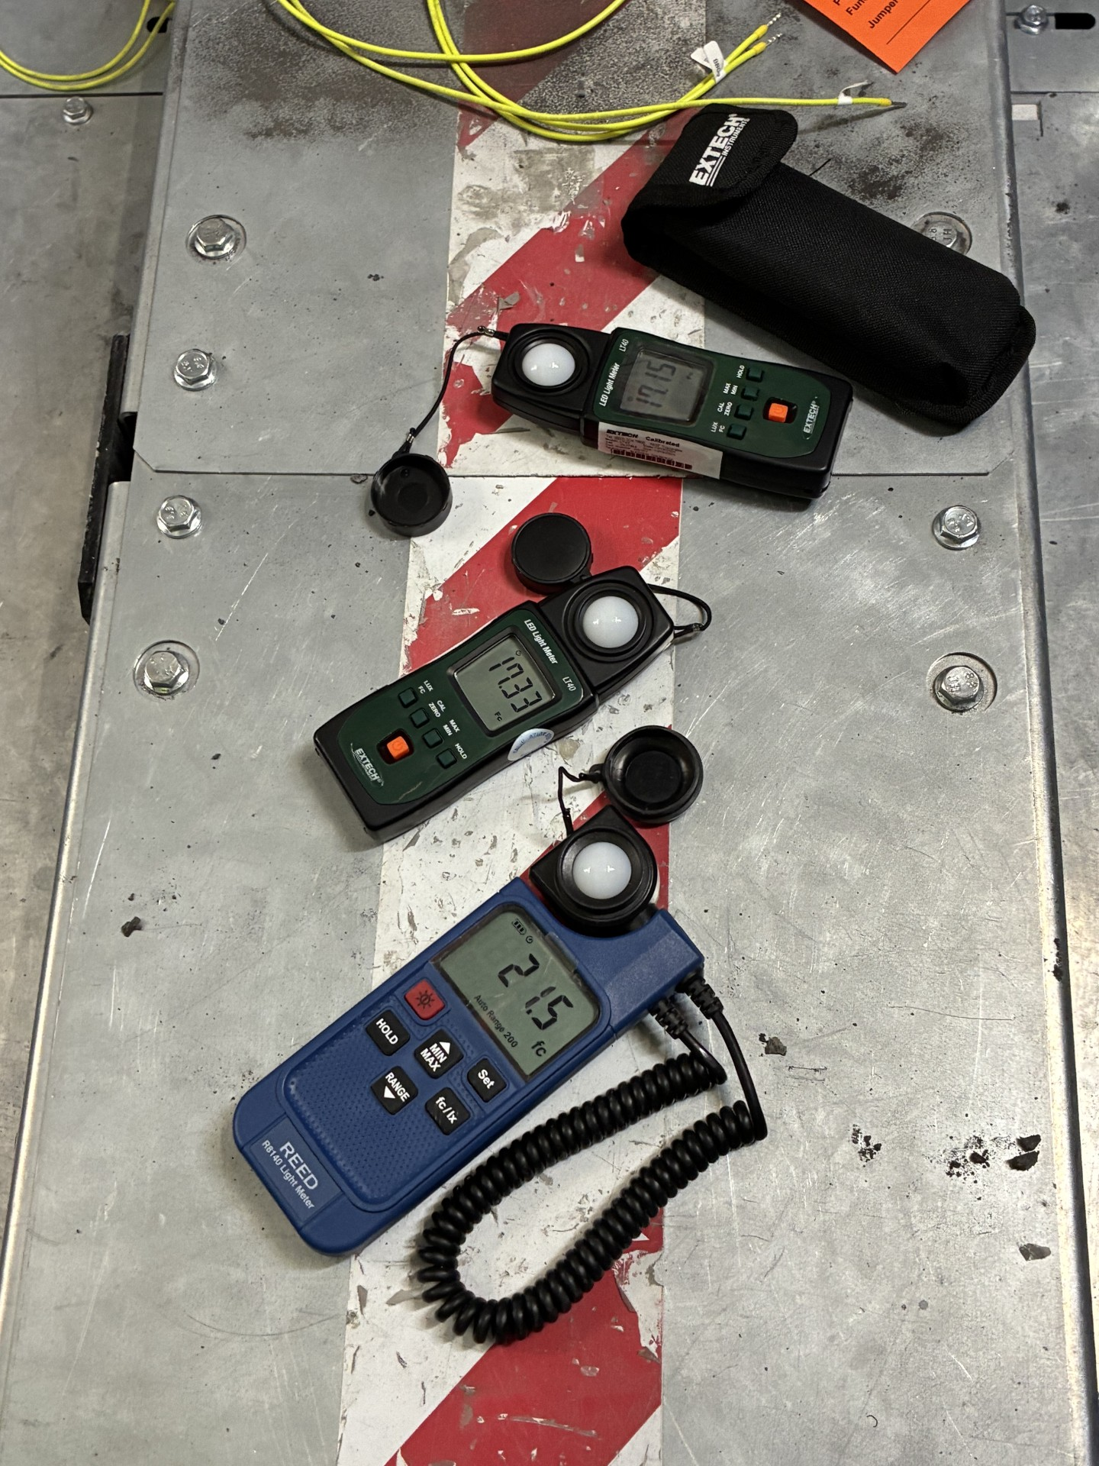

Slide 39
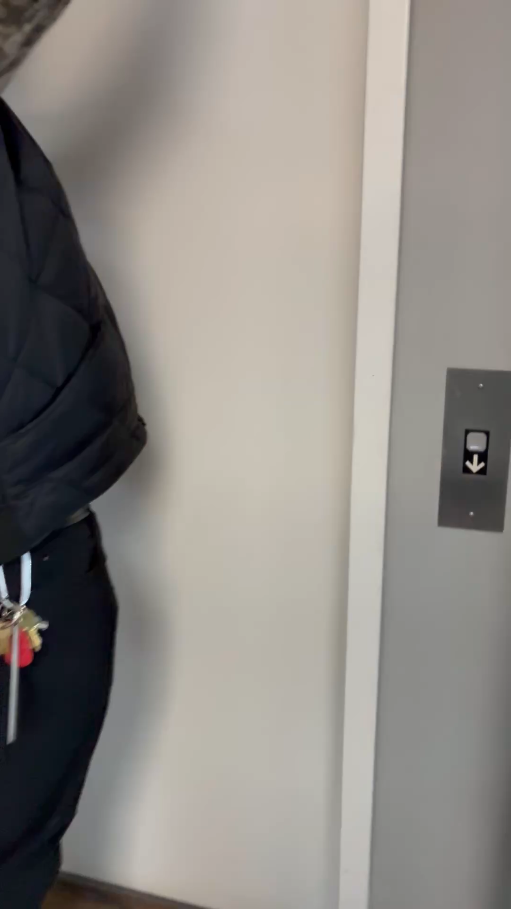

Slide 40
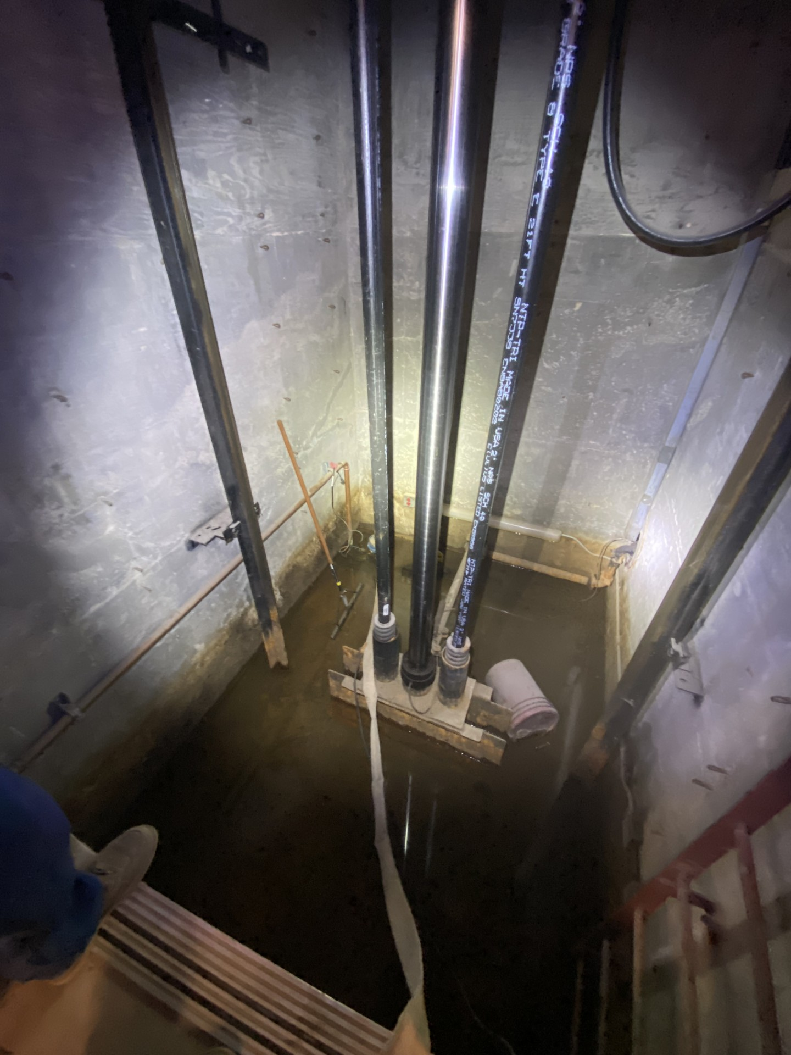
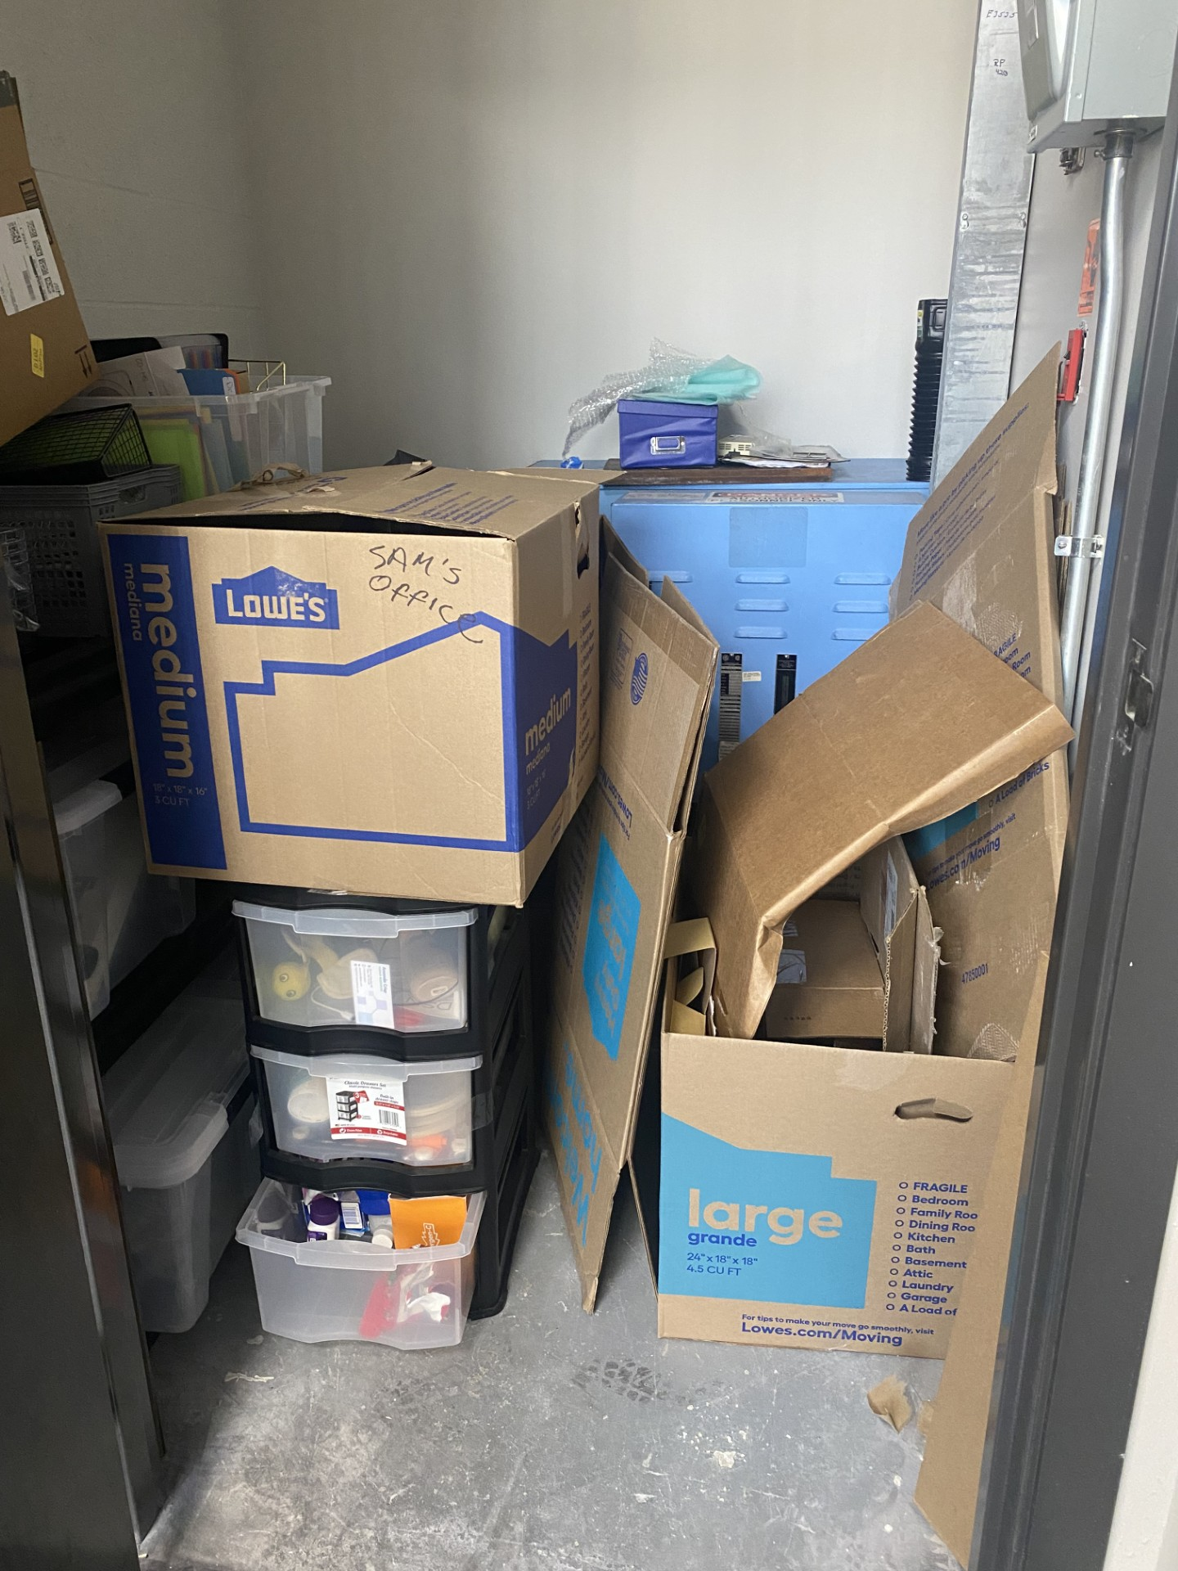

Slide 41
