Slide 1
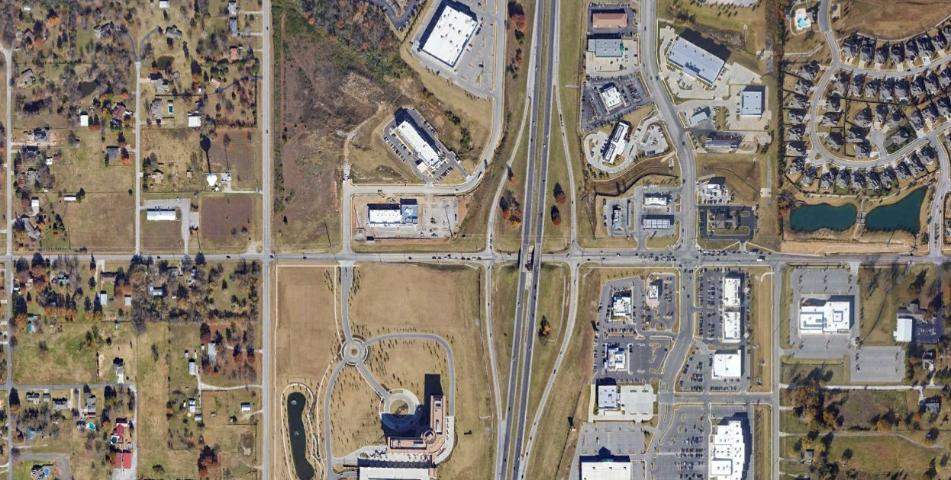


1
81st St. at Union Ave.
2
81st St. at Unit Dr.
3
81st St. at US-75 Southbound Ramps.
[1893] (308) 195
198 (173) [1893]
[523] (68) 77
35 (94) [523]
[4402] (405) 410
[2465] (324)
155
[308] (66)
29
[946] (154)
110
[638]
(88)
56
39 (63) [638]
[3356] (379)
202
[3356] (379)
202
[55] (17)
6
[28] (2)
11
[440]
(50)
61
24 (63) [440]
[3851] (424)
319
[1321] (138)
121
[22] (3)
3
[3059] (264)
286
110 (216) [1970]
190 (355) [3279]
[3851] (424)
319
[7461] (770)
660
54 (100) [748]
105 (6) [132]
198 (286) [2531]
462 (484) [4930]
243
(211) [2465]
[308] (22) 33
127
(88)
[946]
328
(321) [3356]
328
(321) [3356]
[55] (22) 6
7
(7) [22]
391
(369) [3851]
391
(369) [3851]
627
(528) [6250]
[1970] (167) 179
17
(42) [187]
95
(66) [748]
[3279] (297) 319
6
(9)
[28]
11
(22) [132]
[3191] (264) 341
[187] (22) 31
[22] (2) 3
[660] (105) 50
[7781] (680) 714
[5612] (592) 515
[1882] (276) 195
235 (196) [1882]
[182] (10) 119
23 (37) [182]
Union Ave.
80th St.
S Olympia Ave.
1
2
81st St.
3
4
5
81st St.
81st St.
81st St.
Union Ave.
S Unit Dr.
S Olympia Ave.
Legend
4
81st St. at US-75 Northbound Ramps.
5
81st St. at Olympia Ave.
18
(18) [18]
AM Hourly Volume
PM Hourly Volume
416 (443) [4402]
[8913] (979) 902
858 (803) [8913]
AADT Hourly Volume
275 (319) [3059]
231 (198) [2201]
Project Corridor
[9860] (1012)
869
[5612]
(605)
550
[1100]
(143)
132
[2201]
(231)
220
165 (215) [2641]
[5227] (468)
440
Side Streets
[7461] (770)
660
594 (693) [6801]
[9860] (1012)
869
44 (55) [385]
Ramps
1 (0) [6]
N
81st Street Corridor
2023 Traffic Volumes
627
(528) [6250]
974
(902) [9860]
974
(902) [9860]
[21] (3) 0
583
(506) [5227]
Figure
1
[1321] (121) 138
66
(77) [660]
3
(3)
[22]
484
(495) [4930]
[5612] (495) 517
154
(193)
[1607]
110
(110)
[1100]
55
(55) [385]
[4930] (407) 490
[2641] (220) 305
[1607] (187) 149
554 (576) [5612]
[3092] (385) 325
319 (358) [3092]

Slide 2
1
81st St. at Union Ave.
2
81st St. at Unit Dr.
3
81st St. at US-75 Southbound Ramps.
[2767] (450) 285
290 (253) [2767]
[764] (100) 113
51 (137) [764]
[6435] (592) 600
[3604] (473)
227
[450] (97)
42
[1384] (225)
161
[933]
(129)
82
56 (92) [933]
[4907] (553)
296
[4907] (553)
296
[80] (24)
8
[40] (3)
16
[643]
(72)
88
35 (92) [643]
[5631] (619)
467
[1930] (201)
177
[32] (5)
5
[4472] (386)
418
[10907] (1126)
965
161 (315) [2880]
278 (520) [4794]
[5631] (619)
467
79 (146) [1094]
153 (8) [193]
290 (418) [3700]
676 (708) [7207]
356
(309) [3604]
[450] (32) 48
185
(129)
[1384]
479
(470) [4907]
479
(470) [4907]
[80] (32) 8
10
(10) [32]
571
(539) [5631]
571
(539) [5631]
917
(772) [9138]
[2880] (245) 262
24
(61) [273]
135
(97) [1094]
[4794] (434) 467
8
(13)
[40]
16
(32) [193]
[4665] (386) 499
[273] (32) 45
[32] (3) 5
[965] (153) 72
[7781] (680) 714
[8204] (865) 753
[2751] (404) 285
344 (286) [2751]
[265] (14) 174
34 (55) [265]
Union Ave.
80th St.
S Olympia Ave.
1
2
81st St.
3
4
5
81st St.
81st St.
81st St.
Union Ave.
S Unit Dr.
S Olympia Ave.
Legend
4
81st St. at US-75 Northbound Ramps.
5
81st St. at Olympia Ave.
18
(18) [18]
AM Hourly Volume
PM Hourly Volume
608 (648) [6435]
[13031] (1432) 1319
1255 (1174) [13031]
AADT Hourly Volume
402 (467) [4472]
338 (290) [3217]
Project Corridor
[14414] (1480)
1271
[8204]
(885)
804
[1609]
(209)
193
[3217]
(338)
322
241 (314) [3861]
[7641] (684)
643
Side Streets
[10907] (1126)
483
869 (1013) [9942]
[14414] (1480)
1271
64 (80) [563]
Ramps
1 (0) [6]
N
81st Street Corridor
2046 Traffic Volumes
917
(772) [9138]
1424
(1319) [14414]
1424
(1319) [14414]
[21] (3) 0
853
(740) [7641]
Figure
2
[1930] (177) 201
97
(113) [965]
5
(5)
[32]
708
(724) [7207]
[8204] (724) 756
225
(282)
[2349]
161
(161)
[1609]
80
(80) [563]
[7207] (595) 716
[3861] (322) 450
[2349] (273) 217
809 (841) [8204]
[4521] (563) 475
467 (523) [4521]

