Slide 1
Provider Enrollment Guide

Slide 2
Before enrolling as a Diabetes Educator to provide DSMES services.
Review the eligibility requirements. The following providers are eligible to enroll as a Diabetes Educator type (567):A licensed healthcare professional who is individually certified as a: Certified Diabetes Care and Education Specialist (CDCES) by the National Certification Board for Diabetes Education (NCBDE)
Board-Certified Advanced Diabetes Management (BC-ADM) by the Association of Diabetes Care and Education Specialists (ADCES)
Registered dietitian, registered nurse or pharmacist licensed in the state in which they practice and have training and experience pertinent to diabetes self-management.

Slide 3
Diabetes Self-Management Group
Eligible provider groups are recognized by (2) organizations according to the National Standard of Diabetes Self-Management Education and Support.
American Diabetes Association (ADA)
Association of Diabetes Care and Education Specialist (ADCES)

Slide 4
Diabetic Educator
Eligible individual providers include those with the following (2) diabetes education certification.
Board Certified- Advance Diabetes Management (BC-ADM)
Certified Diabetes Care and Education Specialist.(CDCES)

Slide 5
Fill out and submit new contract. Rendering DSMES services requires a new, separate Medicaid contract.
Providers can only enroll if they are part of an accredited DSMES program certified by either the American Diabetes Association (ADA) or Association of Diabetes Care and Education Specialists (ADCES).
Enroll your accredited Group first. Then, wait for approval; this can take 7-21 days. When approval is received, enroll Yourself/Individual, as a Diabetes Educator. Then, wait for approval; this can take 7-21 days.
Contact Provider Enrollment if you have any questions or need assistance. 800-522-0114, option 5 or email providerenrollment@okhca.org

Slide 6
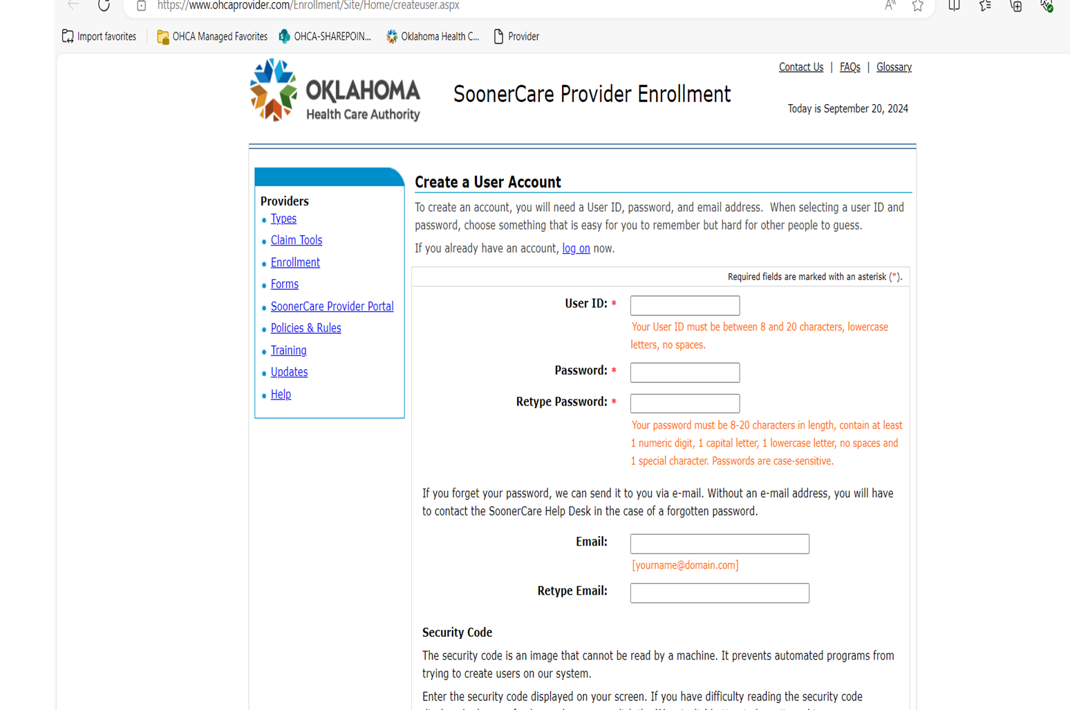
Before beginning the Provider Enrollment Application, create a User account vis the SoonerCare Provider Enrollment page.
Electronic Provider Application (ohcaprovider.com)

Slide 7
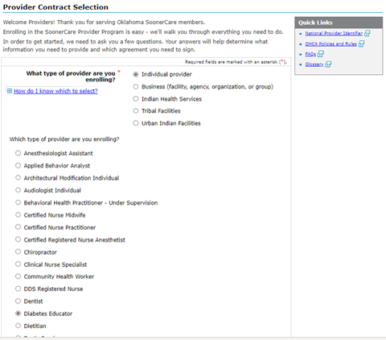
What type of provider are you enrolling?
Start by selecting Business (facility, agency, organization, or group). Your Group(s) is the entity that will bill for DSMT and will receive payment/reimbursement from SoonerCare (Medicaid). Once your Group, that has an accredited DSMES program (ADA or ADCES) is approved, you will receive confirmation emails from SoonerCare that includes an identification number; this number will to be used to fill out the Individual enrollment contract.
Which type of provider are you enrolling?
Choose Diabetes Educator. Choosing this provider type will alert Medicaid that you are certified or have education and training in diabetes self-management and can upload proof of this via a certification or other document that qualifies you to provide this service.
Continue reading main body of contract, by scrolling down; the items that appear on the right column are also included in the main body for you to read and/or fill out.

Slide 8
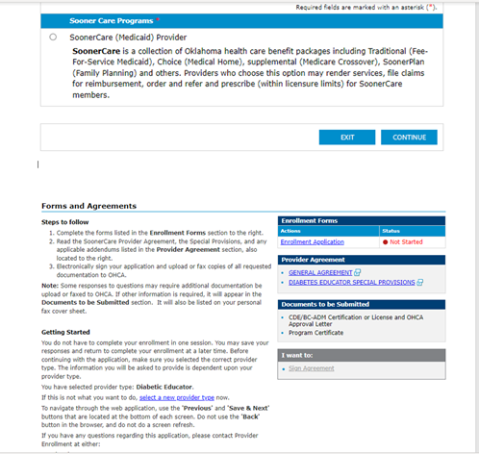
Continue enrolling by reading main body of contract, by scrolling down; the items that appear on the right column are also included in the main body for you to read and/or fill out.

Slide 9
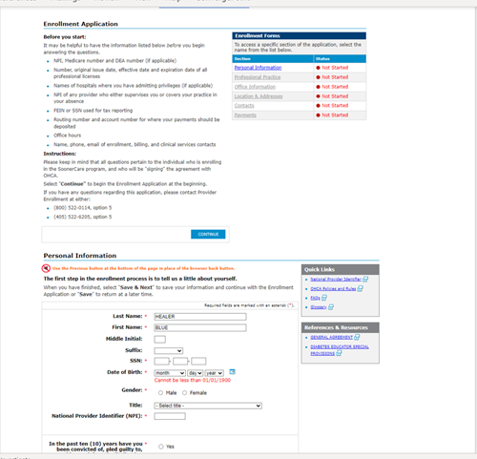
Before you start
Have all listed information available
Personal Information
Fill out your Group information here and choose Group/Corporate FEIN in response to how you will report payments to the IRS. Looks like Individual info goes here?
When enrolling yourself, Provider, fill out information and choose Personal FEIN?
Professional Practice
License or Certification
Please do not enter your Driver’s License number; this is reserved for any License or Certification number.

Slide 10
Please ensure the following information is accurate for quick and efficient communication and enrollment completion.
Professional Practice
Location & Addresses
Contacts
Payment information

Slide 11
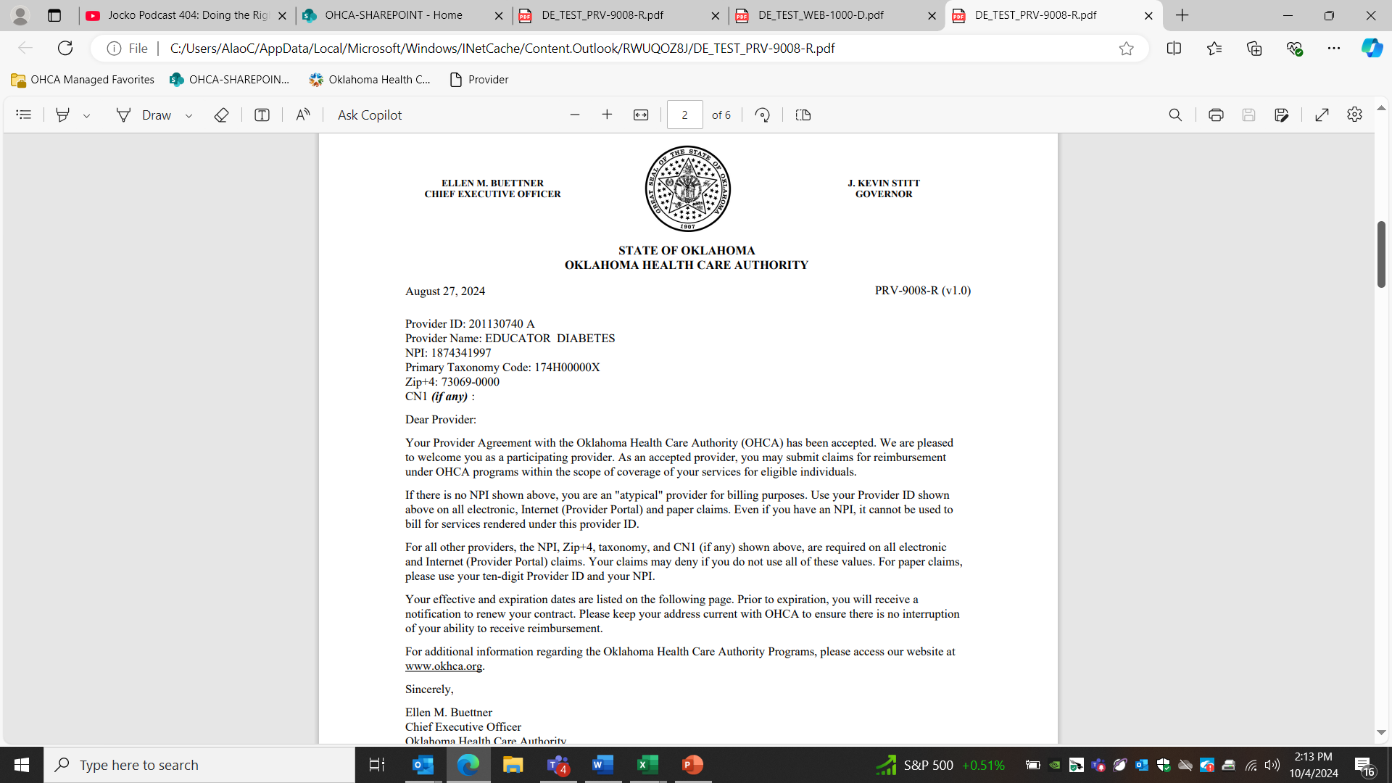
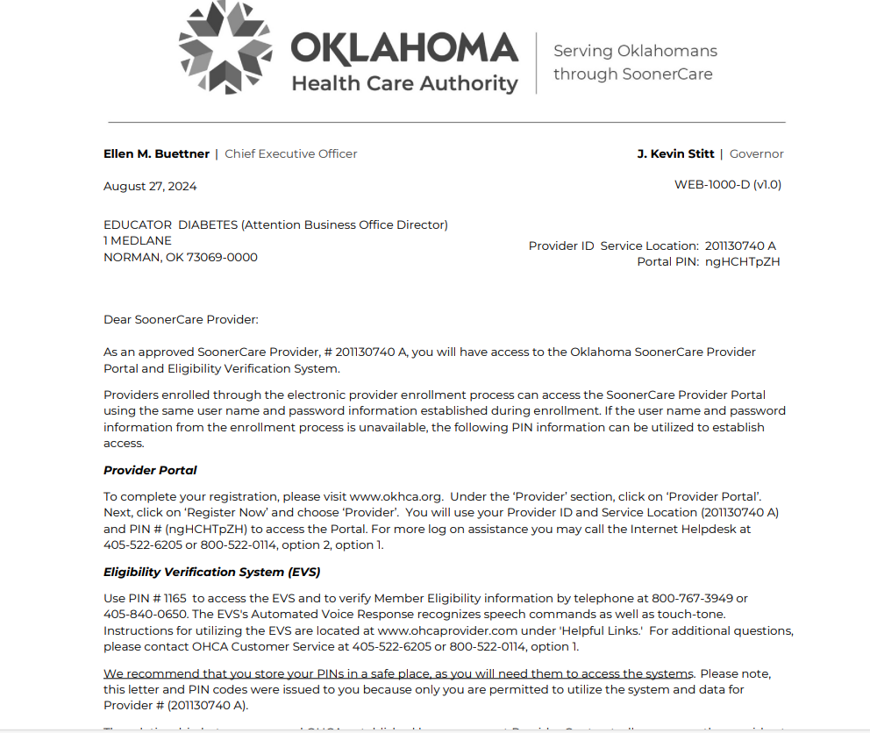
Example of Provider Pin and Agreement approval letters

Slide 12
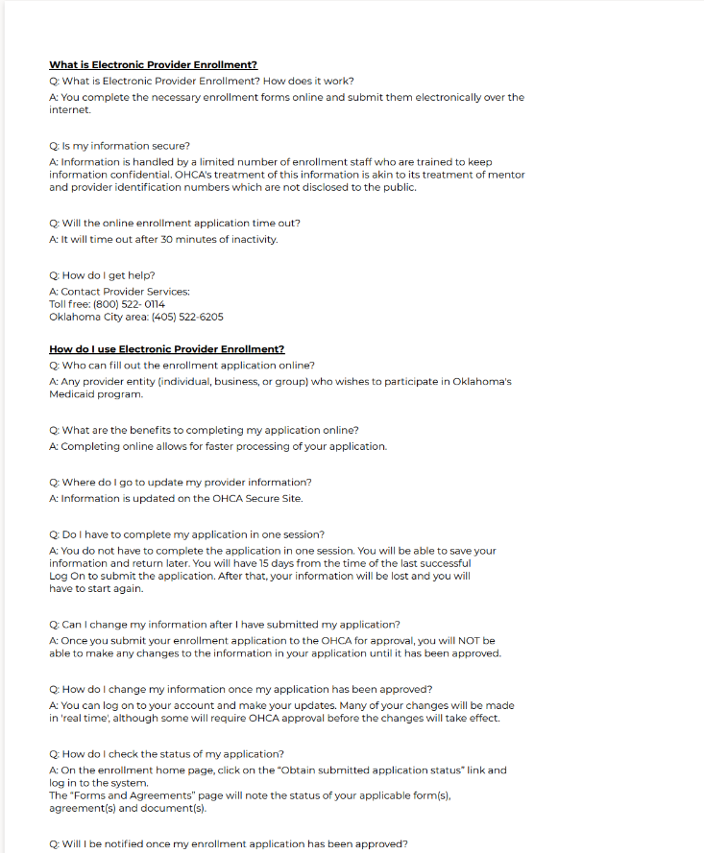
FAQ’S can be located on the Provider enrollment site under the Resource tab.
Provider Enrollment (oklahoma.gov)

Slide 13
Contact Provider Enrollment if you have any questions or need assistance. 800-522-0114, option 5 or email providerenrollment@okhca.org

