Slide 1
SoonerCare School-based IEP Provider contracts
April 2025

Slide 2
description
A comprehensive overview of OHCA’s SoonerCare provider enrollment process with information on new contracts and contract renewals, and helpful tips for efficiency and accuracy.
Recommended audience: All Oklahoma Medicaid school- based EPSDT or rendering providers.

Slide 3
disclaimer
SoonerCare policy is subject to change.
The information included in this presentation is current as of April 2025.
Stay informed with current information found on the OHCA public website by visiting www.oklahoma.gov/ohca.

Slide 4
New provider contracts

Slide 5
provider contracts
To provide medically necessary health care services to SoonerCare members pursuant to an Individualized Education Program (IEP), and to be eligible for payment, providers must have an approved provider contract on file with OHCA.
Providers that require a new contract are:
New to providing services for Medicaid and have never had a SoonerCare contract.
Providers that began the renewal process but have failed to complete the entire renewal process prior to contract expiration.
Previously contracted but did not opt to renew during the contract renewal period.

Slide 6
pre-enrollment steps
1
Create user account
To complete an online application, a user account must first be created.
2
3
Provider type selection
Based on the contract type selected, many different provider types are available (i.e., school-based EPSDT, occupational therapist, speech pathologist).
4
Provider program selection
The program of desired enrollment must be selected (i.e., SoonerCare).
Provider contract selection
The type of provider contract must be selected.
Notes:
Before beginning the enrollment process, users must complete 4 new application steps:

Slide 7
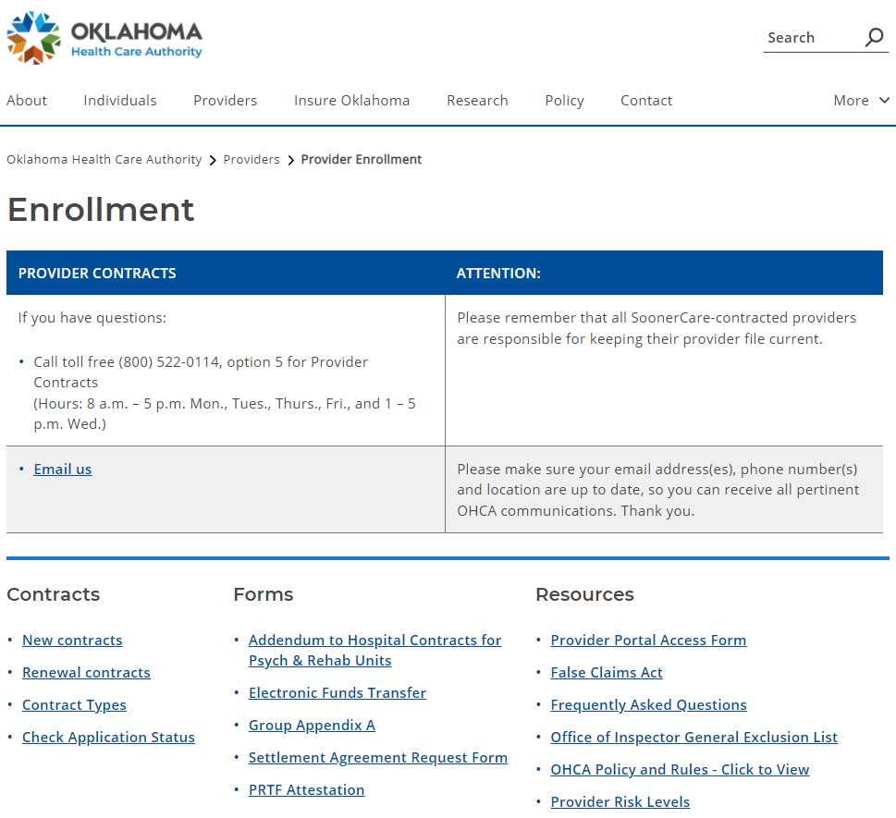
new contracts
The SoonerCare provider enrollment application is found on the provider enrollment page by clicking the New Contracts link, or by visiting www.ohcaprovider.com/Enrollment/Site/Home/createuser.aspx.

Slide 8
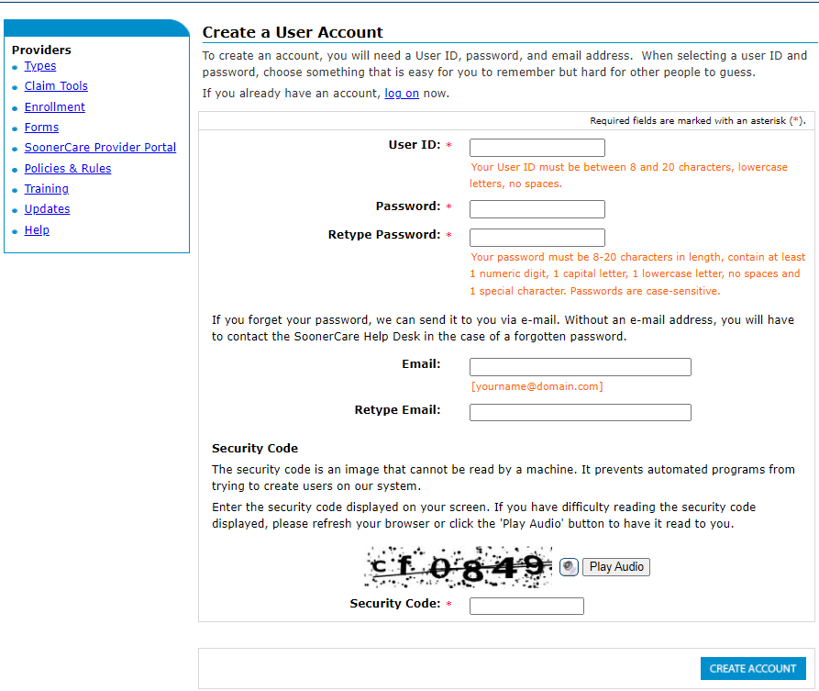
create account
The first step in the pre-enrollment process is to create a user account.

Slide 9
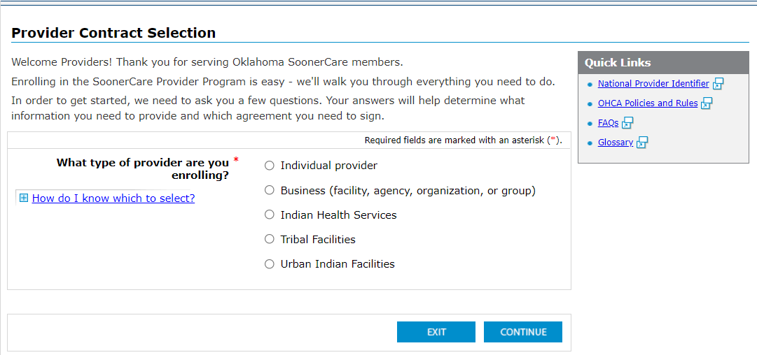
contract type
The next step is to select the type of contract:
Individual provider
Business
Indian Health Services
Tribal Facilities
Urban Indian Facilities
School-based corporations will select a Business contract.

Slide 10
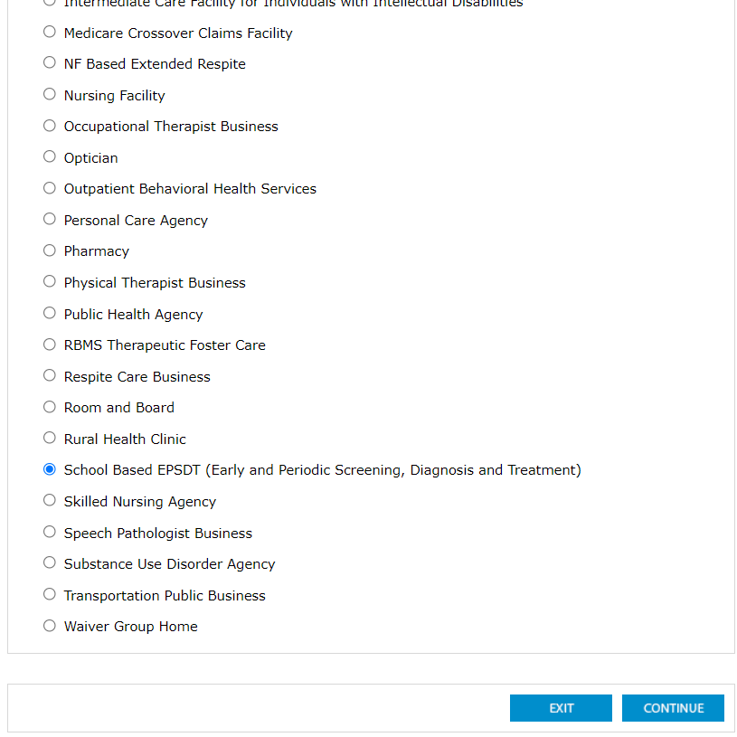
provider type
Providers will then choose the appropriate provider type.

Slide 11
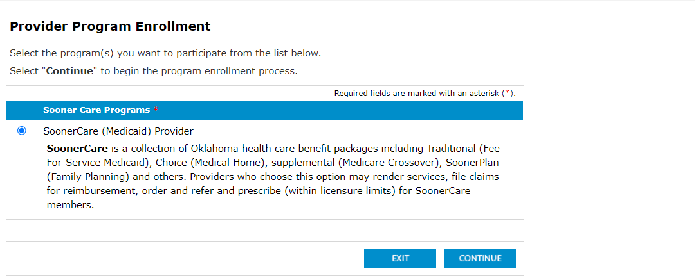
Program
The final step before beginning the enrollment process is to select the program in which to participate.

Slide 12
provider enrollment
To complete the enrollment process, providers will:
Complete the enrollment forms that are prompted for the user.
Read the provider agreement, special provisions, and any applicable addendums that are prompted for the user.
  General Provider Agreement contains the terms and conditions applicable to all providers.
  Special Provisions contains terms for a particular provider type and/or specialty.
Electronically sign the application and upload or fax copies of all requested documentation prompted for the user to OHCA.
Federal laws require some providers to have on-site screening visits. An OHCA provider enrollment contracts representative will conduct these visits for providers that are not already screened by another state or federal agency.

Slide 13
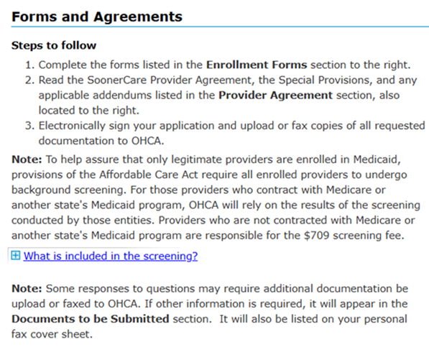
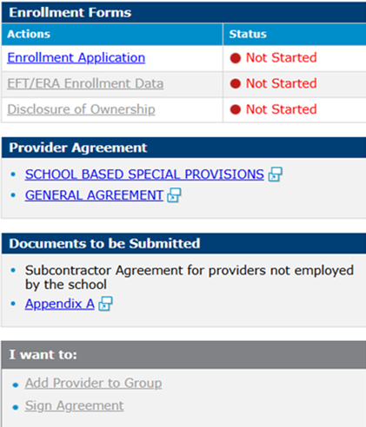
Provider Enrollment

Slide 14
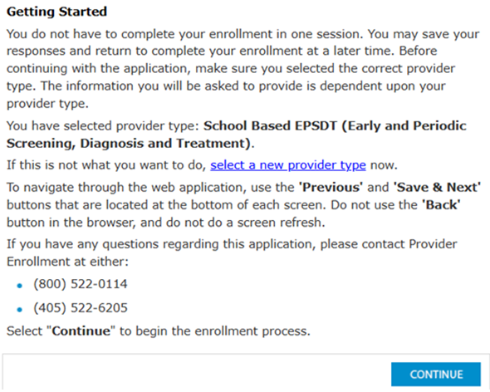
Provider enrollment

Slide 15
appendix a
Specific business provider types are required to obtain a signature from each provider who appoints the business as the agent for receipt of payment for Medicaid-compensable health-care services.
The Appendix A is required for the following business provider contracts:
Groups | Outpatient Behavioral Health
Public Health Agencies | Substance Use Disorder Agencies
Rural Health Clinics (RHCs) | School-Based EPSDT
Federal Qualified Health Centers (FQHCs)

Slide 16

application submission
New provider contracts are processed by provider enrollment within four to six weeks of submission.
OHCA will acknowledge receipt of the application with an application tracking number (ATN). The ATN or SSN/FEIN may be used to check the status of the application here. See Global Message 8/4/20.
    If the application is returned for corrections, email notifications will be sent to the enrollment contact submitted on the application.
    Initial email: the first notification that corrections are needed.
    Second email: sent 15 days after the initial email as a reminder.
    Expiration email: sent 30 days after the initial email as notification the contract is expired, and a new application is required.
Notes:
Play with an animation here

Slide 17
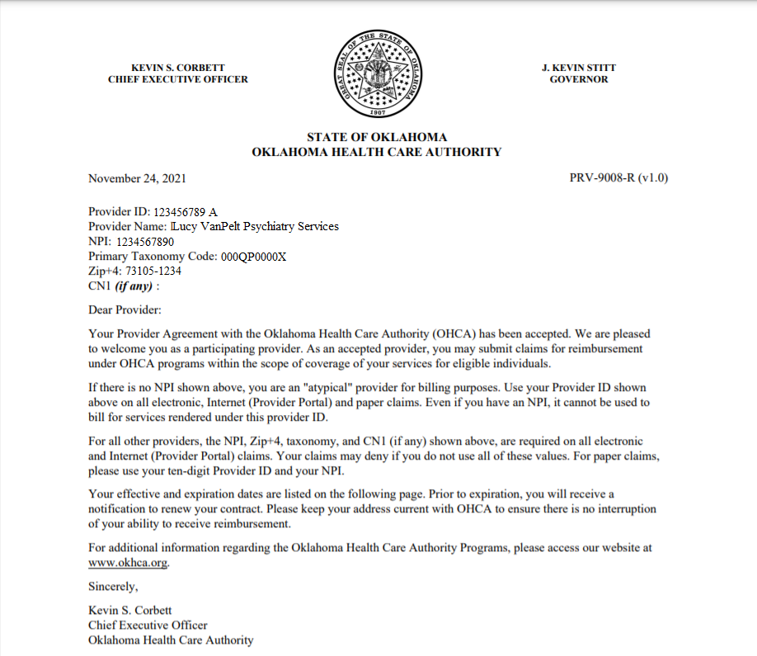
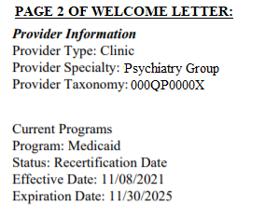
application approval
Upon application approval, official contacts will receive:
Welcome Letter containing important contract information.
  Provider ID
  Primary Taxonomy Code
  Zip +4
  CN1 (if applicable)
  Program
  Effective Date
  Expiration Date
PIN Letter containing secure provider portal login instructions.
Notes:
Add a shot of the Welcome Letter

Slide 18
provider contract renewal

Slide 19

contract expiration
        SoonerCare provider contracts are valid for four years with few exceptions:
        Nursing homes – three years
        ICF/IID – two years
        Behavioral Health Practitioner Under Supervision – one year
Contracts expire according to provider type, for example:
School-based EPSDT group and SB paraprofessionals individual expires June 30, 2025
OT/PT/ST individual contract expires March 31, 2026
OT/PT/ST assistant and SLP fellows individual contract expires January 31, 2029

Slide 20

contract renewal
The contract renewal period opens 75 days prior to the expiration date. OHCA strongly encourages early renewal to avoid delays in contract processing.
Renewal notifications are emailed to the official contact:
Initial notification is emailed 75 days prior to expiration.
Reminder notification is emailed 45 days prior to expiration.
    Contract renewals that have been returned due to errors must be corrected prior to the expiration date or a new contract may be required.
A Renewing Your SoonerCare Provider Contract how-to video is available on the provider training page here.
Notes:
Better wording

Slide 21
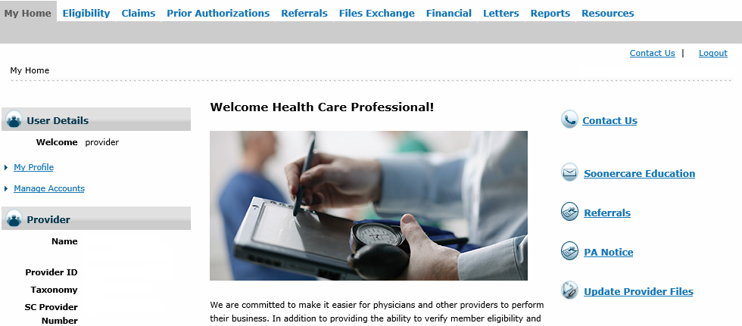

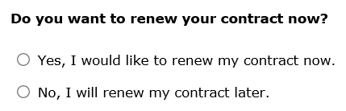
renewing
The contract renewal process can be started by logging in to the secure provider portal and selecting Update Provider Files.
Only the portal administrator or enrollment clerk can access Update Provider Files.
The Provider Portal Access Form is available for administrator account locks. See Global Message 3/19/21.
Notes:
If the contract is within 75 days of expiration, a contract renewal prompt will allow the user to begin the process now or wait until later.

Slide 22
Provider renewal
To complete the renewal process, providers will:
Review the information on file and make any needed changes to the renewal forms that are prompted for the user.
Read the provider agreement, special provisions, and any applicable addendums that are prompted for the user.
Electronically sign the application and upload or fax copies of all requested documentation prompted for the user to OHCA.
Behavioral health and physical therapy groups require a site visit for renewal.
OHCA will acknowledge receipt of the application with an application tracking number (ATN). The ATN or SSN/FEIN may be used to check the status of the application here. See Global Message 8/4/20.

Slide 23
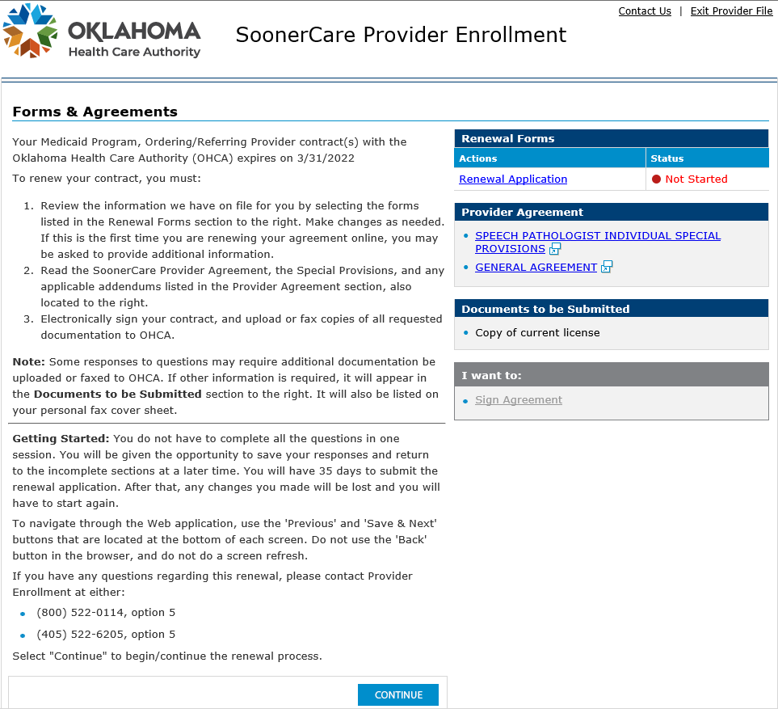

provider renewal cont…
All required forms to complete, agreements and provisions to read, and documents to be submitted will be listed on the right side of the Forms and Agreements page.
Notes:
Add pic 3 only app A is needed for SB group, individual therapist contracts will need to update licenses

Slide 24
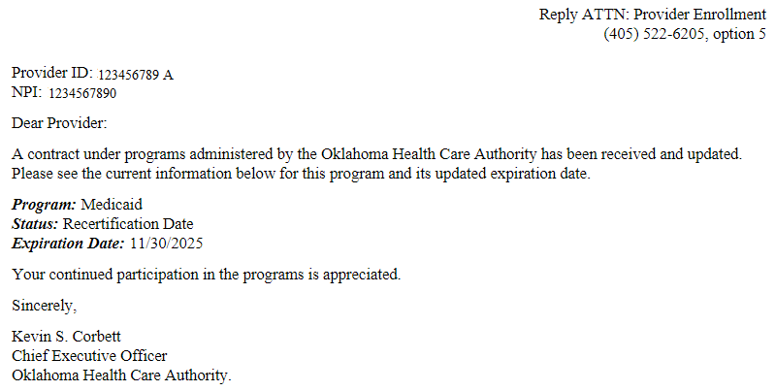

Renewal submission
Notification of the contract update containing the new expiration date will be emailed to the official contact.
    Updates or contract changes submitted via the portal that require OHCA review must be approved before additional changes can be submitted.

Slide 25
maintaining provider file

Slide 26
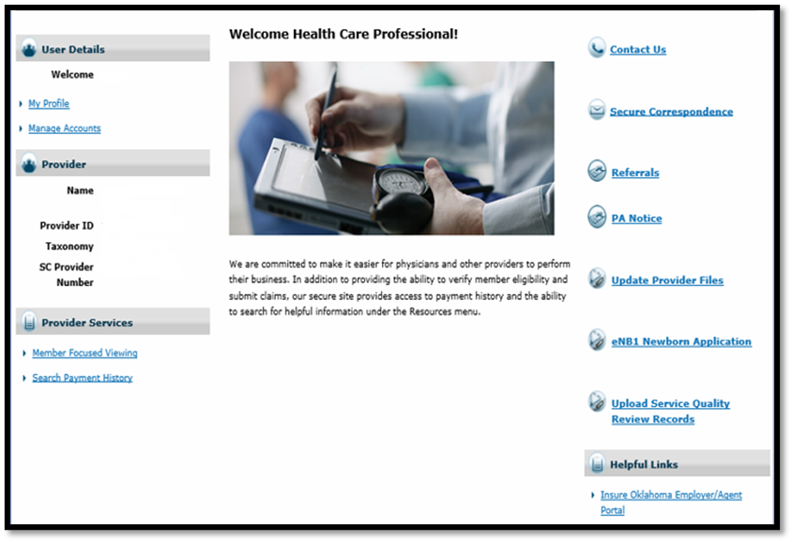

maintaining provider file
Maintaining accurate information on the OHCA provider file is the easiest way to ensure efficiency of claims reimbursement.
Access Update Provider Files from the home screen of the OHCA secure provider portal.
Only the portal administrator or enrollment agent can access Update Provider Files.
The Provider Portal Access Form is available for administrator account locks. See Global Message 3/19/21.

Slide 27
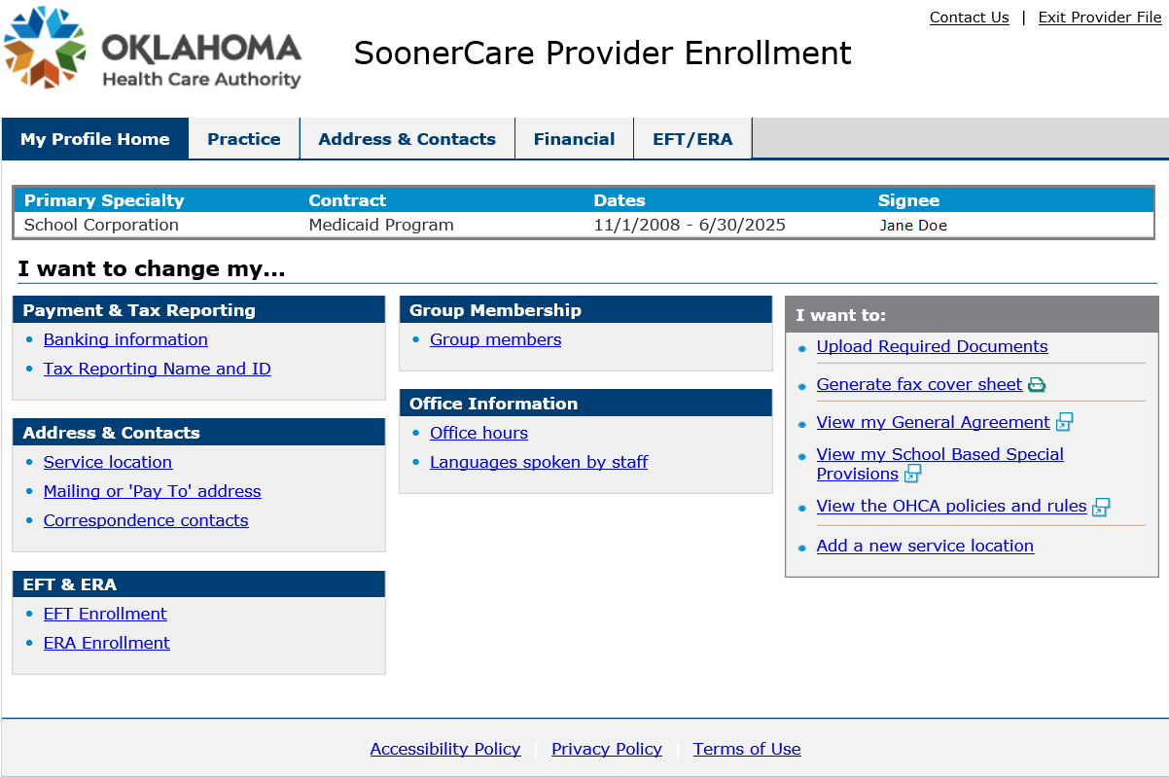
update provider files
Update Provider Files on the secure provider portal allows updates to:
Payment & tax reporting
Address & contacts
EFT & ERA
Group membership
Office information
Additionally, users are also able to:
Upload documents
Enroll in managed care
Add a new service location

Slide 28
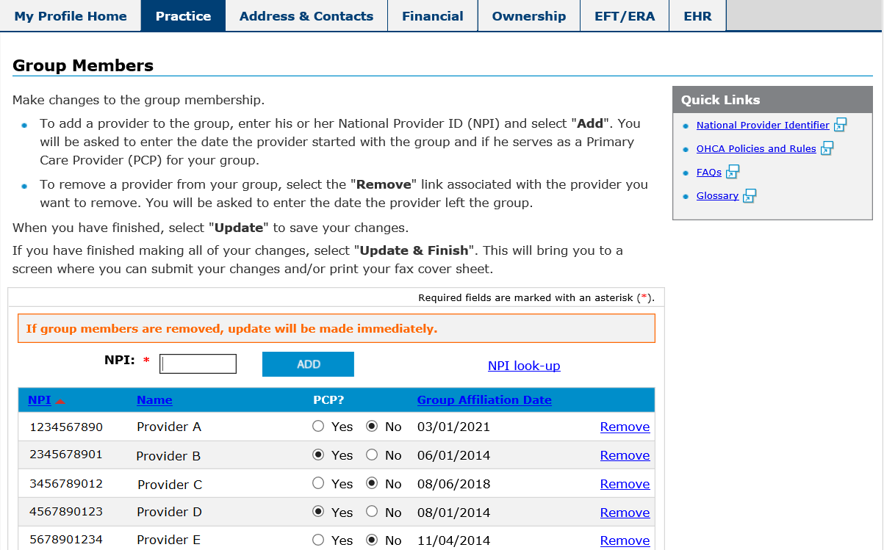
Group members
A current record of group members is crucial for efficient claim processing and provides an accurate list of the individual providers affiliated with the group.
Individual providers can easily be added or removed on the provider portal.
The Appendix A must be signed by the provider and uploaded or faxed to OHCA.

Slide 29
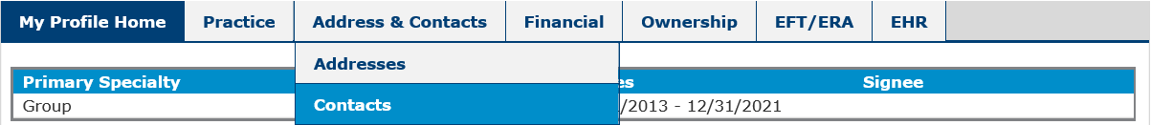
Enrollment/official contact
Update Provider Files allows the portal account administrator to add or update the Enrollment Contact and the Official Contact.
Enrollment Contact: the contact for answering questions about the information submitted in the initial or renewal application, or when an update is made to the provider file.
Official Contact: the email address used for all OHCA communications including contract welcome letter, renewal notice or amendment, provider letters, provider newsletters, and any other required communication.
  Do not add third party contractor information as your official contact unless you want them to receive all official correspondence.

Slide 30
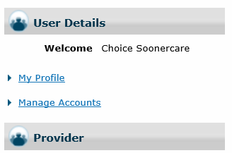
manage account clerks
The Manage Accounts feature of the secure provider portal allows the account administrator to:
Add new clerks
Add registered clerks
Add registered billing agent
Designate billing agent
Add enrollment agent
A Create Clerks how-to video is available on the provider training page.

Slide 31
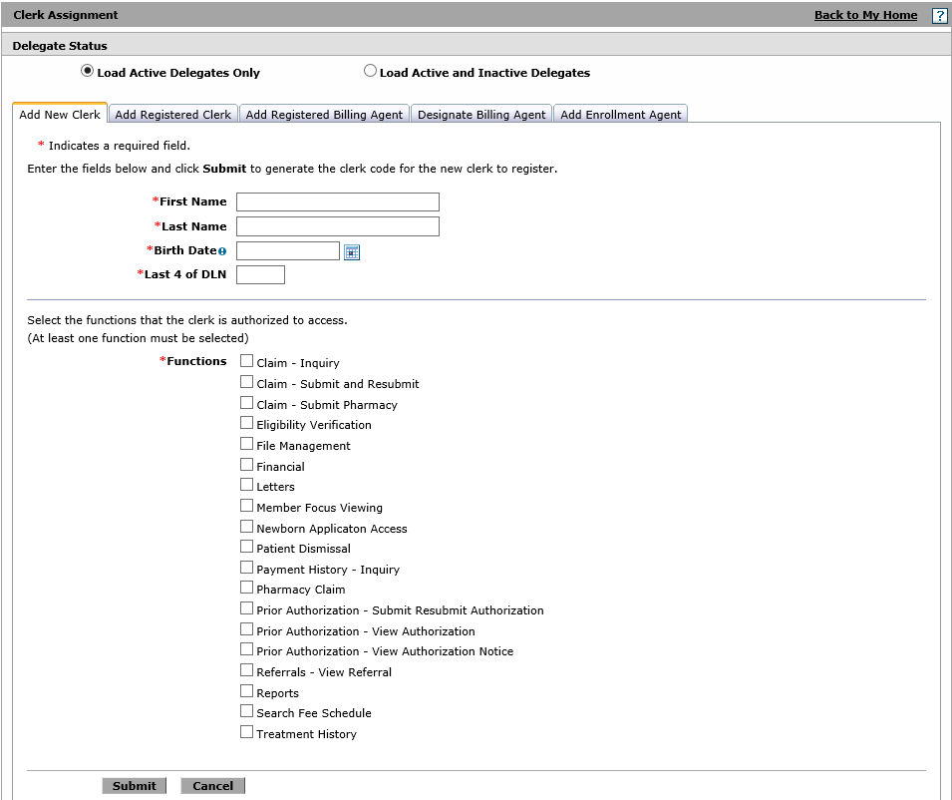
clerk assignment
Clerks can be added, or existing clerks can be set to inactive.
At least one function must be chosen for each clerk.
Administrator may add a registered clerk or an enrollment agent from the list of active clerks.
Notes:
The administrator will assign all the functions the clerk is authorized to access (at least one function must be selected).
Play with screen shots here

Slide 32
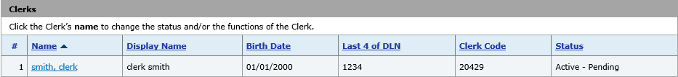
Clerk registration
A clerk code will be generated after adding a new clerk to the portal account.
The clerk will use the clerk code to complete portal registration.
Clerks will remain in “pending” status until portal registration has been completed.
A Register a Clerk how-to video is available on the provider training page.

Slide 33
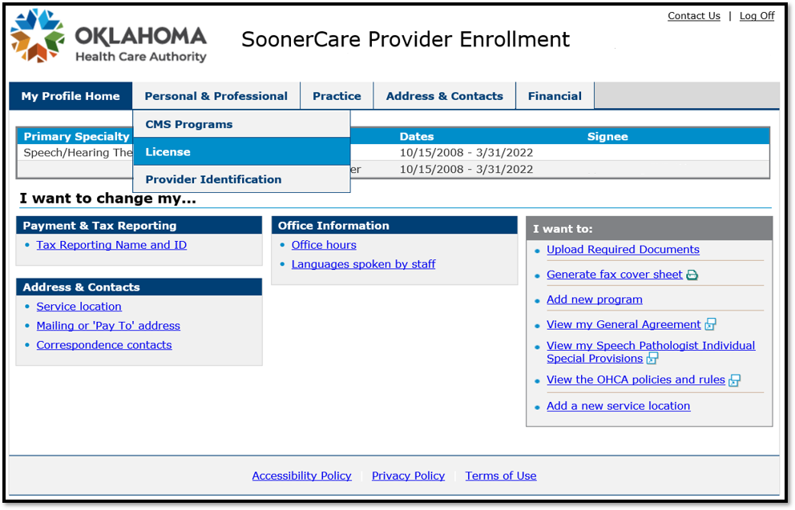
updating license
Licenses for group members must be updated via the secure provider portal from the individual provider’s login.
Notification of license expiration will be emailed to the official contact at 15 days and again seven days prior to the expiration date.
After selecting Update Provider Files, the individual provider will select License from the Personal and Professional tab.

Slide 34
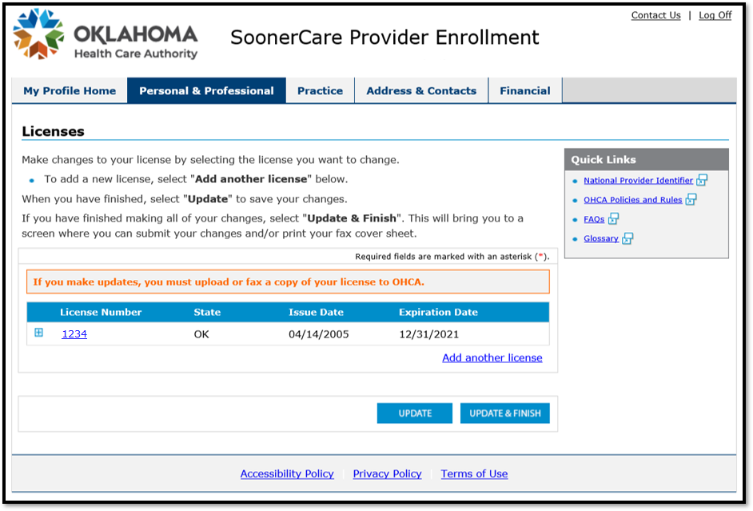
updating license
Make changes to the license by selecting the appropriate one from the list.
A new license may be added by selecting Add another license.

Slide 35
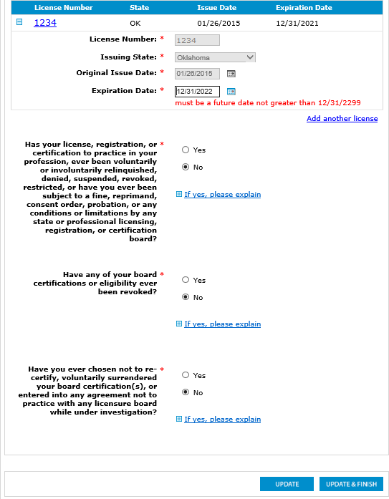
updating license
After the necessary license changes have been made, select Update and Finish to complete the change and to upload a copy of your license.
If any additional credentials require updating, the user will be prompted to update those sections before the license can be uploaded and submitted.

Slide 36
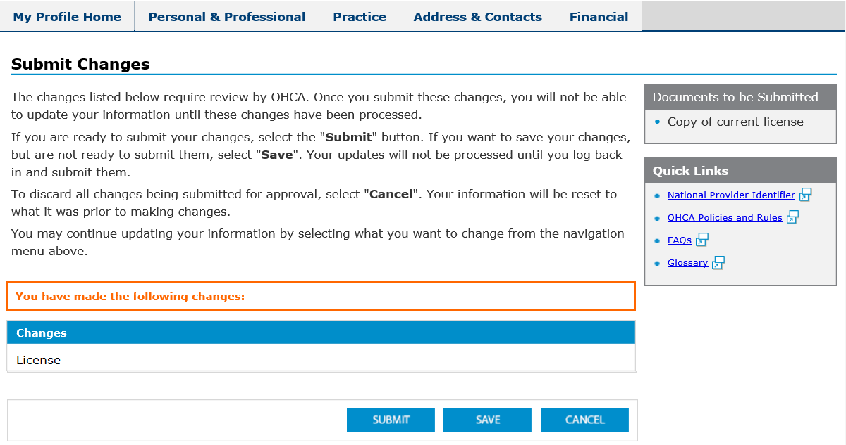
updating license
The changes made will be listed under Changes.
Select Submit to process your updates.

Slide 37
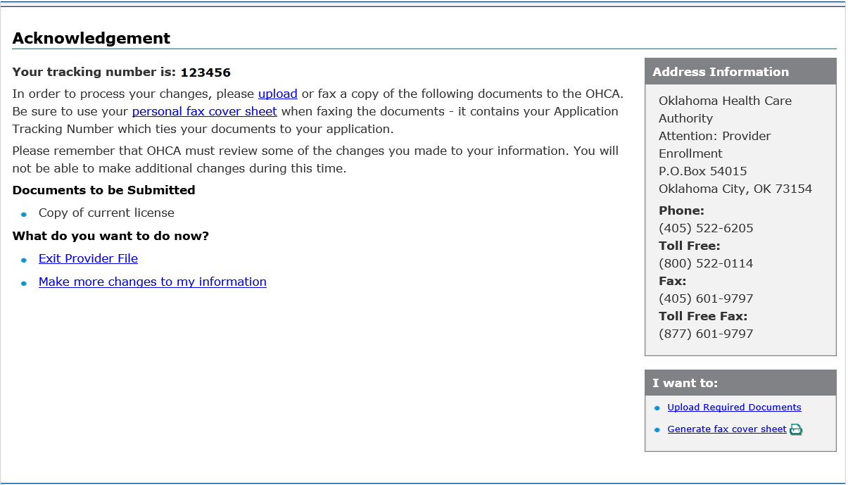
updating license
After submitting the changes, the user will receive an acknowledgement with a tracking number.
To submit the current license, select Upload Required Documents.

Slide 38
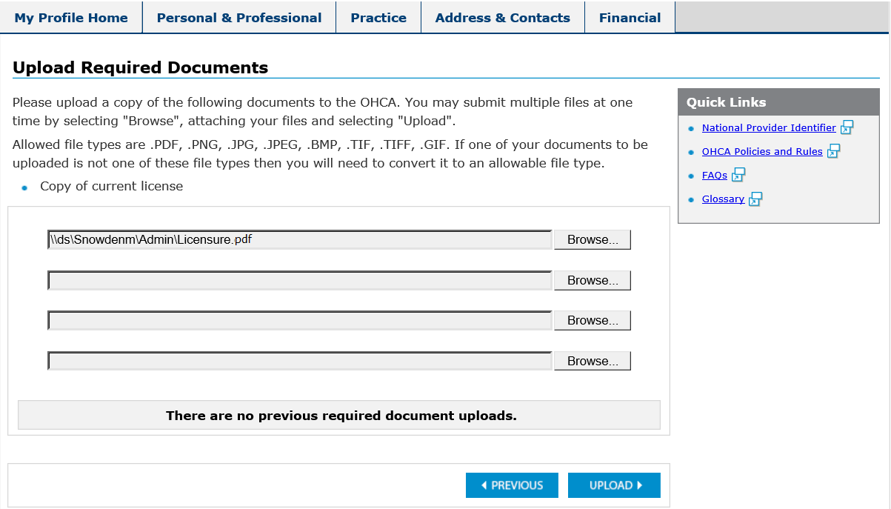
updating license
From the Upload Required Documents section, select the Browse button to find the current license on your device for upload to OHCA.
When the file has been chosen, select Upload.

Slide 39
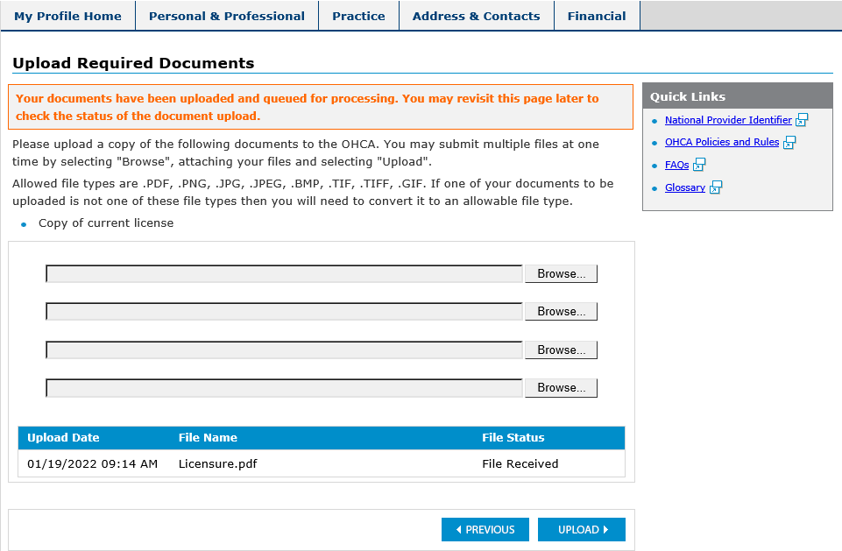
updating license
A message indicating the upload was successful will display, and the file that was uploaded will be listed at the bottom of the page with the file status.

Slide 40
resources

Slide 41
provider enrollment
Phone: 800-522-0114, option 5
Hours: 8 a.m. – 5 p.m. Mon., Tues., Thurs., Fri.
1 – 5 p.m. Wed.
Email: ProviderEnrollment@okhca.org
Web: https://oklahoma.gov/ohca/providers/provider-enrollment.html

Slide 42
Training resources
Provider education specialists:
Education specialists provide education and training as needed for providers either virtually or telephonically.
Requests for assistance should be emailed to: SoonerCareEducation@okhca.org. (Requests should include the provider’s name and ID, contact information, and a brief description of what assistance is being sought.)
For immediate claims or policy assistance, please contact the OHCA provider helpline at 800-522-0114.

Slide 43




GET IN TOUCH
4345 N. Lincoln Blvd.
Oklahoma City, OK 73105
oklahoma.gov/ohca
mysoonercare.org
Agency: 405-522-7300
Helpline: 800-987-7767

