Slide 1

Welcome!

Slide 2
Welcome!
Please turn off your camera
and mute your microphone.

Slide 3
Plan Year 2025​
Benefits Option Period
Dental Plan Breakout Session
Employee Benefits Department​
Human Capital Management

Slide 4
Dental plan presentations

Slide 5
All dental plans
Preventive care.
Basic care.
Major care.
Orthodontic care.

Slide 6






Dental plans

Slide 7





BlueCare Dental
Connecting you to quality health care
through every stage of life
Blue Cross and Blue Shield of Oklahoma, a Division of Health Care Service Corporation, a Mutual Legal Reserve Company, an Independent Licensee of the Blue Cross and Blue Shield Association

Slide 8







BlueCare Dental Benefits — Simplified
SAVING YOU MONEY
ACCESS TO HEALTH CARE
  Affordable plan options to fit your budget
  Discounts throughout the network
  Cost comparison tool to shop for dental services
  Large Dental network across the whole country
  Choose BlueLincs HMO to have all dental and medical info together
  Dental Wellness Center: online resource tool

Slide 9


NO COPAY - PREVENTIVE CARE
  Cleanings and Routine Oral Exams
  Full-Mouth and Bitewing X-Rays
  Sealants
  Space Maintainers
  Topical Fluoride Application
DEDUCTIBLE*
HIGH PLAN
LOW PLAN
Individual
$25
$50
Family
$75
$150
ANNUAL MAX
HIGH PLAN
LOW PLAN
Per Individual
$2,500
$1,500
*Deductible only applies to Basic Care and Major Care category services.

Slide 10
HIGH PLAN
LOW PLAN
BASIC CARE*
  Amalgam and Composite Fillings
  Cleaning, Scaling, and Root Planing
  Emergency (Palliative) Treatments
  Endodontic and Periodontal Services
  Extractions and Oral Surgery
  Topical Fluoride Application
15% In-Network
30% Out-of-Network
Copay
HIGH PLAN
LOW PLAN
MAJOR CARE*
  Bridges, Dentures
  Crowns, Inlays, and Onlays
  Implants
  Reline, Rebase, Recementaions, and Repairs
40% In-Network
50% Out-of-Network
Copay
50% In-Network
50% Out-of-Network
Copay
HIGH PLAN
LOW PLAN
ORTHODONTIA
  Coverage for dependent children to age 19
  No waiting period
  Lifetime Maximum Benefit
50% COPAY
$5,000 LIFETIME
$1,500 LIFETIME
*Deductible applies to these services.

Slide 11

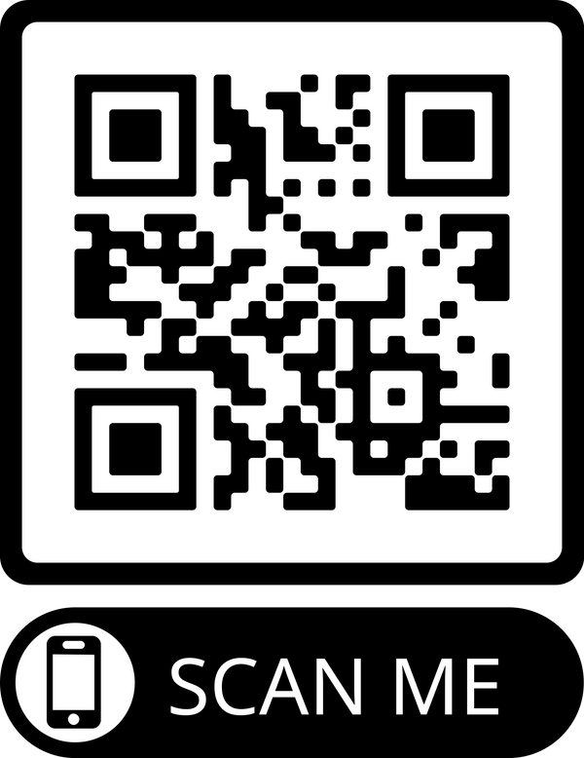


Contact Us
bcbsok.com/state
Customer Service
• Find a dentist
• Prescription drug coverage
• Log into Blue Access for Members
• 855-609-5684
• 24 hours a day
• 7 days a week
Blue Cross and Blue Shield of Oklahoma, a Division of Health Care Service Corporation, a Mutual Legal Reserve Company, an Independent Licensee of the Blue Cross and Blue Shield Association

Slide 12


YOUR CIGNA
DENTAL BENEFITS
Plan year: January 1, 2025 –
December 31, 2025
Offered by Cigna Health and Life Insurance Company, Connecticut General Life Insurance Company, or their affiliates.
862420 b

Slide 13

Welcome to Cigna!
When it comes to
your health,
we’re in this
together.

Slide 14
A plan where one dentist coordinates your care within a network that provides general and specialty dental care
You choose a primary care dentist in the DHMO network where you can receive all your care
By using dentists in the DHMO network you may pay less than you would with other types of dental plans
You pay an office visit fee and the charge listed on your Patient Charge Schedule
There is no out-of-network coverage (except in emergencies)**
There are no deductibles and no annual dollar maximums
Cigna Dental Care® Dental Health Maintenance Organization (DHMO*)

Slide 15

Prepaid Plan (DHMO)
Coverage with no deductibles or waiting periods
Examples of covered services*
Preventive care, such as cleanings and exams, at no added or low cost
Additional cleanings, fluoride, and fluoride varnish available for a copay
Temporomandibular joint (TMJ) diagnosis
General anesthesia/IV sedation when medically necessary
Coverage for brush biopsy, a noninvasive diagnostic procedure for detecting oral cancer
Coverage for teeth whitening (take-home bleaching gel with trays) and athletic mouth guards
No age limit on sealants
Coverage for advanced procedures like crowns and bridges over implants
Second opinions covered
Emergency care
Orthodontic coverage for children AND adults
Notes:
Each member of your family can choose their own network dentist. This is important when, for example, your child is away at school or your spouse needs to find a dentist near work.
Second opinions are covered. Just call Customer Service and they’ll help you make the arrangements.
If you’re in pain and need immediate care, call Customer Service for the name of a nearby network dentist. If an emergency occurs after business hours or a network dentist isn’t available, or you are out of the area, you can use any dentist. Cigna Dental will reimburse up to [$50] of your costs, less applicable patient charges. Or, according to the group agreement/member booklet, e.g., Texas and Pennsylvania have no $ limit.
General Anesthesia/IV sedation is covered when medically necessary and performed by a participating oral surgeon or periodontist.

Slide 16
Your coverage
 | Prepaid Plan- LOW | Prepaid Plan- HIGH
Annual deductible | No deductible | No deductible
Lifetime maximum | None | None
Calendar-year maximum | None | None
Office Visit Fee | $5 | $0
PERCENTAGE YOUR PLAN PAYS
Copay Examples
Preventive care | $0 | $0
Basic restorative Example: Dental Filling- one surface | $23 | $0
Major restorative Example: Root canal, Anterior | $375 | $210
Orthodontia Example: Child/Adult Orthodontia (24-month Treatment) | $2,472 Child $3,384 Adult | $2,040 Child $2,376 Adult
Implants Surgical placement of implant | $1,215 | $1,025

Slide 17

Cigna Dental Oral Health Integration Program®
Available at no added cost to Cigna dental plan members
Pays out-of-pocket costs for specific dental services* if you:
  Have a medical condition that can be affected by gum disease or tooth decay
  Are currently being treated by a doctor for this condition
Eligible conditions: Heart disease, stroke, diabetes, pregnancy, chronic kidney disease, organ transplants, head and neck cancer radiation
Discounts on prescription mouthwash, gels and toothpaste**
Enroll at myCigna.com or call the phone number on back of your Cigna ID card
  Want to know more? Visit myCigna.com or call 800.Cigna24 anytime.
  * You do not need to meet your plan's deductible to receive reimbursement for these services. Any reimbursement you do receive will apply to and is subject to your plan's annual maximum.
  Review your plan materials for a list of covered and non-covered services.
  ** Discounts available through Cigna Home Delivery Pharmacy only. This is a discount, and NOT insurance. If you have other insurance coverage, you should first confirm
  pricing/availability through your insurance carrier as it may result in a lower cost to you.
Notes:
You do not need to meet your plan’s deductible to receive reimbursement for these
services. However, any reimbursement you receive will apply to and is subject to your
plan’s annual maximum

Slide 18

myCigna is your Cigna – Dental
Your personalized Cigna website
Register on myCigna.com in a couple of minutes
Log in anytime to access information, tools and resources
What you can do on myCigna
Take an interactive quiz to measure your risk for cavities, gum disease or oral cancer*
Search for dentists by specialty, procedure, location and language
Check balances, monitor services and manage your dental plan
Use easy tools to estimate costs for over 400 common dental procedures
* These tools are for informational purposes only and should not be used for self-diagnosis. Always see your dentist for appropriate care recommendations and treatment.

Slide 19
We’re here 24/7/365
i
By phone – 800.244.6224
Call anytime day or night for live customer service
Ask for a Spanish-speaking representative or speak with us in your preferred language – interpreter service is available in over 200 languages
Get help finding a dental office
Check your eligibility
  Download the myCigna Mobile App*** for easy access on the go!
myCigna – online or through the mobile app
Review your plan information and check a claim status
Find network dentists
Print temporary ID cards
Change your DHMO dental office*
View year-to-date dental costs and estimate approximate costs prior to treatment
Take oral health assessments that you can share with your dentist

Slide 20
THANK YOU FOR YOUR TIME!

Slide 21
Appendix A
Minnesota Residents: When enrolling in a DHMO plan, you must visit your selected network dentist in order for the charges on the Patient Charge Schedule to apply. You may also visit other dentists that participate in our network or you may visit dentists outside the Cigna Dental Care network. If you do, the fees listed on the Patient Charge Schedule will not apply. You will be responsible for the dentist’s usual fee. We will pay 50% of the value of your network benefit for those services. You’ll pay less if you visit your selected Cigna Dental Care network dentist. Call Customer Service for more information.
Oklahoma Residents: DHMO for Oklahoma is an Employer Group Pre-Paid Dental Plan. You may also visit dentists outside the Cigna Dental Care network. If you do, the fees listed on the Patient Charge Schedule will not apply. You will be responsible for the dentist’s usual fee. We pay non-network dentists the same amount we’d pay network dentists for covered services. You’ll pay less if you visit a network dentist in the Cigna Dental Care network. Call Customer Service for more information.
DHMO for residents of Minnesota and Oklahoma

Slide 22


2025 Dental Benefits Options
for State, Education & Local Government Employees
Celebrating 20 years of serving State of Oklahoma employees and their families!

Slide 23



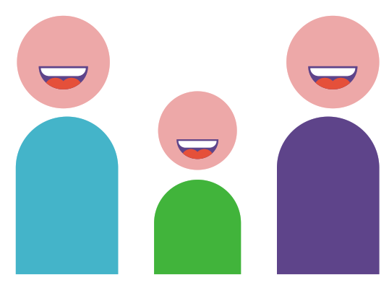

We Deliver a Superior Customer Experience
DDOK does not deny coverage due to pre-existing conditions
No waiting periods before you can begin receiving treatment
Our coverage includes replacement of a missing tooth, even if it was lost prior to your DDOK coverage
99%
Plan options for State employees include
orthodontic coverage for adults and children.
We allow benefits for comprehensive orthodontic cases, even if treatment was started prior to DDOK coverage
Overall member satisfaction rating – and percentage of inquiries (calls) resolved during initial contact

Slide 24
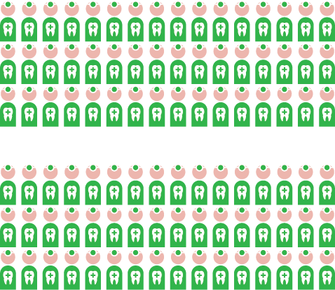

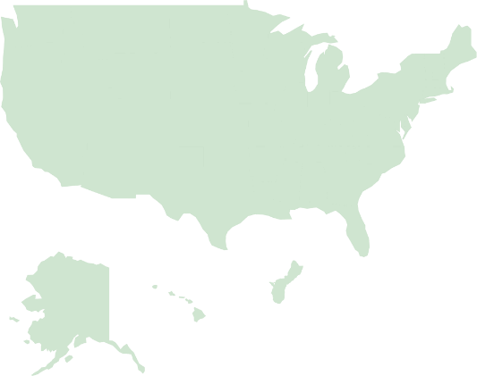
We Deliver the Largest Network of Dentists
Oklahoma’s Largest Dental Network
Our unmatched network strength means
your dentist likely participates with Delta Dental –
ask if your dentist is a Delta Dental PPO provider
to enjoy maximum savings!
Just over 1,800 dentists practice in the state, and more than 1,000 of those dentists participate in Delta Dental’s PPO network.
Nationwide
Access

Slide 25
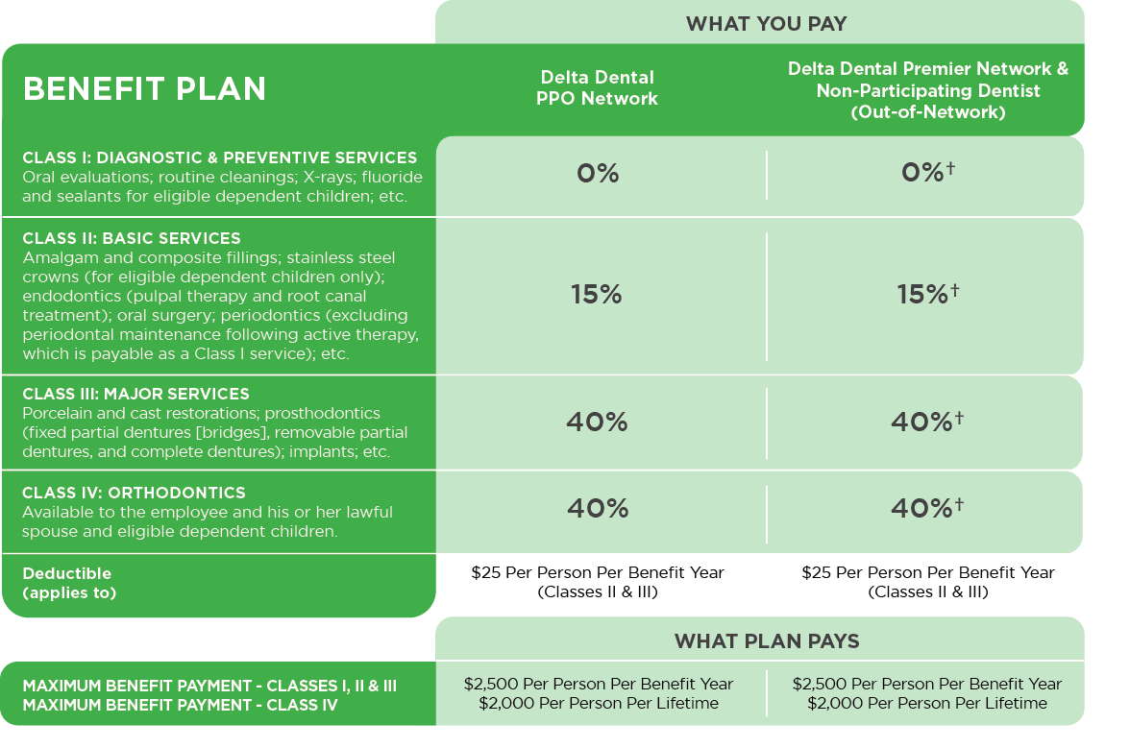
Option 1: Delta Dental PPO**
†If you receive treatment from a Delta Dental Premier provider, you will be responsible for the difference between the PPO allowable and Premier allowable amounts. If you are treated by a dentist who does not participate with Delta Dental (out-of-network), you will be responsible for the difference between the dentist charge and the PPO allowable amount.
**Dependents eligible To age 26

Slide 26
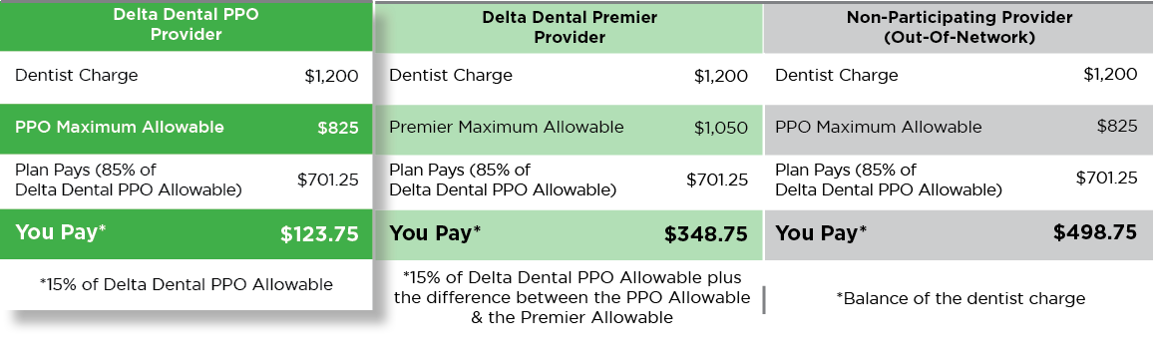
Option 1: Delta Dental PPO
This plan option provides access to both the Delta Dental PPO and the Delta Dental Premier networks. Subscribers of this plan are welcome to receive treatment from the licensed dentist of their choice, but will have lower out-of-pocket expenses when they visit a Delta Dental PPO participating dentist.
Example
Payment of a covered Class II dental service**
**Assumes deductible is satisfied

Slide 27
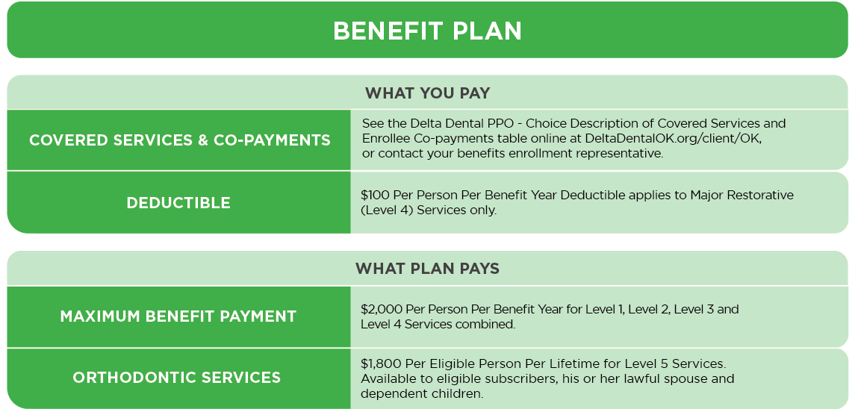
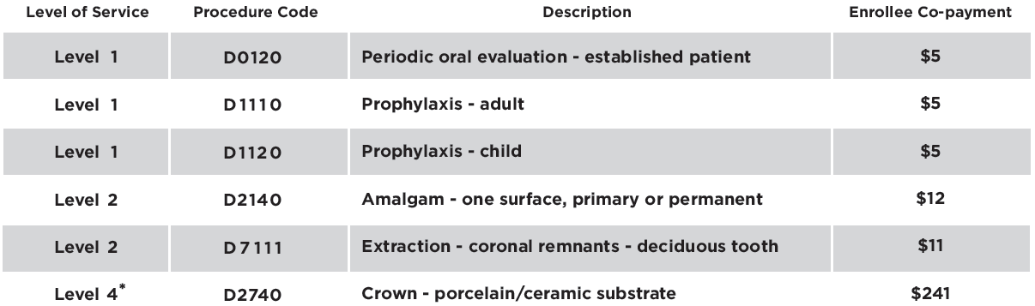
Option 2: Delta Dental PPO – Choice**
Members who select this low-cost program have access to the Delta Dental PPO network and will be responsible for the amounts reflected in the Delta Dental PPO – Choice Description of Covered Services and Enrollee Co-payments table along with any deductible. Their out-of-pocket expenses will be lower if they use a Delta Dental PPO provider.
Examples of Covered Services & enrollee Co-payments
*Assumes deductible is satisfied
**Dependents eligible To age 26

Slide 28

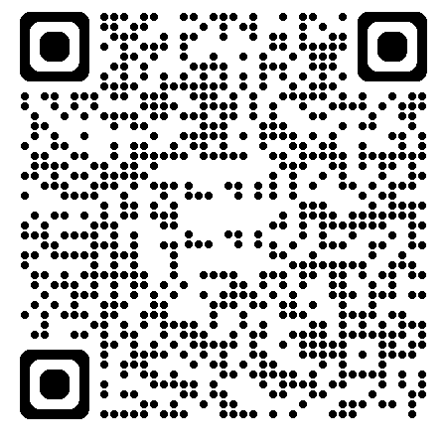
Visit Our Custom Website for State Employees
To learn more about the plans and services available to you with Oklahoma’s leading dental benefits provider, please scan the QR code to visit DeltaDentalOK.org/client/OK
Review Plan Information
Search for Participating Dentists
Access Monthly Health Tip
Learn Answers to FAQs
Register for Spotlight to access:
  an electronic ID card
  plan information, including Explanation of Benefits (EOBs)
  secure messaging with our Customer Service team
  claim status and history, and more!
Visit DeltaDentalOK.org/client/OK today!

Slide 29

We would welcome the opportunity to serve you and your family in 2025.
Please do not hesitate to contact us with any questions.
Live Answer Customer Service
Monday – Thursday, 7:00 a.m. – 6:00 p.m.
Friday, 7:00 a.m. – 5:00 p.m.
405-607-2100 (OKC Metro) 800-522-0188 (Toll Free)
DeltaDentalOK.org/client/OK

Slide 30

Dental Plan
WE LOVE TO MAKE
YOU SMILE!
HealthChoiceOK.com

Slide 31

WHY CHOOSE HEALTHCHOICE DENTAL?
  Network and non-network benefits available.
  Network providers file your claims for you.
  No limit on orthodontic benefit for members under age 19.
  $2,500 calendar year maximum benefit per person for preventive, basic and major services.

Slide 32

Preventive Services
Network and non-network covered at 100% of allowable amounts.
Cleanings and topical fluoride treatments; two per calendar year.
Bitewing X-rays; two per calendar year.
Full mouth X-rays; one every 36 months.

Slide 33

Basic Restorative Services
Extractions, including wisdom teeth.
Oral surgeries, including general anesthesia.
Root canals and crown repairs.
$25 per individual/$75 per family calendar year deductible.
Plan pays 85% of allowable amounts when using a network provider.

Slide 34

Major Restorative Services
  Initial placement of full or partial removable dentures.
  Dental implant approved by FDA.
  Inlays, onlays and crown restorations.
  $25 per individual/$75 per family calendar year deductible.
  Plan pays 60% of allowable amounts when using a network provider.

Slide 35

Orthodontic Services
  No lifetime maximum.
  No calendar year deductible.
  Orthodontic services for members under age 19.
  Orthodontic services for treatment of TMD at any age.*
  12-month waiting period applies to new enrollees to the plan.
  Plan pays 50% of allowable charges.
*If diagnosed with TMD, certification may be required.

Slide 36

Resources
HealthChoiceOK.com
  Dental handbook.
  Provider Search page.
  EGID Member Services
  405-717-8780 or 800-752-9475
HealthChoice Customer Care
  800-323-4314
TTY 711

Slide 37

Dental Insurance
Prepared for: State of Oklahoma
ADF# MULTI1825.18
Notes:
Thank you for taking time out of your day to listen to a short talk about the importance of Dental benefits.

Slide 38
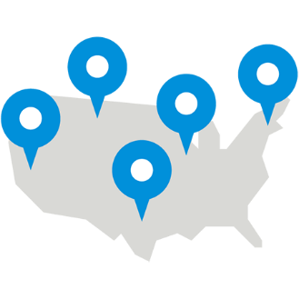



Dental PPO ^{D1} – What’s in it for you? ^{D2 D3}
You can choose a provider from the PDP Plus Network, carefully selected, pre-screened dentists^{D1}
You’ll typically pay 35-50% less than the average charges in the same area^{D4 D6}
Usually your dentist files dental claims on your behalf– meaning less paperwork for you
You’ll have easy access to pre-treatment estimates,^{D3} and real-time claims processing

Slide 39
Dual Option Benefits Breakdown
PDP PLUS Network
High Classic MAC |  | Low Classic MAC
In-network dentists: percentage of negotiated fee^{D4} | Out-of-network dentists: Maximum Allowable Charge^{D5} | In-network dentists: percentage of negotiated fee^{D4} | Out-of-network dentists: Maximum Allowable Charge^{D5}
Services Provided
Type A: Preventive | 100% | 100% | 100% | 100%
Type B: Basic | 85% | 85% | 70% | 70%
Type C: Major | 60% | 60% | 50% | 50%
Type D: Orthodontia | 60% | 60% | 50% | 50%
Annual deductible For type: B and C services | $25 individual/ $75 family | $25 individual/ $75 family | $50 individual/ $150 family | $50 individual/ $150 family
Annual benefits maximum excluding orthodontia | $5000 per person | $5000 per person | $1,500 per person | $1,500 per person
Orthodontia lifetime benefits maximum | $5000 Lifetime maximum Adults/Children | $5000 Lifetime maximum Adults/Children | $2000 Lifetime maximum Adults/Children | $2000 Lifetime maximum Adults/Children
Child(ren)’s eligibility for dental coverage is from birth up to age 26.
Notes:
Here are the highlights of the High Classic and Low Classic Plans.
Type A, preventive services, are covered 100%.
For Type B, basic services, your benefit plan covers 85% under the High Classic Plan, and 70% under the Low Classic Plan; once you’ve paid your annual deductible.
You can also see the coverage specifics for Type C, major services, the annual benefits maximum of $5000 or $1,500 (depending on what plan you choose) and orthodontia coverage for both adults and children.
Please refer to your enrollment materials for additional information.

Slide 40
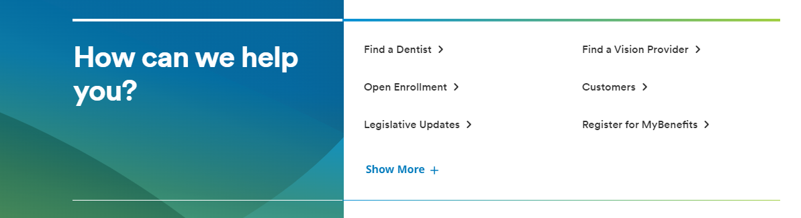
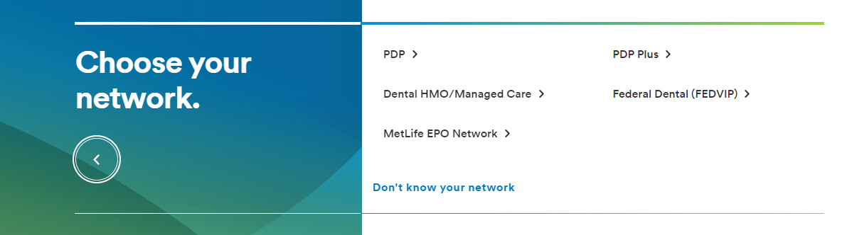
Find a Dental Provider
With MetLife Dental insurance, you can choose from thousands of general dentists and specialists nationwide. You can find the names, addresses, languages spoken and phone numbers of participating dentists by searching our online Find a Dentist directory.
Step 1:
Go to metlife.com
Step 2:
Select “Find a Dentist” next to “How can we help you?"
Step 3:
Select "PDP Plus" next to "Choose your network."
Enter your Zip, City or State and select the “Find a Dentist” button. You will then be prompted to select your plan from the list. The plan name is located in your Schedule of Benefits.
Notes:
With MetLife Dental insurance, you can choose from thousands of general dentists and specialists nationwide. You can find the names, addresses, languages spoken and phone numbers of participating dentists by searching our online Find a Dentist directory.

Slide 41
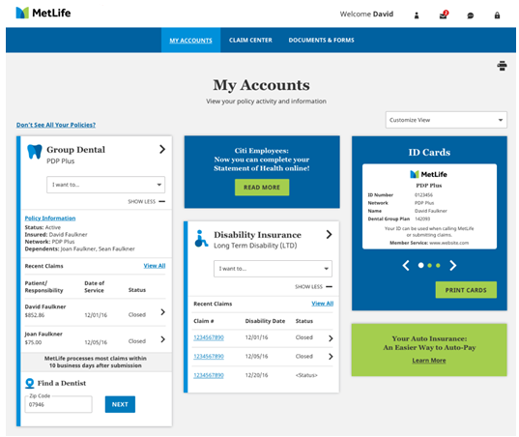
You can benefit from MyBenefits
MetLife Online Services capabilities may vary by product and may not be available to all customers.
www.metlife.com/mybenefits
With MyBenefits you can...
2
  View enrollment status
  Check recent claims and status
  Print ID cards
  Find essential forms
  Access educational tools
1
1
Customized product section with additional policy
contract and product details
Easy access to Forms, Customer Support and Claims Center
2
Notes:
MyBenefits is the quickest and easiest way to get extensive information about your coverage. You can access helpful tools, benefit information and take advantage of the self-service features.
With MyBenefits you can…
View enrollment status
Check recent claims and status
Print Dental ID cards
Find essential forms
And Access educational tools

Slide 42
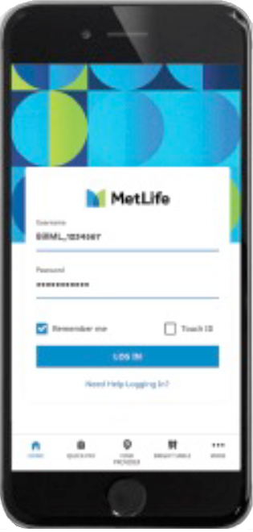
The MetLife Mobile App
Download “MetLife US” at the App Store or Google Play. Log in with your MyBenefits information to access these features.*
Dental | Find a dentist and get estimates on most procedures. View your claims. Access and print your electronic ID card.
ID cards are not required to obtain dental services.
Notes:
The MetLife Mobile App is available on the App Store and Google Play. After downloading the app and registering at www.metlife.com/mybenefits from a computer, you can quickly and securely access coverage details, find a dentist and get estimates on most procedures, view your claims and access & print your electronic dental ID card.
Please note, ID cards are not required to obtain dental services.

Slide 43
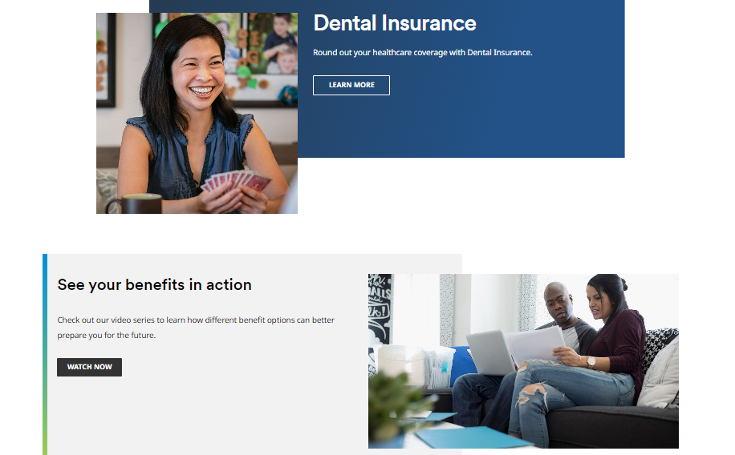
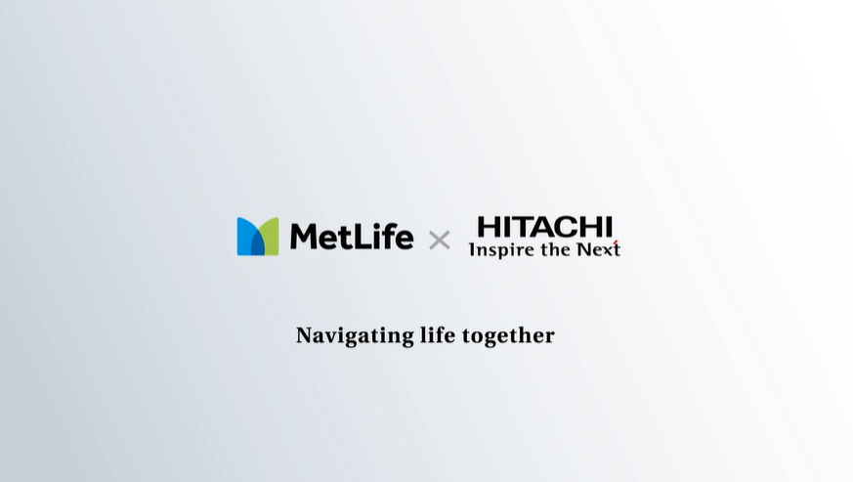

www.metlife.com/info/oklahoma/
1-855-676-9443
Your benefits microsite can help
you understand the importance
of dental benefits and the
coverage options available.
Dedicated Customer Contact
Phone Number.
Metropolitan Life Insurance Company, New York, NY
L0821016378[exp1022][All States][DC,GU,MP,PR,VI]
© 2023 MetLife Services and Solutions, LLC
Metropolitan Life Insurance Company, New York, NY
© 2023 MetLife Services and Solutions, LLC
Notes:
If you have any questions or would like additional information, please call 1-855-676-9443 or visit www.metlife.com/stateofoklahoma.

Slide 44
Thank you.
Notes:
Thank you for listening to this brief presentation from MetLife.

Slide 45
Dental Footnotes
* May be subject to any plan cost sharing such as benefits maximums.
D1. Like most group benefit programs, benefit programs offered by MetLife and its affiliates contain certain exclusions, exceptions, reductions, limitations, waiting periods and terms for keeping them in force. Please contact MetLife or your plan administrator for costs and complete details.
D2. Certain providers may participate with MetLife through an agreement that MetLife has with a vendor. Providers available through a vendor are subject to the vendor’s credentialing process and requirements, not MetLife’s. If you should have any questions, contact MetLife Customer Service.
D3. A pre-treatment estimate is only an estimate. The actual amount that MetLife will pay is determined when a claim is submitted, and is subject to any co-payments, deductibles, cost sharing and benefits maximums
D4. Negotiated fees refer to the fees that in-network dentists have agreed to accept as payment in full for covered services, subject to any deductibles, copayments, cost sharing and benefit maximums. Negotiated fees are subject to change.
D5. Reimbursement for out-of-network services is based on the lesser of the dentist’s actual fee or the Maximum Allowable Charge (MAC). Maximum Allowable Charge: The out-of-network Maximum Allowable Charge is equal to the in-network negotiated fee.
D6. Based on internal analysis by MetLife.
D7. R&C fee refers to the Reasonable and Customary (R&C) charge, which is based on the lowest of 1) the dentist’s actual charge, 2) the dentist’s usual charge for the same or similar services or 3) the usual charge of most dentists in the same geographic area for the same or similar services as determined by MetLife.
D8. Please see plan details for out-of-network benefits.
D9. MetLife PDP Copay plans are only available to groups with 1,000 or more eligible employees. Copay plans are not available for insured cases in Texas, including plans sitused in Texas or covering Texas residents. Copay plans are also not available for insured cases in Connecticut.
D10. Certain Limitations apply to some services; please review your Schedule of Benefits for full details.
D11. In California, orthodontic and pedodontic specialty services require pre-approval. Your selected participating dentist will contact SafeGuard for pre-approval. Once approved, your dentist will contact you with the name of a participating specialist.

Slide 46
Product Disclaimers
Like most group benefit programs, benefit programs offered by MetLife and its affiliates contain certain exclusions, exceptions, waiting periods, reductions of benefits, limitations and terms for keeping them in force. Please contact MetLife for complete details.]
Group dental insurance policies featuring the Preferred Dentist Program are underwritten by Metropolitan Life Insurance Company, New York, NY 10166.
ADF# MULTI1825.18

Slide 47

YOUR BENEFITS FROM SUN LIFE
Discover new ways to protect what you love
Janet Ruggiano
Benefits Counselor, Sun Life
PY 2025

Slide 48

Dental insurance
Protects your smile
Prevents other health issues
Lowers out-of-pocket expenses

Slide 49

Sun Life Dental
Dental insurance can help lower your out-of-pocket expenses so you and your family can maintain healthy smiles – and better overall health, too.
Deductible: $30 per person per calendar year
Annual maximum: $1750 per person per calendar year – Preventive, Basic and Major Services
Orthodontia Services: $1500 Lifetime Maximum per child to age 19
Freedom to choose dentists both in and out of the network
Periodontal disease can lead to receding gums, loss of teeth, and can increase the risk of other health problems such as heart disease and diabetes.¹
1. https://www.mayoclinic.org/diseases-conditions/periodontitis/symptoms-causes/syc-20354473 (accessed 08/23)

Slide 50

Coinsurance for Covered Services
Procedure | In Network | Out of Network
Preventive – Type 1 | 100% | 100%
Basic – Type 2 | 85% | 70%
Major – Type 3 | 60% | 50%
Orthodontia – Type 4 | 60% | 50%
These are the percentages your plan pays of the provider’s fee (after any applicable deductible has been satisfied).

Slide 51

Network dentists can save you* $$
Example | Network Dentist | Non-Network Dentist
Average charge for crown** | $1,278 | $1,278
Minus network discount | 30% | NA
Actual fee | $894 | $1,278
Insurance pays 50% | $447 | $639
Claimant pays | $447 | $639
You could save $192 by going to a network dentist!
*This example is for illustrative purposes only. Cost of dental procedures may differ depending on location or dental provider. Savings may also differ in cases when deductibles apply or if the dentist’s discount differs from 30%
**2023 Fair Health data. Figures have been rounded to the nearest dollar.

Slide 52

Lifetime of Smiles®
Your plan includes:
Brush biopsies for early detection of oral cancer
Genetic testing to help identify individuals at genetic risk for gum disease
Periochips to control bacteria and reduce the size of periodontal pockets
Four cleanings per year to help prevent gum disease (coverage up to 4 periodontal cleanings in a 12-month period)^{1,2}
Tooth-colored fillings for back teeth
1. Dental prophylaxis cleaning is limited to 1 time in any 6-month period and periodontal maintenance procedure is limited to 1 in any 3-month period. Total number of combined dental prophylaxis cleanings and periodontal maintenance procedures cannot exceed 4 in a 12-month period. 2. Classification of services varies by plan design.

Slide 53


Teledentistry
Virtual access to dental providers, whenever, and wherever you are.
Members*can now use TeleDentistry.com Virtual Dental Visits for situations such as:
  Experiencing a dental emergency and not having a dentist
  Needing access to a dentist after hours
  Wanting to consult a dentist without leaving home or while traveling
Learn more at www.teledentistry.com/sunlife
*Teledentistry.com services are only available to members covered under dental PPO plans issued or administered by Sun Life Assurance Company of Canada or, in New York, dental PPO plans issued or administered by Sun Life and Health Insurance Company (U.S.) who have access to the Sun Life Dental Network, Sun Life Focus Dental Network, Assurant Dental Network or Assurant Focus Dental Network. Members covered under a prepaid or indemnity plan are not eligible for services through Teledentistry.com.

Slide 54

Accessing your dental ID card
If your card isn’t available yet
Provide this info and your social security number at your next dental appointment.
Information for your dentist:
Sun Life Dental Network®
Group name: State of Oklahoma
Policy #: 918714
Effective date: January 1, 2025
Electronic claims: Payor 70408
Toll-free phone: 800-442-7742, extension 1555443
Snap a picture
You can access a copy of your dental ID card through your Sun Life account at www.sunlife.com/account
Check out our short video for step-by-step instructions on downloading your dental ID card at www.sunlife.com/dentalIDcard

Slide 55

How to find a dentist
Visit www.sunlife.com/findadentist
  Select the network listed on your ID Card
  Enter your search criteria and a list of participating dentists will be provided
Call customer service at 800-442-7742 for assistance in locating a network dentist
Access it from the Dental Health Center at www.sunlife.com/dentalhealthcenter
Is your Dentist not in our network? Use the Provider nomination card if your dentist is not in our network of dentists.

Slide 56

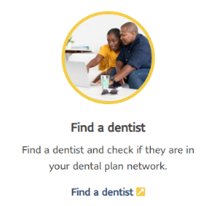
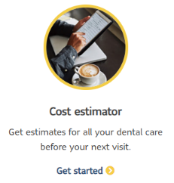
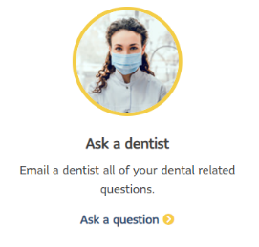
Sun Life’s Dental Health Center
Get the most from your dental plan by visiting our Dental Health Center
Learn more about dental treatments and find average dental procedure costs
Access a dental insurance glossary
Read the latest dental news
Pose questions through ask-a-dentist
Take control of your dental health at www.sunlife.com/dentalhealthcenter

Slide 57

The importance of submitting a pre-determination
We highly recommend a pre-determination for any of those major services that are expected to exceed $500
Pre-determination facts:
A pre-determination is an estimate of how much of a proposed treatment plan will be covered under your dental program.
A pre-determination allows you, the member, to figure costs before receiving major treatment.
A pre-determination is designed to help avoid any
mis-understanding between you, your dentist, and us as to how much will be paid for any dental services.

Slide 58

What if you are in the middle of a treatment?
Treatment in progress
We require your history/treatment plan from your provider at the time of claim processing. Please let your dentist know that you have a new carrier and to submit your history/treatment plan to our dental claims area. We will not pay benefits if the prior plan has an extension of benefits provision that covers the treatment. Benefits may also be subject to prorating.
Orthodontia in progress
Orthodontia coverage must have been available under the prior carrier’s plan and a payment must have been issued under that plan for the orthodontic services in progress. Any benefits allowable will be up to the lesser of the maximum benefit of our plan or the prior plan reduced by any payments made by the prior carrier. To determine your eligibility for benefits, please forward to us your current treatment plan as well as the total benefit paid by the prior carrier.]
These guidelines are intended to provide general information on coverage for dental treatments in progress when your dental coverage is transferred to us. This information only applies to individuals enrolled in dental coverage under the prior carrier’s plan for your employer. If you weren’t enrolled for dental coverage with the prior carrier for your employer this will not apply to you. More specific information regarding coverage can be found in your issued contract or by contacting Sun Life.

Slide 59

You’ve built a great life.
Protect it.
Enroll in your Sun Life benefits during your Open Enrollment
Notes:
You’ve built a great life. Protect it.
REMINDER: Sign up when life insurance is first offered so you won’t have to answer medical questions and provide proof of good health.

Slide 60
The “fine print”
This dental plan does not provide coverage for pediatric oral health services that satisfies the requirements for “minimum essential coverage” as defined by the Patient Protection and Affordable Care Act. (“PPACA”).
Notes:
The “fine print”
This AD&D insurance policy may have Evidence of Insurability requirements and exclusions subject to state law.
[This AD&D insurance policy has exclusions and limitations.]
Please see your plan details for more information.
[This coverage does not constitute comprehensive health insurance (often referred to as “major medical coverage”) and does not satisfy the requirement for Minimum Essential Coverage under the Affordable Care Act.]

Slide 61
Not approved for use in New Mexico.
Group insurance policies are underwritten by Sun Life Assurance Company of Canada (Wellesley Hills, MA) in all states, except New York, under Policy Form Series 93P-LH, 98P-ADD, 07-SL REV 7-12, 07P-LH-PT/07C-LH-PT, 01P-ADD-PT/01C-ADD-PT, GP-A, GC-A, 12-GP-01, 15-GP-01, 12-DI-C-01, 16-DI-C-01, 12-SD-C-01, 13-SD-C-01, 13-SDPort-C-01, 12-AC-C-01, 12-ACPort-C-01, 16-AC-C-01, 16-ACPort-C-01, 13-ADD-C-01, 13-ADDPort-C-01, 15-ADD-C-01, 12-GPPort-P-01, 12-STDPort-C-01, 16-SD-C-01, 16-SDPort-C-01, 16-CAN-C-01, 16-CANPort-C-01, 15-LF-C-01, 15-LFPort-C-01, 16-DEN-C-01, 16-VIS-C-01, TDBPOLICY, TDI-POLICY, 20-HI-C-01, 12-GPPort-P-01, 20-HIPORT-C-01, 20-PFML-GP-01-MA, 21-PFML-GP-01-CT, 23-FAMLI-GP-01-CO, 22-PFML-GP-01-OR, 23-SD-C-01, 23-SD-PORT-C-01, 23-SD-R-01, 23-SD-R-02, 23-SD-R-03, 23-SD-R-04, 23-SD-R-05, 23-SD-R-05. Prepaid dental products are provided and administered by Sun Life Assurance Company of Canada (SLOC) under Form Series BDC-GDSA, PDC, and are provided by prepaid dental companies, affiliated with SLOC, under Form Series BDC-GDSA, UDC-CA-GA06-UDC, UDC-CA-GA06-89, FB-NJ-0281, UDC-09-GDSA-TX, PDC in certain states except New York. Prepaid dental companies are Denticare of Alabama, Inc., United Dental Care of Arizona, Inc., UDC Dental California, Inc., United Dental Care of Colorado, Inc., Union Security DentalCare of Georgia, Inc., United Dental Care of Missouri, Inc., Union Security DentalCare of New Jersey, Inc., United Dental Care of New Mexico, Inc., UDC of Ohio, Inc., and United Dental Care of Texas, Inc.. In New York, group insurance policies are underwritten by Sun Life and Health Insurance Company (U.S.) (Lansing, MI) under Policy Form Series 15-GP-01, 13-GP-LF-01, 13-LF-C-01, 13-GP-LH-01, 13-ADD-C-01, 12-DI-C-01, 13-LTD-C-01, 13-STD-C-01, 06P-NY-DBL, 07-NYSL REV 7-12, GC-A, GP-A, 12-GP-SD-01, 13-SD-C-01, 13-SDPort-C-01, 12-GP-01, 12-AC-C-01, 12-ACPort-C-01, 13-LFPort-C-01, 13-ADDPort-C-01, 15-LF-GP-01, 15-SD-GP-01, 12-STDPort-C-01, 16-VIS-C-01, 15-HI-GP-01, 20-HI-C-01, 12-GPPort-P-01. In New York, prepaid dental products are provided and administered by Sun Life and Health Insurance Company (U.S.) (SLHIC) (Lansing, MI) under Form Series BDC-GDSA-NY. Product offerings may not be available in all states and may vary depending on state laws and regulations. Certain provisions, benefits, exclusions or limitations may vary by state. Plans contain limitations, exclusions and restrictions. Contact us for additional information. The group insurance policies described in this advertisement do NOT provide basic hospital, basic medical, or major medical insurance.
© 2024 Sun Life Assurance Company of Canada, Wellesley Hills, MA 02481. All rights reserved. The Sun Life name and logo are registered trademarks of Sun Life Assurance Company of Canada. Visit us at www.sunlife.com/us.
GVMPPPT-EE-4496A-aj #1365442988 05/24 (exp. 05/26)

Slide 62
Questions?

