Slide 1

Welcome!

Slide 2
Welcome!
Please turn off your camera
and mute your microphone.

Slide 3
Plan Year 2025​
Benefits Option Period
Health Plan Breakout Session
Employee Benefits Department​
Human Capital Management

Slide 4
Health plan presentations

Slide 5





Health plans

Slide 6
All health plans
Out-of-pocket maximums.
Prescription drug benefits.
Designated provider networks.
Preventive services.
No preexisting condition exclusions.
Coordination of benefits.
Coverage of emergency care.

Slide 7
Some health plans
Calendar year deductibles.
Referral for specialist visits.
Preauthorization for certain medical services.

Slide 8
All HMO plans
No deductibles.
No coinsurance.
No balance billing.
You designate a primary care physician.

Slide 9
Health plans overview
No benefit changes for any of the health plans for Plan Year 2025.

Slide 10





BlueLincs HMO
Blue Cross and Blue Shield of Oklahoma, a Division of Health Care Service Corporation, a Mutual Legal Reserve Company, an Independent Licensee of the Blue Cross and Blue Shield Association

Slide 11





MEET SHAWN
Shawn is a 35-year-old living in Oklahoma City. He is a prediabetic who is looking for employee-only coverage.
He is a prediabetic
Looking for employee-only coverage
Shawn
Loves living in OKC & traveling

Slide 12







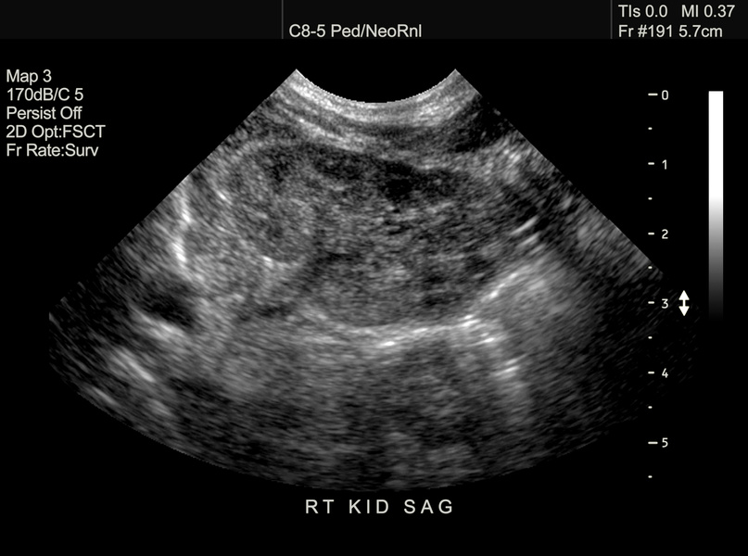
MEET THE
HOPPER
FAMILY.
Away From
Home Care
Pregnancy &
Parenting
Tools
Jason
Maria
Telemedicine
Visit
24-hour
Nurseline
Axel
Carson
Baby Hopper
Connecting you to quality health care
through every stage of life

Slide 13





Your Benefits with
BlueLincs HMO
SAVING YOU
MONEY
ACCESS TO
HEALTH CARE
•No deductible
•Low copay for primary doctor visits
•The most affordable
employee-only HMO option
•Largest HMO network in the state
•No referrals required within the network
•24/7 Nurseline & Virtual Visits

Slide 14




PROVIDERS WHERE YOU ARE
St. Francis
Ascension St. Johns
Hillcrest
Integris Health
Mercy
St. Anthony
OSU Health Center
Lakeside Womens
McBride Orthopedic
OU Medical Center
Oklahoma Heart Center
Norman Regional
McAlester Regional Wagoner Health
Northeastern
Rural Wellness
Indian Health Care
Cleveland Hospital
In-network providers
in every county in Oklahoma
116 in-network hospitals

Slide 15



Your Wellness = Our Priority
Wellness Coaching
Fitness Program
Professionally certified coaches help employees with nutrition, physical activity, stress management, tobacco cessation, improving blood pressure, improving cholesterol, weight loss,
and weight maintenance.
The Fitness Program is a flexible membership program that gives your employees access to a nationwide network of thousands of fitness locations as well as digital options.
  Well onTarget Member Wellness Portal
  Fitness and Nutrition Tracking
  BluePoints
  Health Assessment
  Self-Management Programs
  Preventive Care Reminders

Slide 16




Contact Us
bcbsok.com/state
Customer Service
• Find a doctor or hospital
• Prescription drug coverage
• Log into Blue Access for Members
• 855-609-5684
• 24 hours a day
• 7 days a week

Slide 17
2025 Active & Pre-Medicare Benefits
State, Education & Local Government

Slide 18

CommunityCare Mission Statement
To serve Oklahomans with local, personalized, and compassionate services in pursuit of every member's optimal health and wellbeing.
Valued partnership for 30 consecutive years!
Comprehensive Benefits
Superior
Customer Experience
Affordable Premiums
Large Provider Network
CommunityCare has the lowest HMO plan premiums for spouse and family coverage!

Slide 19

Medical & Prescription Drug Benefits
No Changes
Medical
Family OOP: $8,000*
Lab/X-ray: $0*
Prescription Drugs
Preferred Generic: $15
Preferred Brand: $40
Additional Highlights
No PCP Referrals
Complex Imaging: $200*
Non-Preferred: $70
Specialty: $160
$0 copay on select generics
Specialty medication vendors with online enrollment:
IP Hospital: $350/day (max 5 days)
Specialist: $50
30-day supply
- CVS Caremark
- AllianceRx Walgreens Prime
90-day supply (Retail or Mail Order)
- Blood pressure
- Cholesterol
- Antidepressants
- Anti-inflammatory
OP Hospital: $300
No Deductible $0
Mail Order Vendors:
CVS Specialty
Walgreens Specialty
PCP: $35
ER Copay: $200*
* Lowest of all HMO Plans

Slide 20




















CommunityCare Network
Warren Clinic
Ascension Medical Group

Slide 21
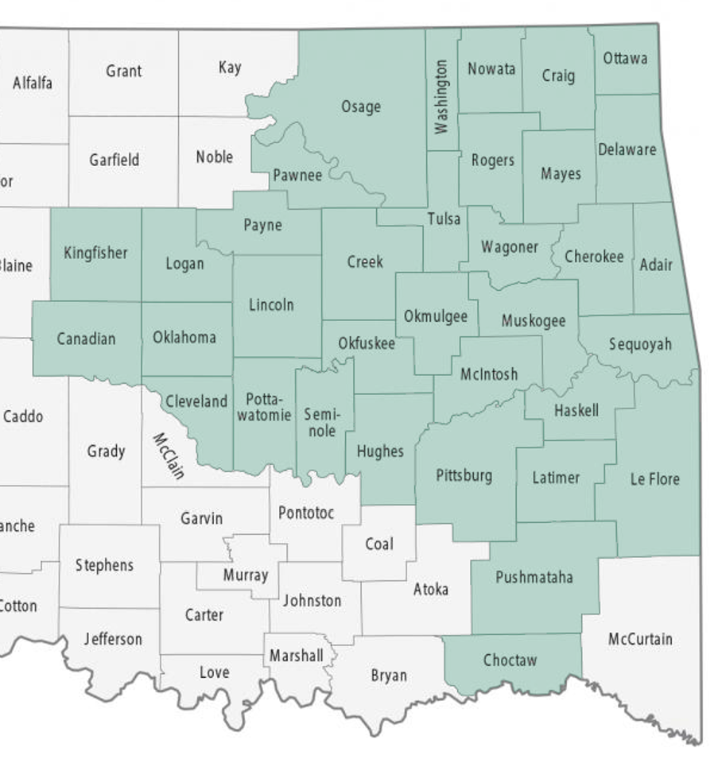
CommunityCare Service Area
Continuing in 2025 with 35 Counties.
Visit state.ccok.com to verify providers.
Contact Customer Service for assistance.

Slide 22


Enhanced Mobile App
Download CommunityCare Mobile App:
Access your digital ID card
Benefits and out-of-pocket summary
Claims and EOB information
Provider directory and much more!
Enhanced App Features Include:
Device Authentication using Face ID
Send a secure email to CommunityCare
Links to health and wellness resources
Display member address, phone, and email in Profile

Slide 23
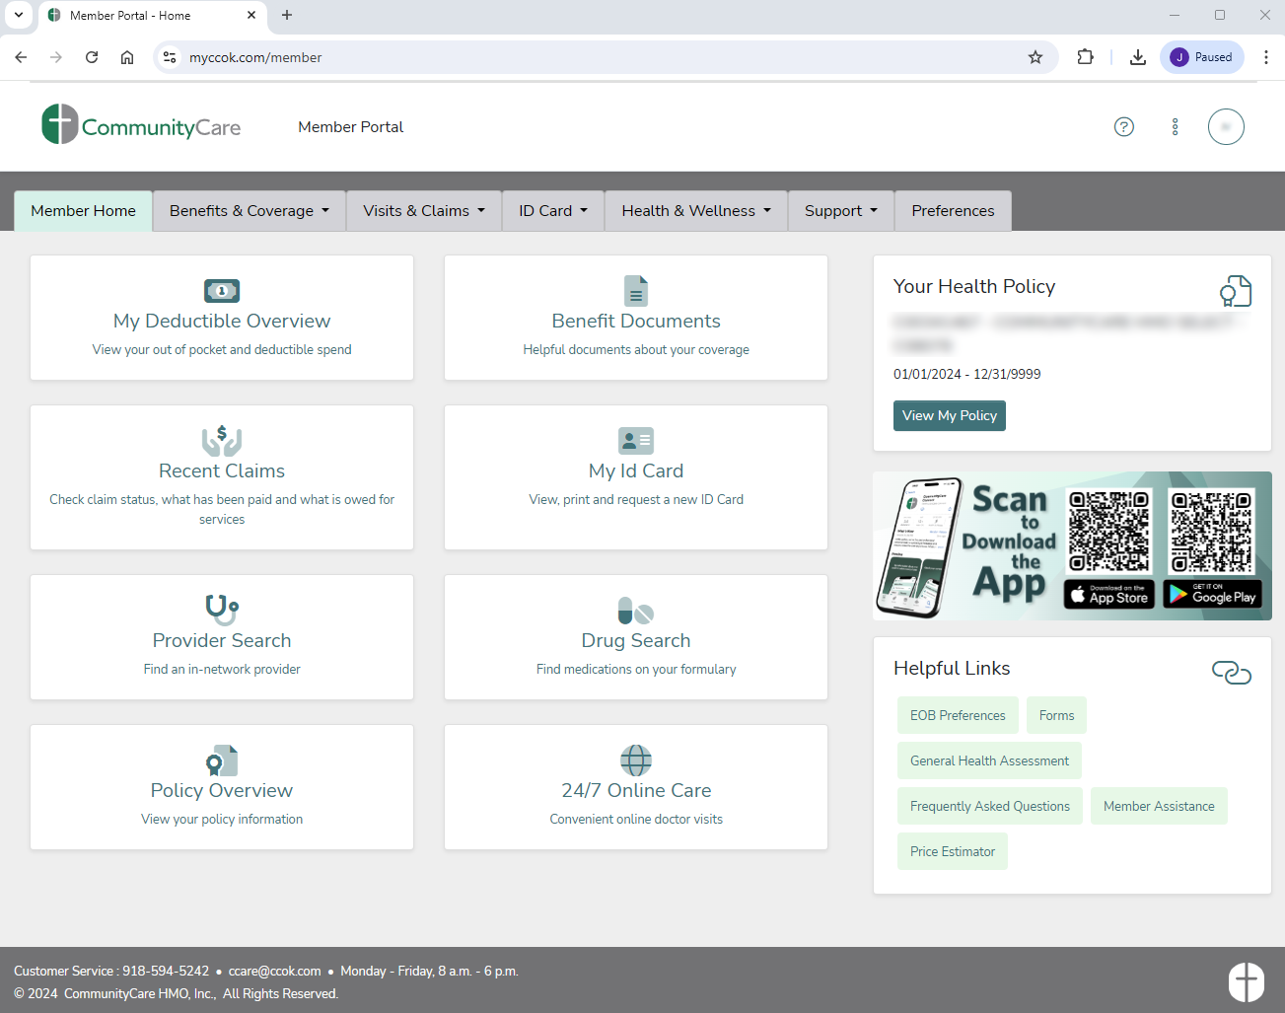
Enhanced Member Portal
ID Card Images
Benefits & Coverage
Visits & Claims
Health & Wellness
Preference for EOB Delivery
EOBs & FAQs
Provider & Pharmacy Directory
Prescription Drug Search

Slide 24
Convenient options while at home or traveling!
Call PCP or Nurseline
Access to Virtual Visits
Emergent or Urgent
Fill a Prescription
Obtain Early Refill

Slide 25
Healthcare without hurdles!
Access to Care
Broad Network
Urgent/Emergent Care Worldwide
Outstanding Service
Fast Claims Processing
First Call Resolution 92%
Caring for Members
Personal Attention
Low Claims Denial Rate

Slide 26





Customer Service:
918-594-5242 or 800-777-4890
M - F (8 a.m. – 6 p.m.)
Pharmacy Help Desk:
877-293-8628
Answered 24/7
24-Hour Nurse Line:
918-594-5242 or 800-777-4890
(Press option #5)
Custom Website:
state.ccok.com
Where Care means more.

Slide 27

STATE OF OKLAHOMA
Education & Government Employees Plan
January 1-December 31, 2025
STP25
MLGMH25-ST

Slide 28
Choose a plan that puts its MEMBERS FIRST!
20
continuous years of serving State of Oklahoma employees and educators!

Slide 29
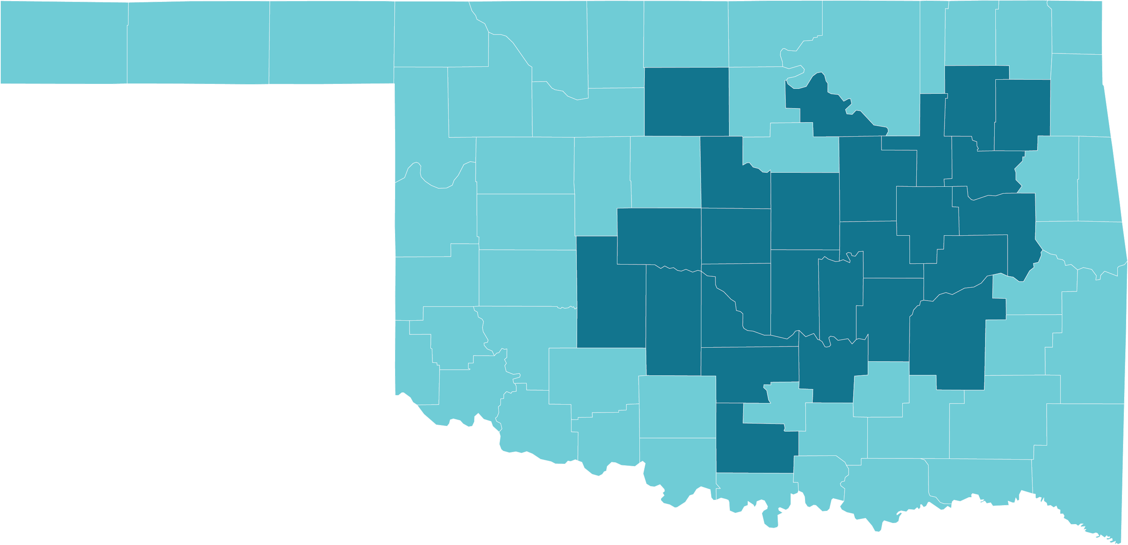
ELIGIBILITY & SERVICE AREA
26 COUNTY SERVICE AREA
Must be a permanent resident in our service area
Must be a current State of Oklahoma employee and/or educator

Slide 30








2025 State of Oklahoma Employees and Educators
Key Plan Benefits
Benefit | Copay
Primary Care Physician Visit | $0 copay for unlimited visits
Specialist Visits | $50 copay
X-Rays & Labs | $10 copay
Physical Therapy | $35 copay
Urgent Care | $25 copay
Specialty Scans | $250 copay preferred facility $750 copay non-preferred facility
Outpatient Surgery | $300 copay preferred facility $800 copay non-preferred facility
Inpatient Hospital | $300 copay per day $900 maximum copay per admission
Out-of-network care is not covered except for emergency or urgent care situations.

Slide 31





STAY AHEAD of whatever life throws!
$0 copay for Unlimited Primary Care Physician Visits
HUSK Marketplace Gym Membership Discounts
$500 Maternity
Delivery Copay
$20 Tier 1 Generics
for a 30-day supply

Slide 32

THOUSANDS OF PROVIDERS in our provider network
Tulsa Area
Harvard Family Physicians
Utica Park Clinic Physician Group
Hillcrest Medical Center
Hillcrest South Hospital
Hillcrest Hospital Claremore
Hillcrest Hospital Pryor
Tulsa Spine & Specialty Hospital
Oklahoma Heart Institute
Oklahoma Surgical Hospital
OSU Medical Center
OSU Physicians
Bailey Medical Center, Owasso
Oklahoma Spine and Brain Institute
McAlester Regional Health Center
Oklahoma City Area
VIPCare
Mercy Hospital
Mercy Primary Clinics
Integris Baptist Medical Center
Integris Baptist Medical Center Portland Avenue
Integris Health Edmond
Integris Southwest Medical Center
Integris Primary and Specialty Care Clinics
Oklahoma Heart Hospitals (North & South)
Bone & Joint at St. Anthony
St. Anthony Hospital
Variety Care Clinic
Lakeside Women’s Center of Oklahoma
This is not a full list of providers. Other providers are available in our network. The provider network may change at any time. You will receive notice when necessary. To see if your local provider or hospital is in network, visit www.GlobalHealth.com or call Customer Care at 1-877-280-5600 (TTY: 711) 9:00 AM – 5:00 PM, Monday-Friday

Slide 33
Connect with us!
1-877-280-5600 (TTY: 711)
www.GlobalHealth.com/Oklahoma/MyStatePlan

Slide 34

5098

Slide 35

WHY CHOOSE HEALTHCHOICE?
Five flexible health plan choices offer a variety of options to best fit you and your families needs.
PPO plans.
Large medical provider and pharmacy networks.
Network and non-network benefits.
Self-referrals to a specialist.
Free and easy mobile benefit app.

Slide 36

WHICH PLAN IS RIGHT FOR YOU AND YOUR FAMILY?
Tobacco-free plans
FLEXIBILITY Enjoy the flexible use of your health plan. | BUDGET-FRIENDLY Offers first-dollar coverage. Ideal for those with minimal health care needs. | SAVINGS Lower your premium to maximize your savings.
  HealthChoice High
  Option 1
  HealthChoice Basic
  Option 2
  HealthChoice HDHP
  Option 3
    Copays for office visits.
    Lowest deductible and out-of-pocket maximum.
    Alternative plan for tobacco users.
    HealthChoice pays first $500 of covered medical expenses.
    No copays for network services.
    Alternative plan for tobacco users.
    Lowest premiums available.
    Copays for network services after deductible.
    Use with a health
    savings account
    (HSA) for tax
    advantages.

Slide 37

ALTERNATIVE HEALTHCHOICE PLANS
Tobacco Users
HealthChoice High Alternative Option 1 | HealthChoice Basic Alternative Option 2 | HealthChoice HDHP Option 3
    Calendar year deductible $1,000 Ind./$2,750 family.
    Lowest deductible and out-of-pocket maximum.
    Network calendar year out-of-pocket maximum $3,550 Ind./$8,400 family.
    Premium is the same as HealthChoice High.
    HealthChoice pays first $250 of covered medical expenses.
    Calendar year deductible $1,250 Ind./$1,750 family.
    No office copays for network services.
    Premium is the same as HealthChoice Basic plan.
    Plan features and premiums are the same as Tobacco-Free HDHP plan.

Slide 38
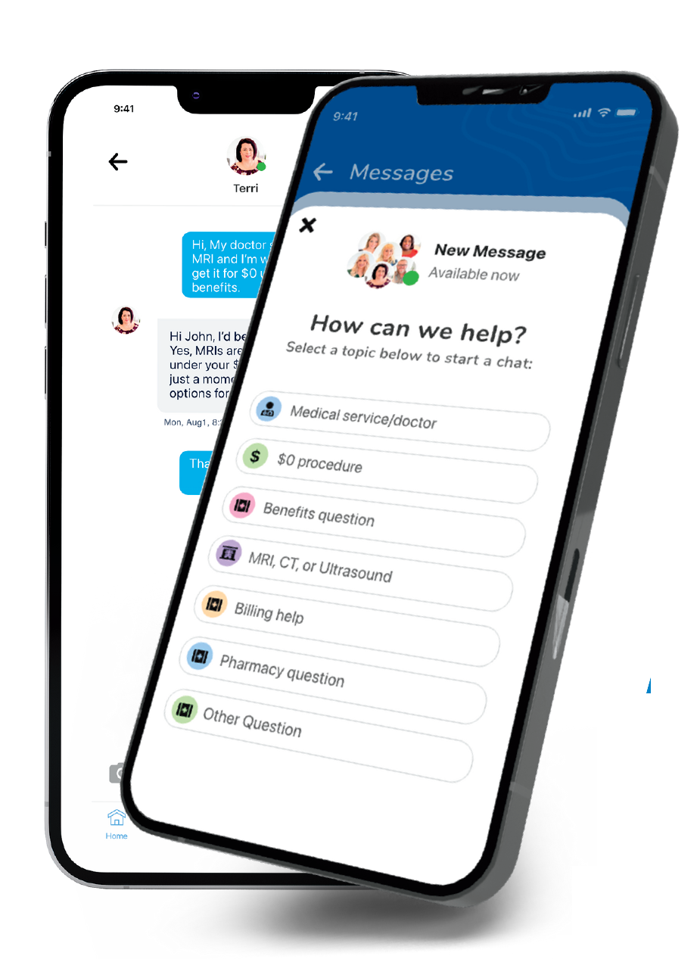

HEALTHCHOICE APP
Save time, money and frustration with an app that has it all!
Chat with a Care Guide – Guides are available 24/7 and can help guide you to care, answer benefit questions and even help make appointments!
Save Money – Access $0* medical care including MRIs, CT scans, ultrasounds, surgeries, and much more.
Access:
  Claims and EOBs.
  Insurance cards.
  Find network providers.
  Access SwiftMD – Telemedicine.
  Check deductible and out-of-pocket maximum amounts and more!
Meet Your Care Guides
*HDHP members must first meet their deductible.
Search HealthChoice in your app store and download

Slide 39
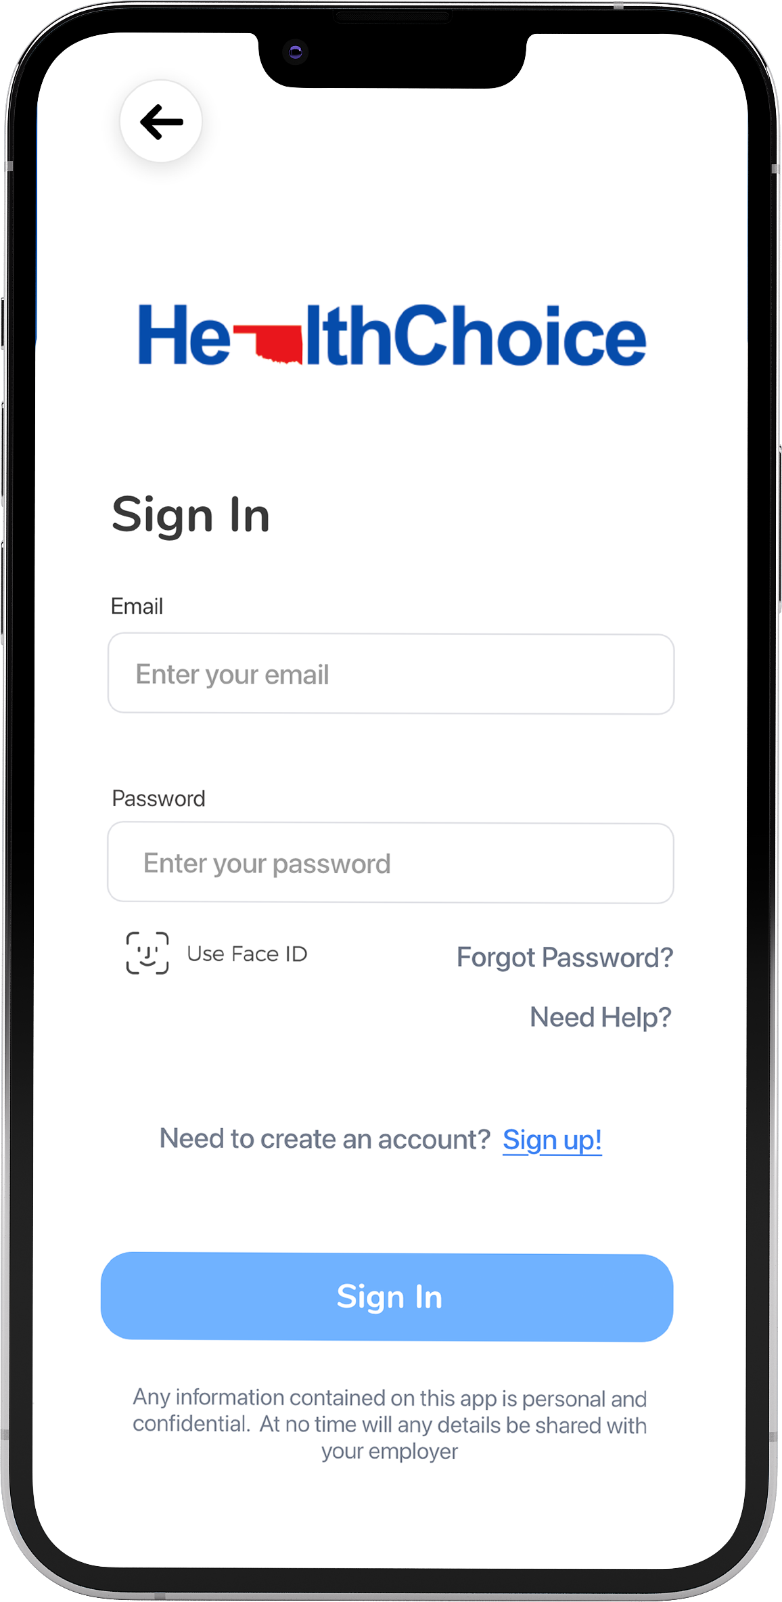
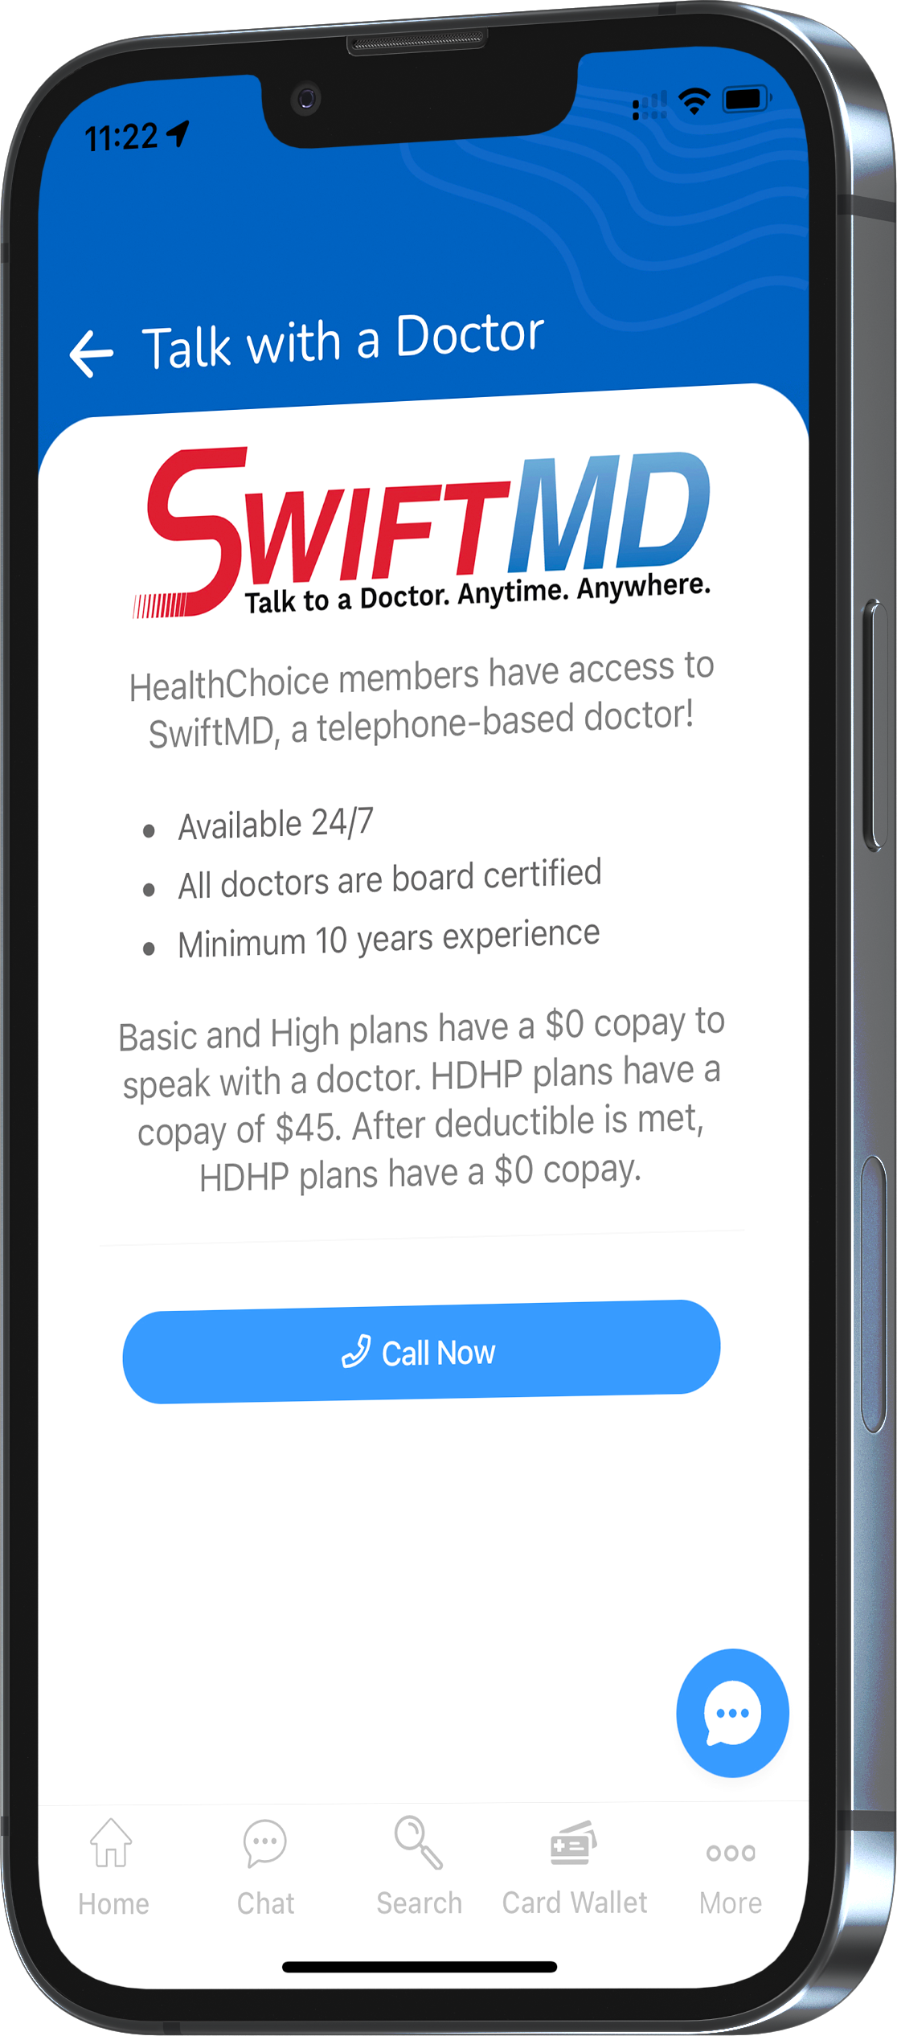
Telemedicine – SwiftMD
Available 24/7 with no limit on visits.
Board-certified physicians.
$0 cost for High and Basic plans.
$45 for HDHP members.
Swift MD.com.
Passcode HCOK20.
Access SwiftMD through the HealthChoice App!

Slide 40
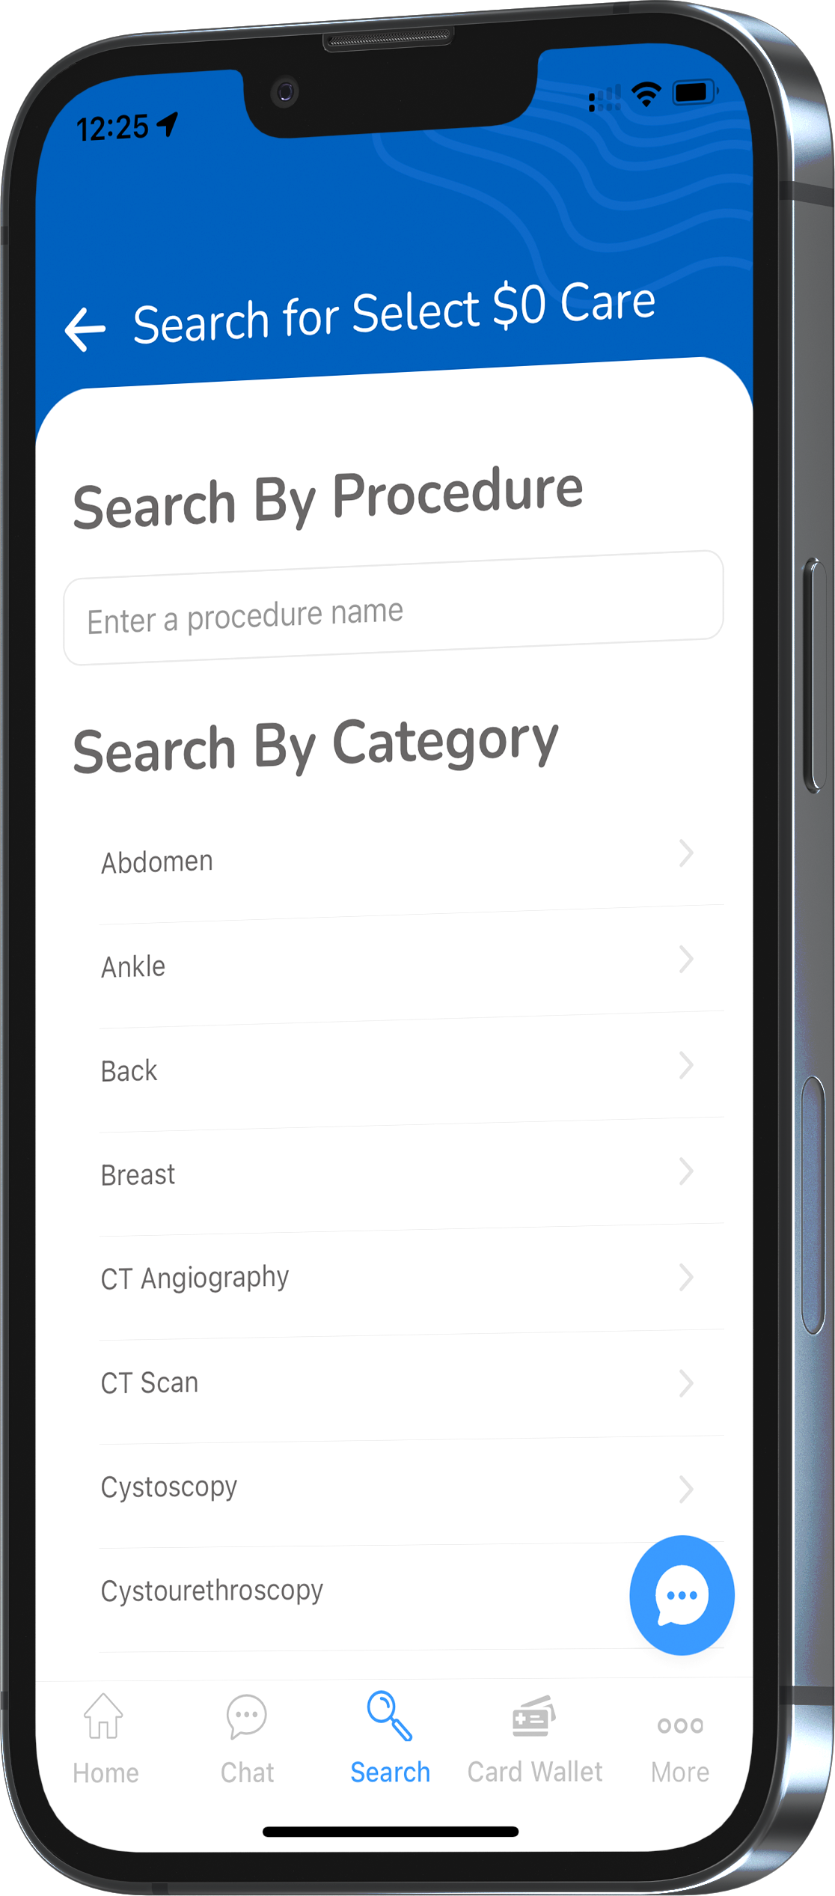
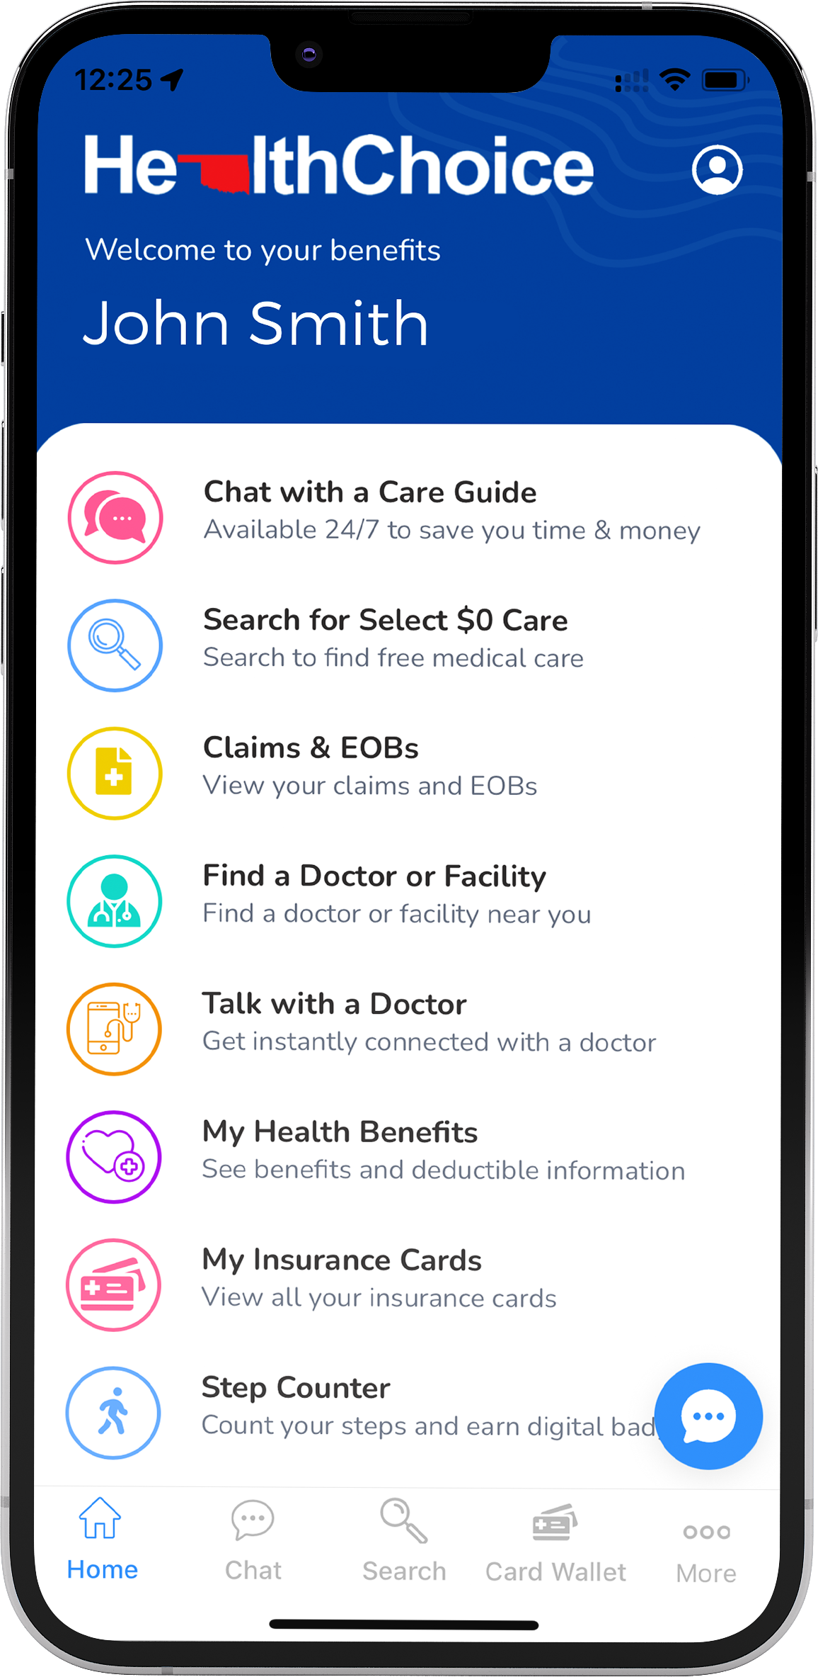
$0 Select Program – all plans
    Select services and procedures are covered at 100% of the bundled allowable.
    Select services include:
      MRI scans.
      CT scans.
      Ultrasounds.
      Some surgeries and more!
    No age limit or limits on the number of procedures.
    Incentive payments.
    HDHP members must meet their deductible first.
Accessible through the HealthChoice app!

Slide 41

Pharmacy benefits – all plans
    30- and 90-day supply.
    Generic, Preferred, Non-Preferred, and Specialty copays.
    High and Basic: $100 pharmacy deductible per individual before pharmacy copays apply.
    HDHP: $1,750 medical and pharmacy deductible combined per individual/$3,500 per family must be met before pharmacy copays apply.

Slide 42

CARE Programs
  CARE programs – all members
    Maternity CARE
      One-on-one calls with an OB/GYN nurse.
      Ongoing support for those who are pregnant.
      Receive health resources and answers about body changes and baby’s growth.
      Participants can receive a $25 reward card.

Slide 43

CARE Programs
  CARE programs – all members
    Ongoing Condition CARE
      Personalized guidance – diabetes, high blood pressure, heart disease, asthma or other serious health conditions.
      CARE professionals help participants manage symptoms of depression.

Slide 44
CARE Programs
  CARE programs – all members
    Wellness CARE
      Focuses on personal health.
      Wellness coordinators provide support and resources.
      Provides education and motivation for focusing on healthy behaviors.
      Interactive opportunities to learn about fitness, nutrition, stress management and lifelong habits.

Slide 45

Tobacco-free attestation
Attestation must be completed by Dec. 31, 2024.
Applies only to returning HealthChoice High and Basic plan members.
HDHP members are not required to complete the attestation. However, if you wish to enroll in the High or Basic plan for Jan. 1, you will need to complete the attestation.
If you are in the process of quitting tobacco, you must be tobacco free for 90 days prior to attesting.
Tobacco users still qualify for the High or Basic plan if you:
    Show proof of an attempt to quit using tobacco.
    Provide a letter from your physician.
  Failure to complete will result in being moved to HealthChoice High Alternative or Basic Alternative plan Jan. 1.

Slide 46

HealthChoiceOK.com
  Log in now to:
  View your Things-to-do, a personalized benefit to-do list.
  Check your benefits and see what’s covered.
  Check what you owe and how much you’ve paid.
  Find a doctor in your network.
  Learn about medical conditions and your treatment options.

Slide 47

RESOURCES
  HealthChoiceOK.com
  Health Insurance Handbook.
  Provider Search page.
  HealthChoice member Portal.
  HealthChoice Benefits App.
  EGID Member Services
  405-717-8780 or 800-752-9475
HealthChoice Customer Care
  800-323-4314
  TTY 711

Slide 48
Questions?

