Slide 1

Office of Management and Enterprise Services
Modernized Solicitation Template

Slide 2
Current state
Multiple templates of state terms exist, which cause confusion, are duplicative and burdensome to maintain and increase the risk of mistakes.
The procurement file contains many documents, but it is unclear which are contract documents versus documentation for the file.
Request for proposal templates contain bidder instructions in various sections and clauses, unnecessarily increasing the burden on bidders to catch everything required.

Slide 3
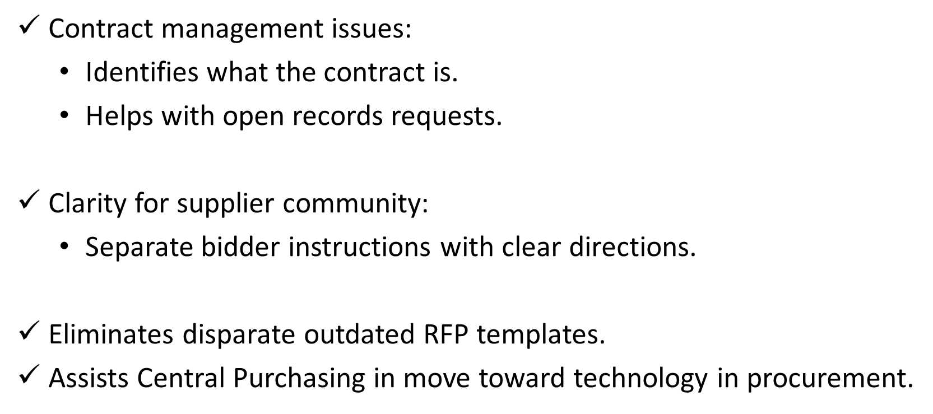
The why

Slide 4

New contract structure
Signed contract:
Memorialize, as applicable:
  Negotiated exceptions/master terms.
  BAFO.
  Negotiated supplier terms.
  Bid confidentiality.
  Incorporate attachments.
Attachments:
  RFP.
  General terms.
  As applicable:
    IT terms.
    Statewide terms.
    Agency terms.
    Exceptions.
  Bid including as applicable:
    Supplier terms.
    BAFO.

Slide 5
Crosswalk to current RFP sections
Current | New
Section A general provisions | General terms
Section B special provisions | Acquisition-specific terms Agency terms (including BAA, federal-required terms, statement of work, etc.). Statewide terms. IT terms.
Section C solicitation specifications | Request for proposal Purpose. Contract term/renewals. Specifications. RFP amendments.
Section D evaluation | Bidder instructions
Section E instructions to bidder | Bidder instructions
Section F checklist and/or schedule | Bidder instructions
Sections G and H other and price and cost | Bidder instructions

Slide 6
Walkthrough of
RFP and bidder instructions
Walk through the pilot of the new contract structure to illustrate differences in the request for proposal and bidder instructions.

Slide 7
Duplicative terms are trouble
Similar terms relating to the same subject:
  How does one determine if the terms are conflicting?
  Invites various interpretations of the term conflicting.
  Adds unnecessary risk to the state.

Slide 8
Troublesome duplicative terms examples
Section A:
The state may terminate the contract, in whole or in part, for default or any other just cause upon a 30-day written notification to supplier.
Example Section B:
Agency may terminate the contract for cause upon giving supplier 60 days’ notice prior to termination. Agency shall provide supplier with a 30-day written notification of termination.

Slide 9
Troublesome duplicative terms examples
Section A:
Insurance coverage:
Security and privacy liability insurance, including coverage for failure to protect confidential information and failure of the security of supplier’s computer systems that results in unauthorized access to customer data with limits of $5 million per claim.
Example Section B:
Insurance coverage:
Security and privacy liability insurance, including coverage for failure to protect confidential information and failure of the security of supplier’s computer systems that results in unauthorized access to customer data with limits of $1 million per claim and $2 million annual aggregate.

Slide 10
Deduplication of agency-specific terms
Only an agency has appropriate context for relevant or preferred terms particular to that agency.
Each agency is in the best position to determine terms it prefers instead of, or in addition to, the state’s general terms.
OMES Central Purchasing does not have this context for each agency and the risk of error increases if the agency does not deduplicate agency-specific terms.
The new contract structure does not include the sentence, “Section B terms prevail over Section A terms in event of a conflict.”

Slide 11
Deduplication of agency-specific terms
Examples:
  Federal funding requirements that result in a stricter audit clause than contained in the general terms.
  Stricter termination for cause provision.
  Increased insurance coverage requirements.
  Heightened security requirements, e.g., at prison facilities.
  Sensitive data terms, e.g., IRS Publication 1075 re: Federal Tax Information.

