Slide 1

Welcome!

Slide 2
Welcome!
Please turn off your camera
and mute your microphone.

Slide 3
Plan Year 2025​
Benefits Option Period
Vision Plan Breakout Session
Employee Benefits Department​
Human Capital Management

Slide 4
Vision plan presentations

Slide 5
All vision plans
Coverage for exams, lenses, frames, contact lenses and more.
Designated provider networks.
Limited coverage for services by non-network providers.

Slide 6


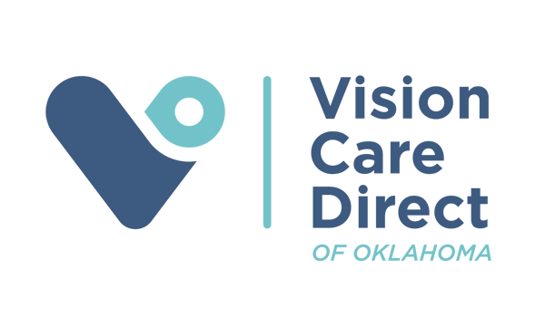
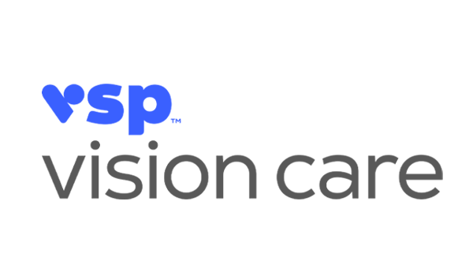
Vision plans

Slide 7
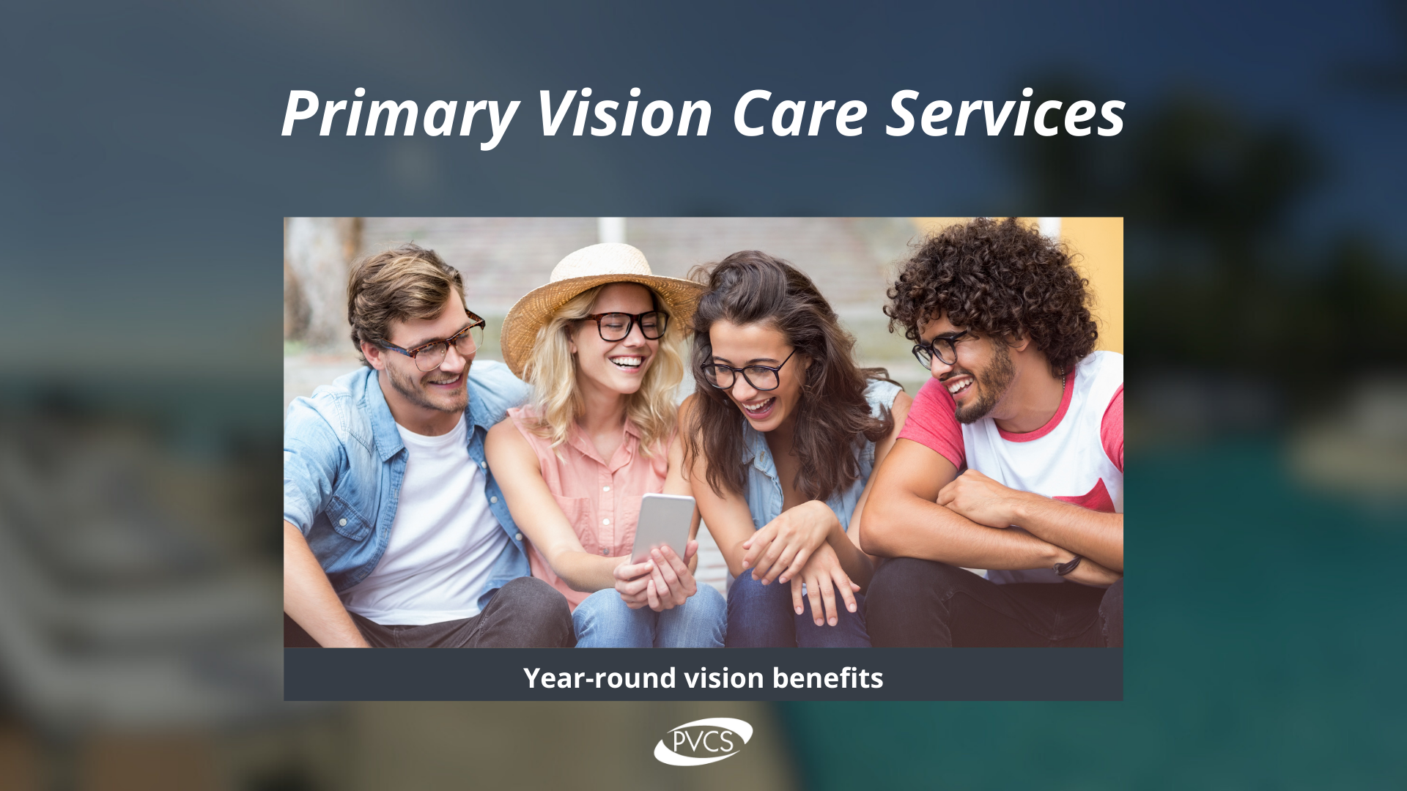
PRIMARY VISION CARE SERVICES
An Oklahoma Vision Care Company
www.pvcs-usa.com | 888-357-6912

Slide 8
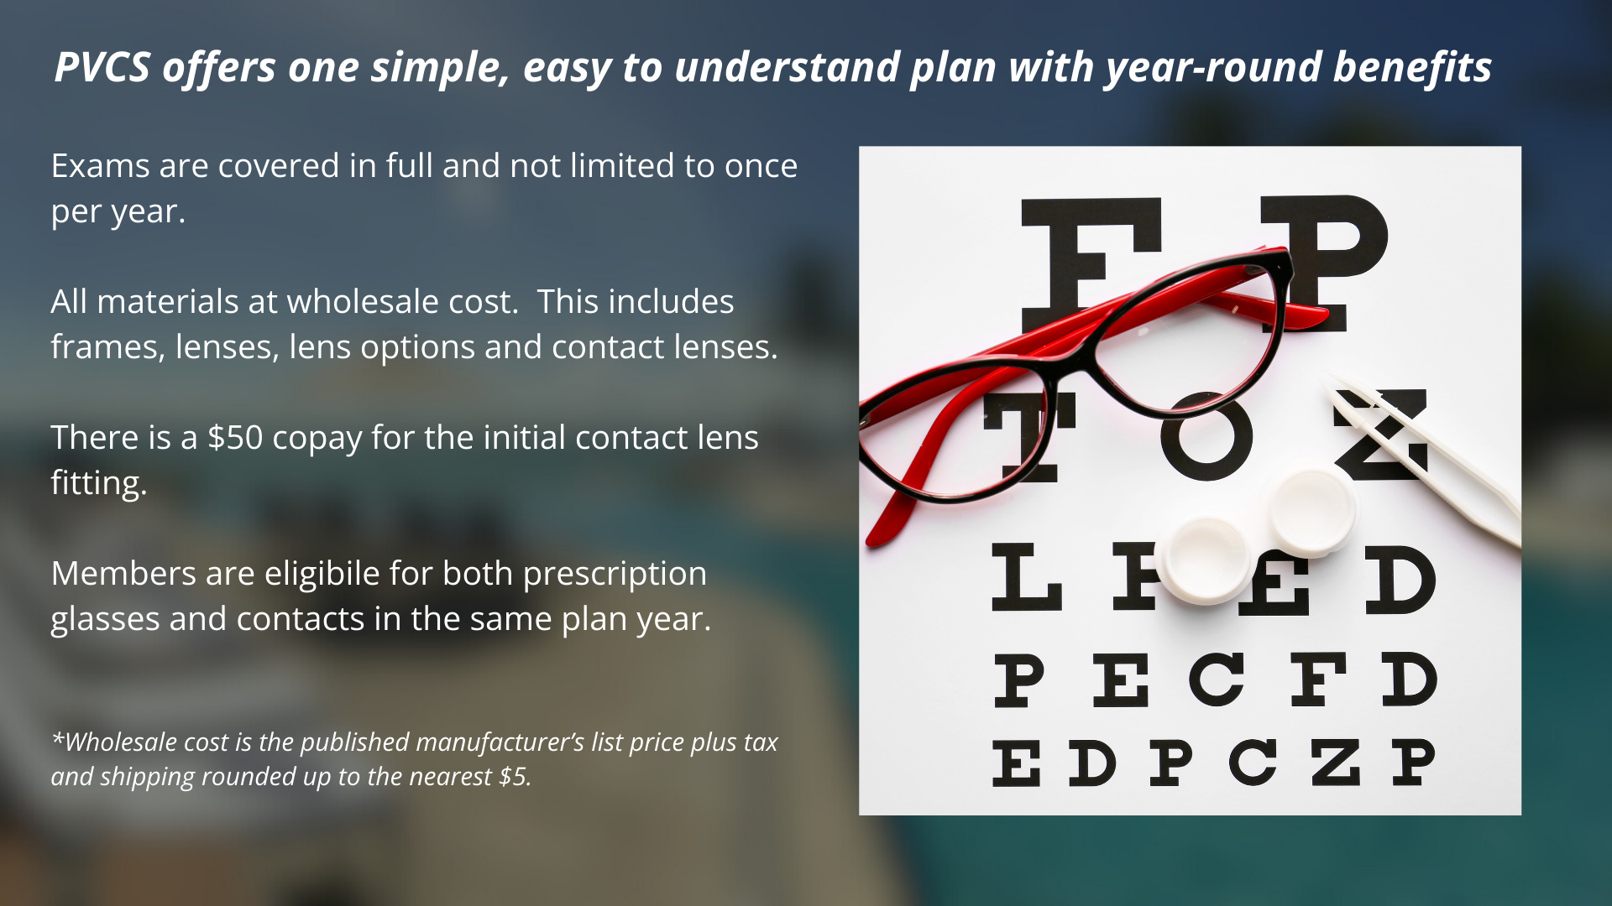

Slide 9
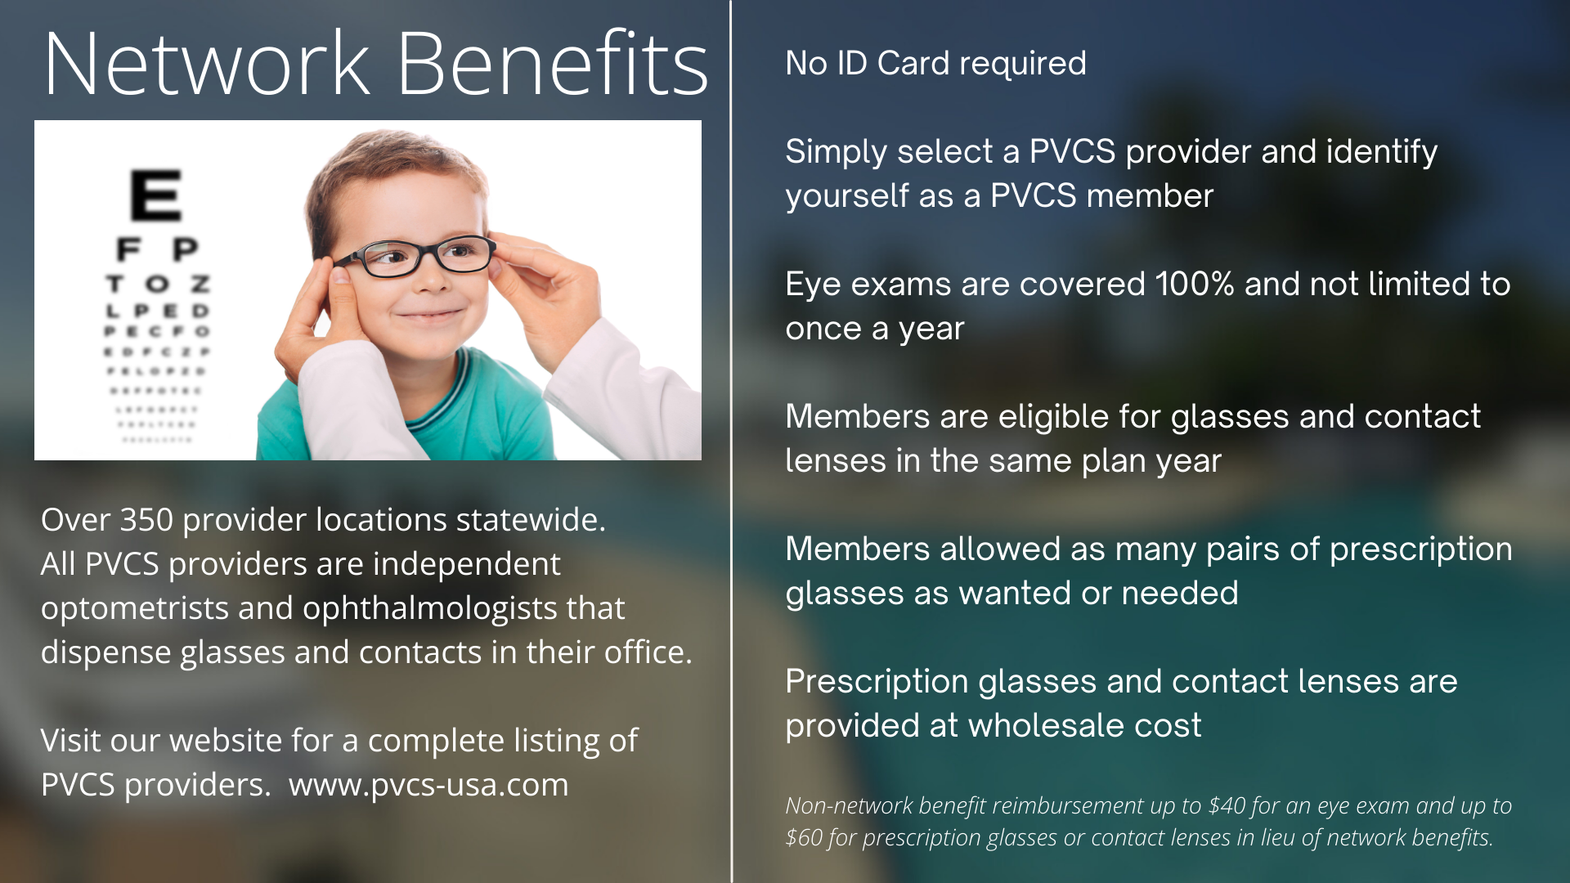

Slide 10
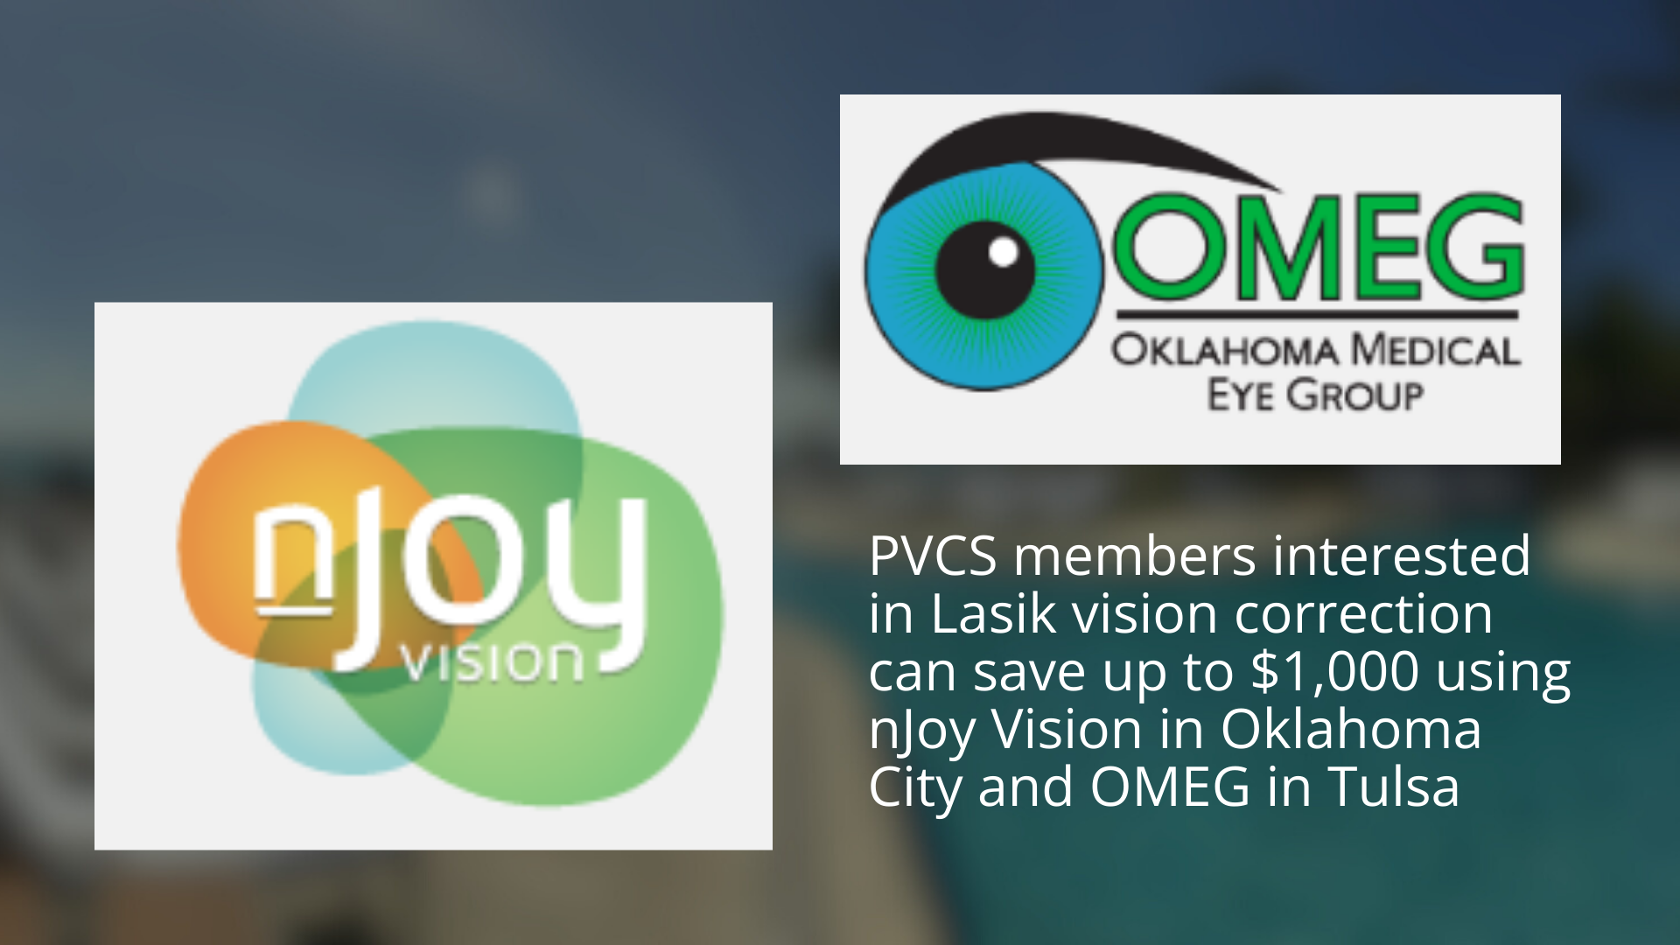

Slide 11
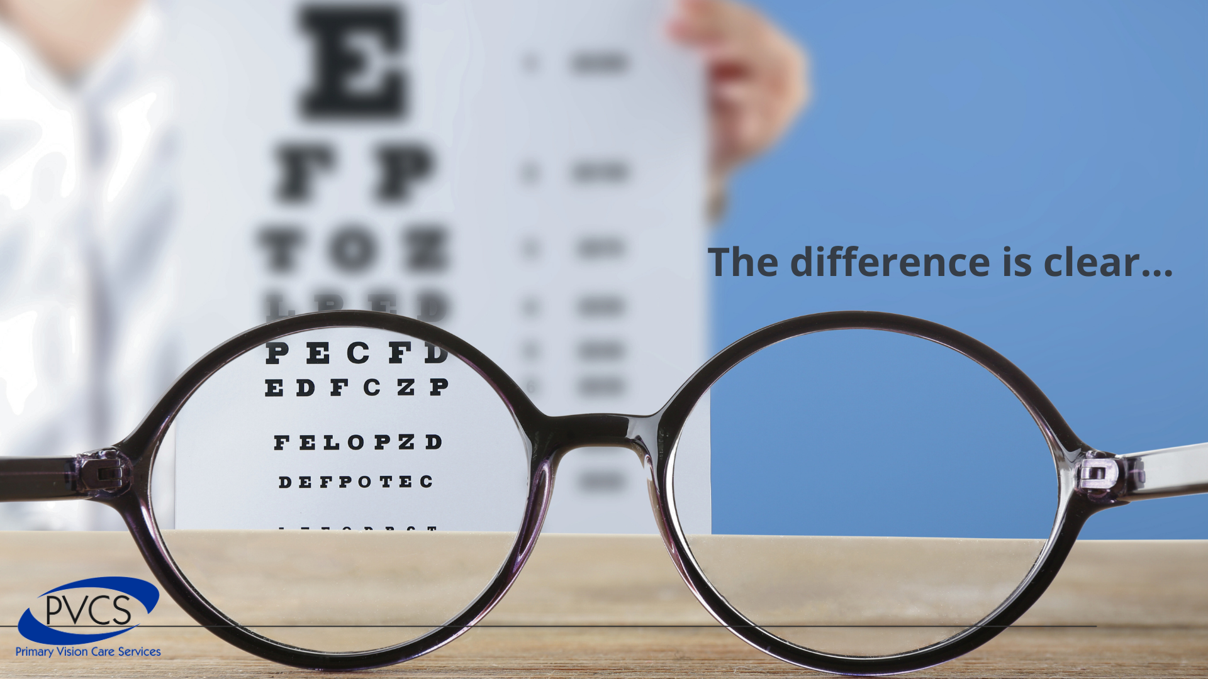

Slide 12


Slide 13

State of Oklahoma 2025 Option Period
2025 Benefits Presentation

Slide 14

An overview of your vision benefits
Offers flexibility and choice
In-network benefits available through network eye care professionals or go out-of-network and be reimbursed at your plan's out-of-network rates.
Find an in-network eye care professional at superiorvision.com. Call your eye doctor to verify network participation.
Obtain a vision exam with either an MD or OD.
Use different eye care professionals for exam and for eyewear.
No claim forms or vouchers required for in-network services.
Personalized ID card in the mail and in the app (not required, but recommended for convenience when visiting an eye
care professional).

Slide 15
Your in-network vision benefits
In-network benefit | Member copays
Routine eye exam (one per calendar year) Ophthalmologist (MD) or Optometrist (OD) | $10
Frames & lenses (one pair lenses per calendar year) Standard lenses (single vision, bifocal, trifocal and standard progressive lenses) | $25
Contact lens fitting (one per calendar year) | $25
In-network benefit | Member allowances
Frames (one per calendar year) | $150 retail allowance
Contact lenses (one allowance per calendar year) Elective Medically necessary | $150 retail allowance Covered

Slide 16
Your out-of-network vision benefits
Out-of-network benefit | Member reimbursement
Routine eye exam (one per calendar year) Ophthalmologist (MD) or Optometrist (OD) | $34, less $10 copay (MD) $26, less $10 copay (OD)
Eyeglass lenses (one pair lenses per calendar year) Standard lenses (single vision, bifocal, trifocal) | $26, less $25 copay (Single) $39, less $25 copay (Bifocal) $49, less $25 copay (Trifocal) $39, less $25 copay (Standard Progressive Lens)
Contact lens fitting (one per calendar year) | Not Covered
Out-of-network benefit | Member reimbursement
Frames (one per calendar year) | $81, less $25 copay
Contact lenses (one allowance per calendar year) Elective Medically necessary | $100 $210

Slide 17

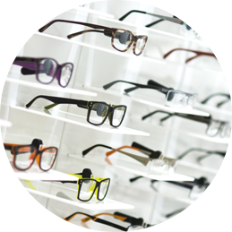
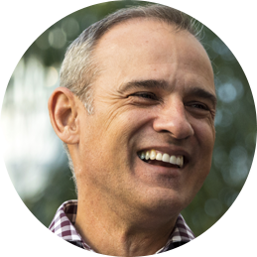
You can also get value-added discounts
Discounts on covered eyewear
20% for amounts over the frame or contact lens allowances, lens add-ons, and other prescription materials on first pair of glasses
10% off retail for specialty contact lens fit
Discounts on non-covered eyewear
30% on extra pairs of eyeglasses
30% off additional exams
20% for lens options on extra eyeglasses
20% off additional contact lenses
10% for additional, disposable contacts
$39 max out-of-pocket for retinal imaging
LASIK discounts
Members can see low prices (typically under $1,000 per eye) on LASIK procedures administered by QualSight.
*Out-of-pocket costs may vary based upon plan design.

Slide 18

Have questions?
Join us online or give us a call
  Website: superiorvision.com
  Phone: 1 (844) 549-2603
  Live support:
    Monday – Friday: 8AM – 9PM CST
    Saturday: 10AM – 4:30PM CST
  Benefit information
  Eligibility status
  Claims information
  Eye care professional listings
  Assistance with issues and special requests
We have answers!

Slide 19
MetLife Vision benefits are underwritten by Metropolitan Life Insurance Company, New York, NY. Certain claims and network administration services are provided through Superior Vision Services, Inc. (“Superior Vision”), a Delaware corporation. Superior Vision is part of the MetLife family of companies. Like most group benefit programs, benefit programs offered by MetLife and its affiliates contain certain exclusions, exceptions, reductions, limitations, waiting periods and terms for keeping them in force. Please contact MetLife or your plan administrator for costs and complete details.
SVS-MKG20-0293v001 PPT 06/2020

Slide 20
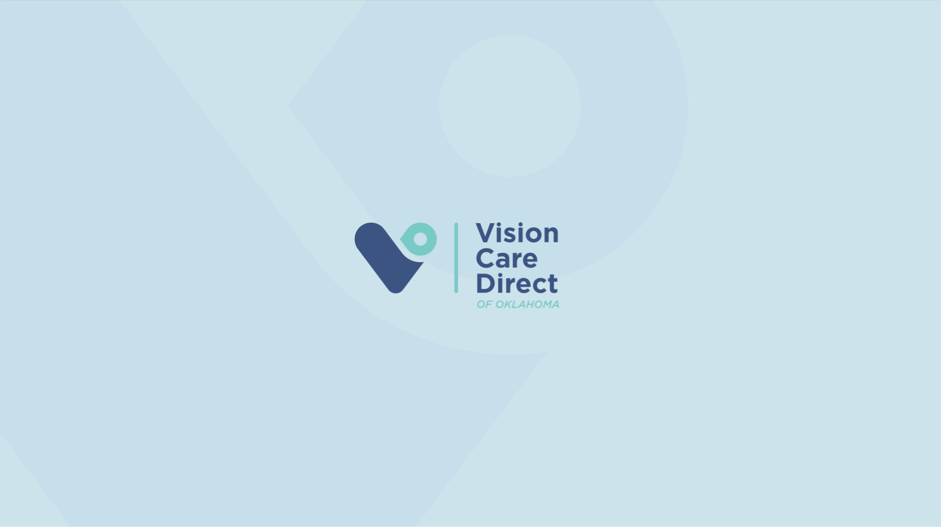

Slide 21


Slide 22


Slide 23


Slide 24
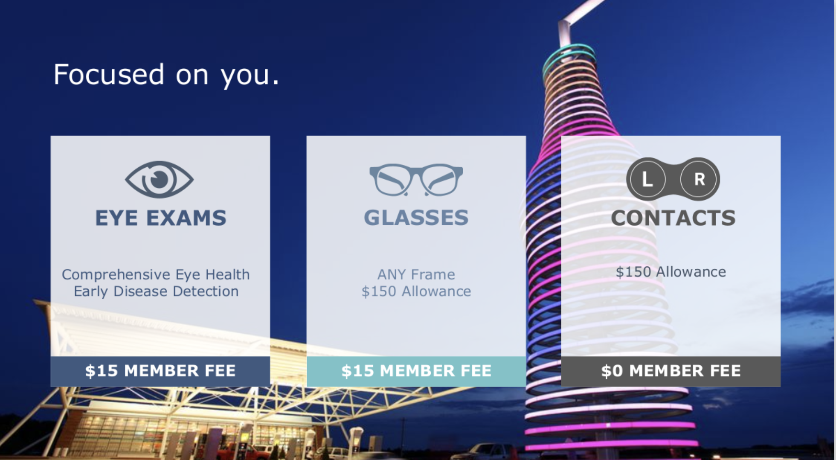

Slide 25
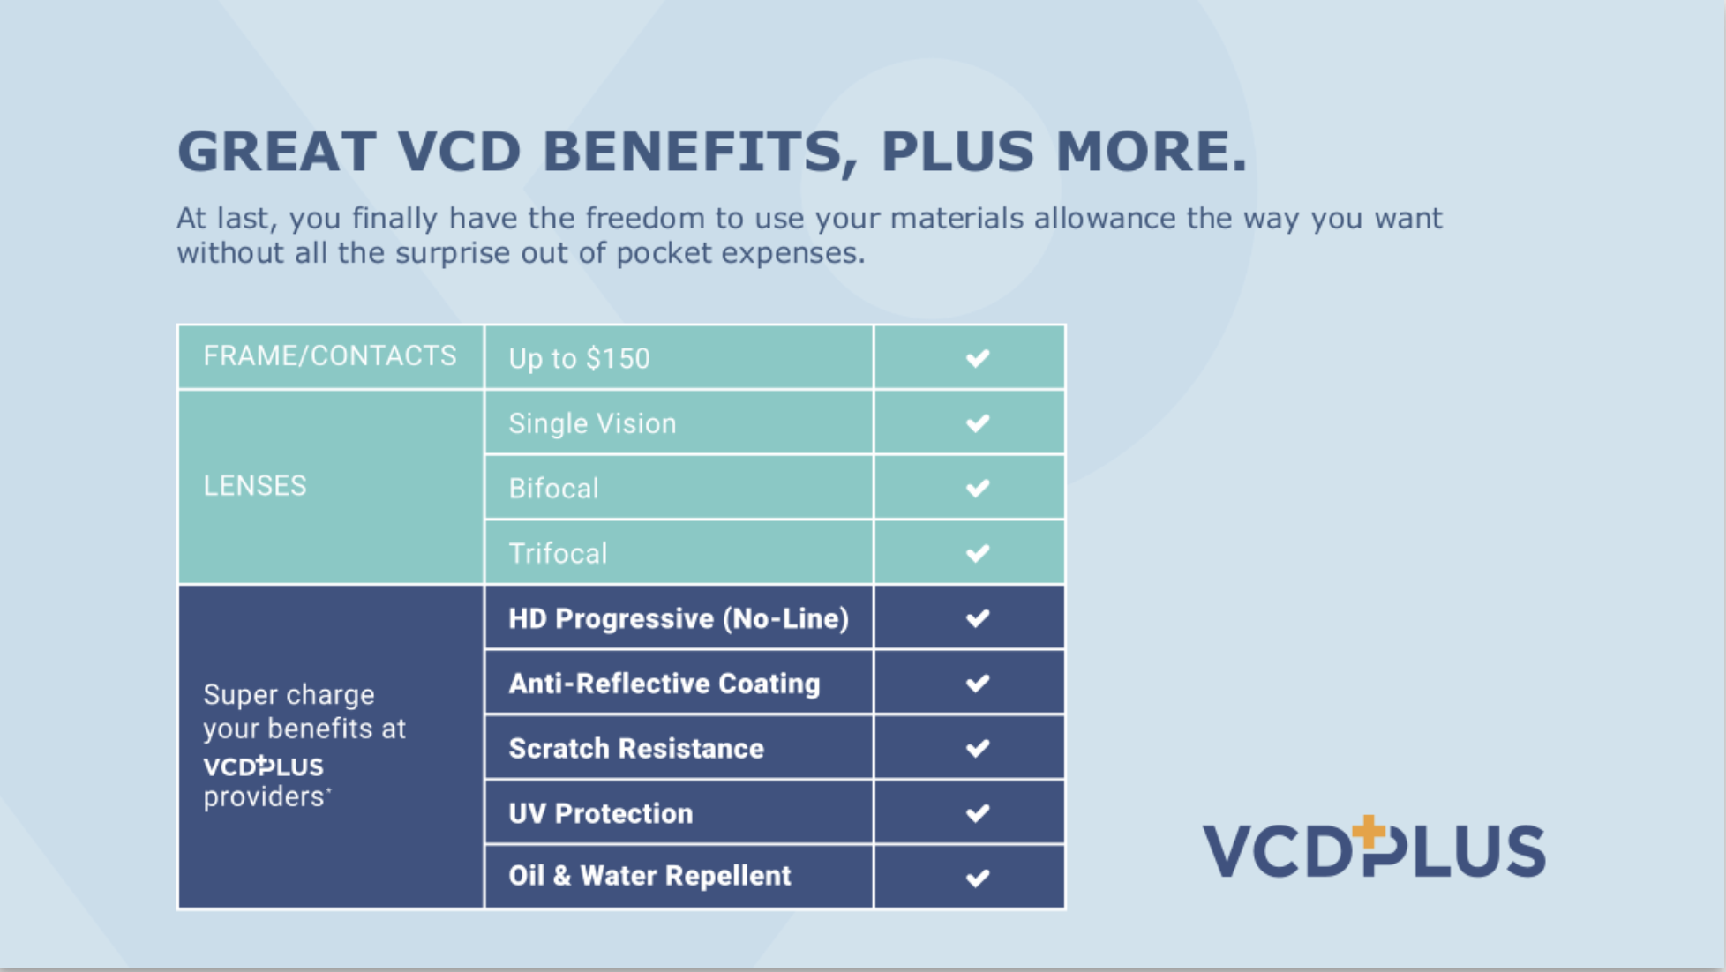

Slide 26
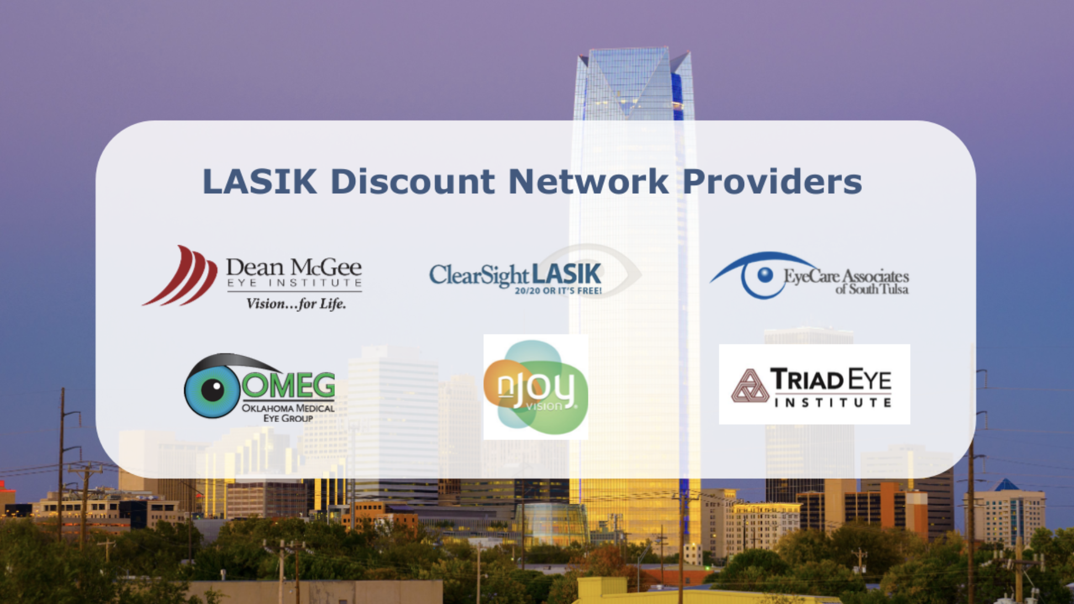

Slide 27
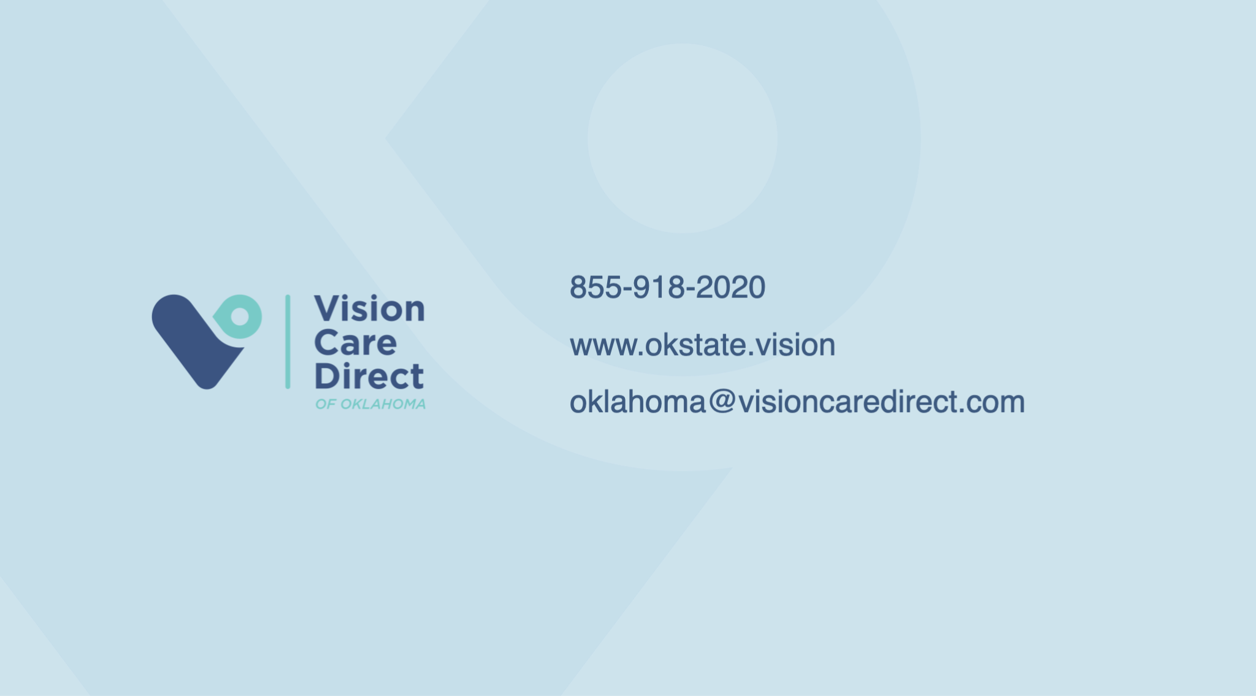

Slide 28

It’s Time to Enroll
Get to know Your
VSP Vision Benefits

Slide 29




Great Eye Care with a Hefty Side of Savings
Vision Care
is Essential
Savings that Really Stack Up
Thousands of
In-Network
Choices
Founded by
Doctors
Focused on You

Slide 30
Vision Care is Essential
Did you know an eye exam
is the only
non-invasive way to view blood vessels in your body?
Signs of
more than
270 health conditions can be detected during an
eye exam*
Your eye doctor can be the first to detect certain conditions, like diabetes*
*Full Picture of Eye Health, American Optometric Association, 2020

Slide 31
Your VSP Plan Snapshot:
Frequency
Copays
Allowances
Exam: Every 12 months
Frame: Every 12 months
Lenses: Every 12 months
$10 WellVision Exam®
$25 Glasses
$60 Contact lens exam
$20 Essential Medical Eye Care
$39 Retinal Imaging
$170 frame + $50 allowances for featured frame brands
$120 contacts
(instead of glasses)
Essential Medical Eye Care:
Retinal imaging for eligible members with diabetes. Additional exams and services beyond routine care to treat immediate issues from pink eye to sudden changes
in vision or to monitor ongoing conditions such as dry eye, diabetic eye disease, glaucoma, and more. Coordination with your medical coverage may apply. Ask your VSP network doctor for details
VSP® members save an average annual savings of $471*
*Check out the Member Benefit Summary for details. Savings based on state and national averages for eye exams and most commonly purchased brands. This number represents average savings for a VSP member at an in-network provider. Your actual savings will vary depending on the eyewear you choose, your plan and the eye doctor you visit.

Slide 32
Your VSP Plan Snapshot:
Lens Enhancements - Base Plan
Lenses
Lens Enhancements
Fully covered single vision, lined bifocal, lined trifocal lenses, and impact resistant lenses for children
Fully covered standard progressives, anti-glare coating, and light-reactive lenses $40 copay for premium and contact lenses
Average savings of 30% on other lens enhancements
VSP® members save an average annual savings of $471*
*Check out the Member Benefit Summary for details. Savings based on state and national averages for eye exams and most commonly purchased brands. This number represents average savings for a VSP member at an in-network provider. Your actual savings will vary depending on the eyewear you choose, your plan and the eye doctor you visit.

Slide 33

Savings Beyond Benefits
50%
Save 50% on additional pairs of glasses and sunglasses at Visionworks®
$250
Average savings at Eyeconic®, plus free shipping and returns
Plus, VSP members get access to Exclusive Member Extras
$50
Additional $50 on Featured Frame Brands
$1,200
Save up to $1,200 on Lasik
$300
Get up to $300 in contact lens rebates
*Offers vary based on state and benefit plan. Brands and offers subject to change.
*Savings based on doctor’s retail price and vary by plan and purchase selection; average savings determined after benefits are applied. Ask your VSP network doctor for more details. VSP is providing information to its members, but does not offer or provide any discount hearing program. VSP makes no endorsement, representations or warranties regarding any products or services offered by TruHearing, a third-party vendor. TruHearing is not insurance and not subject to state insurance regulations. For additional information, please visit vsp.com/offers/special-offers/hearing-aids/truhearing. For questions, contact TruHearing directly. Not available directly from VSP in the states of Washington and California.

Slide 34



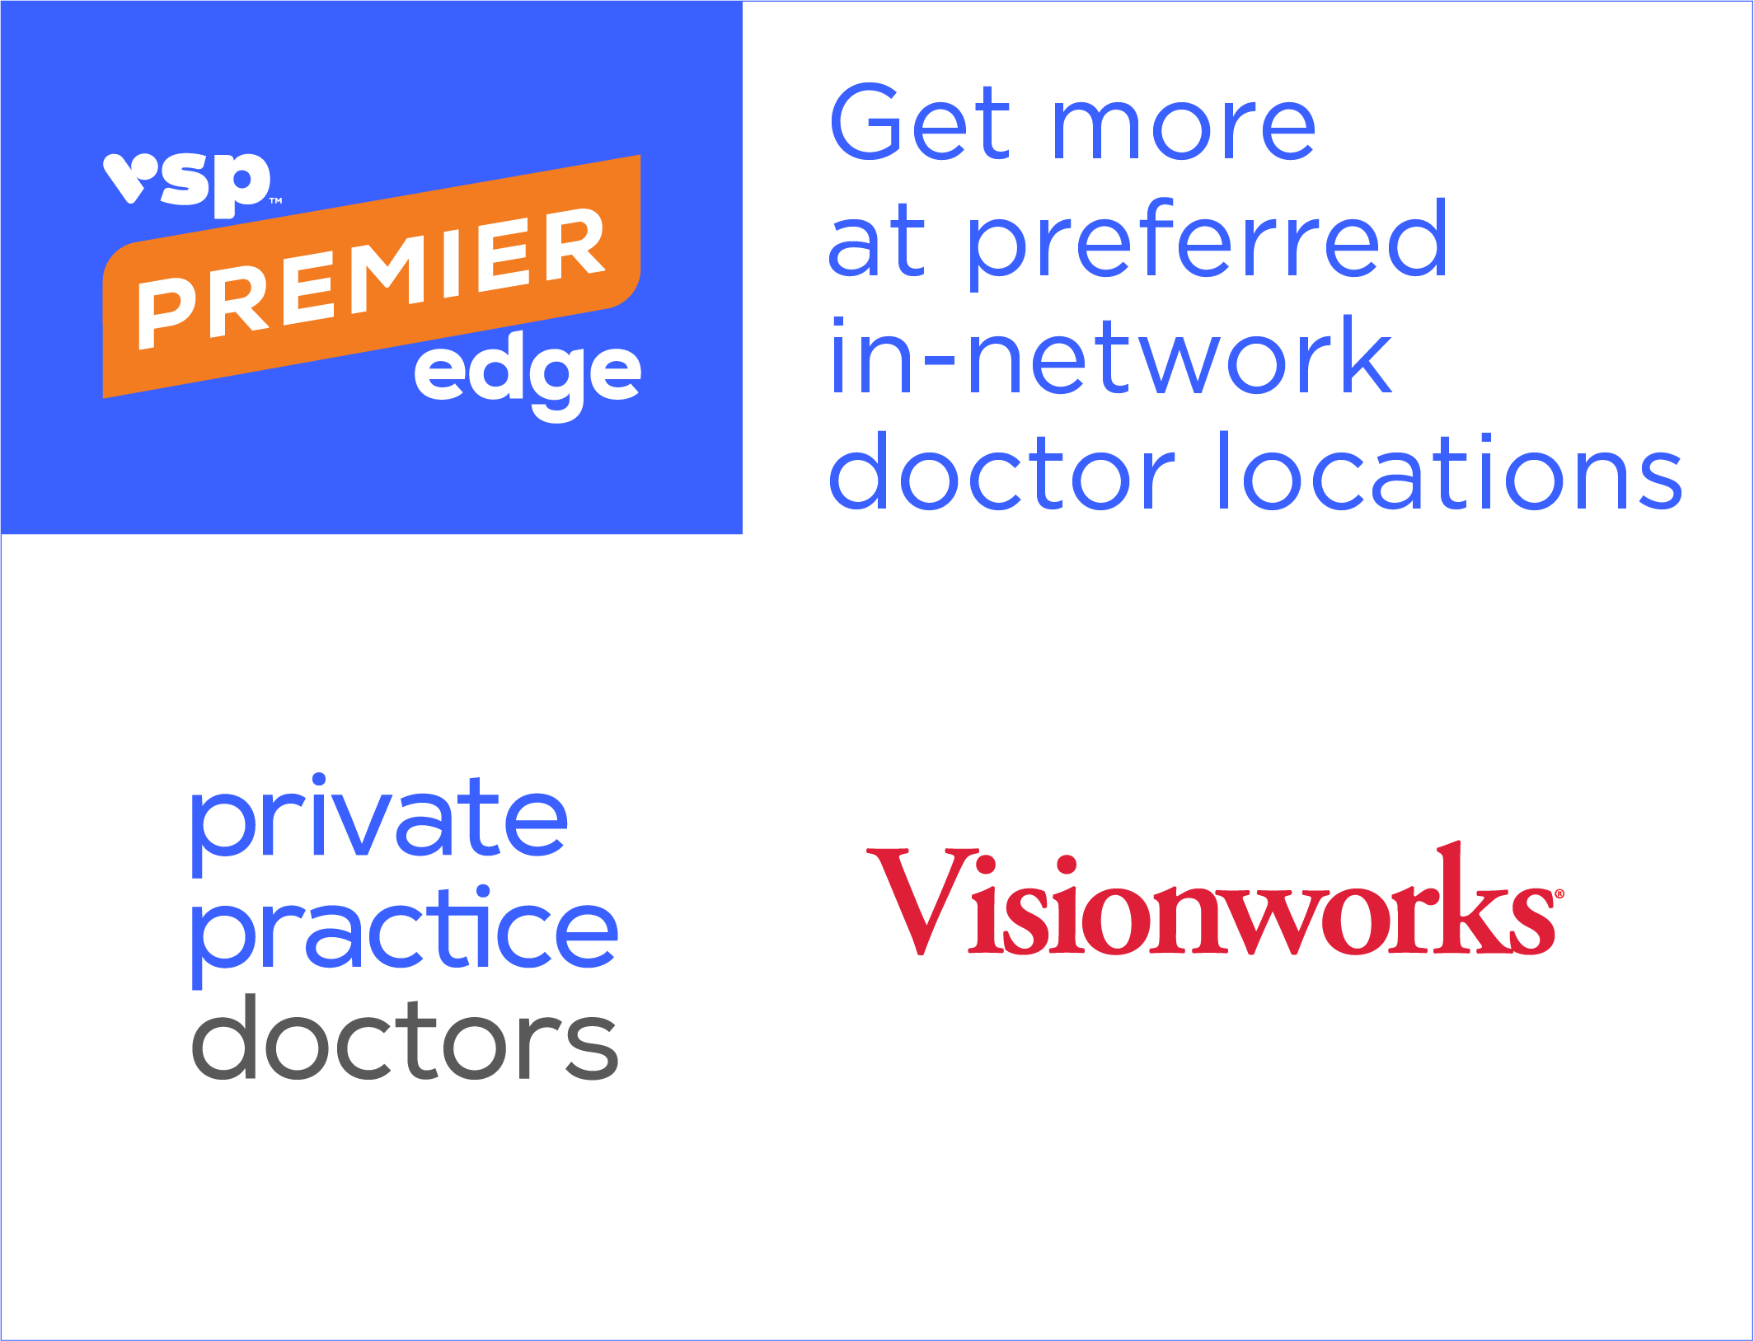






The Choice is Yours
It’s easy to choose the care that’s right for you.
Your benefits go further when you visit a
VSP Premier EdgeTM
location, including private practice doctors
and Visionworks®!
Private Practice locations
Retail
locations
Online at Eyeconic®
Participating Retail Chains like these ̶
and more

Slide 35
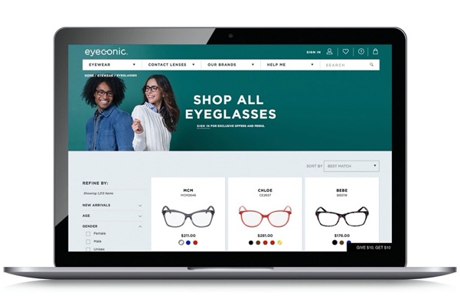
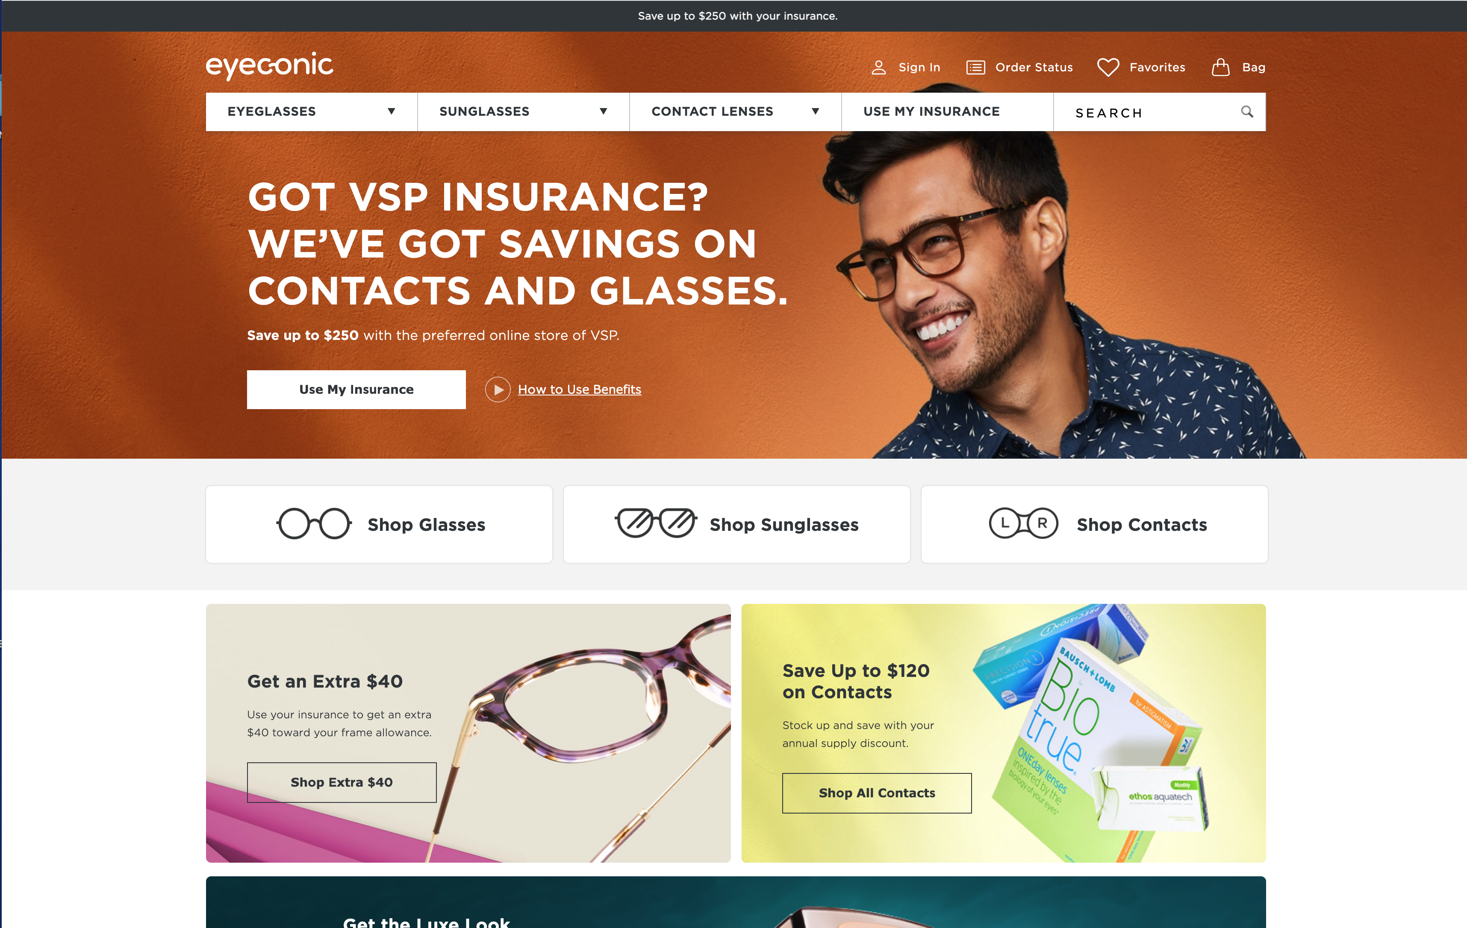

Eyewear Shopping Online at Eyeconic
Eyeconic is the VSP online eyewear store that seamlessly connects your VSP vision benefits to
your account. You’ll get:
A huge selection of contact lenses and designer frames 24/7 – and the Virtual Try-On Tool.
Free shipping and returns.
20% off any out-of-pocket expenses on eyewear
after your frame allowance is applied.
Specialty sizes that fit your needs.
Find your product, customize your order and we do the rest. Start saving today at eyeconic.com® today.

Slide 36
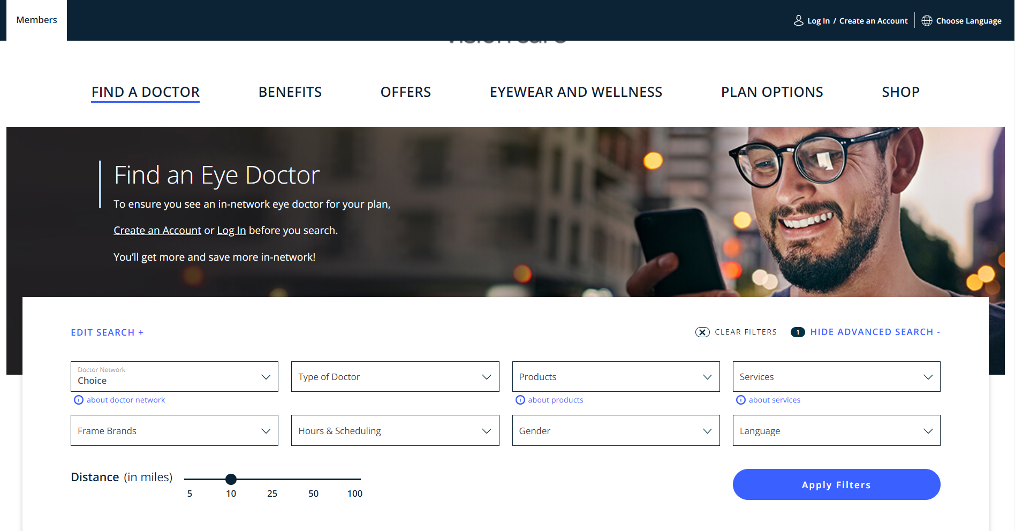
The Right Doctor for You
Using the Find a Doctor
tool on vsp.com is easy
      Visit vsp.com/eye-doctor
      (or navigate from vsp.com home page)
      Enter the preferences that are
      meaningful to you like:
        Location
        Gender
        Language
        Frame brands
        Specialty
        Services
        Hours & Scheduling
A sliding distance bar makes finding a match nearby easy. You can even opt to view locations on a map.

Slide 37

Using Your Benefit is Easy
Once you’ve enrolled…
Create an account at vsp.com and review your personalized benefit information.
Find a VSP in-network doctor by visiting vsp.com or calling 800.877.7195.
Simply tell your eye doctor’s office that you have VSP–and we’ll take care of the rest!

Slide 38

Enroll Today!
VSP helps you see well and be well with
the coverage and quality care you deserve.
Visit vsp.com or call 800.877.7195.
©2024 Vision Service Plan. All rights reserved.
VSP, Eyeconic, Eyeconic.com, and WellVision Exam are registered trademarks, and VSP Premier Edge is a trademark of Vision Service Plan.

Slide 39
Questions?

